Slide 1
TODAYS’ SESSION
GOALS
1. Online quiz
2. The Great Awakening
3. “Rhetorical Safari” – group activity
4. Practice analysis
5. Midterm exam: format and instructions
To understand the Great Awakening as a transitional period between Puritan America and the Enlightenment
To learn about figurative speech and rhetorical devices
To practice close reading (a.k.a literary analysis)

Slide 2
Quiz – Week 6
    In your smartphone/tablet/laptop, go to this URL: Kahoot.it
    Enter the following Game Pin: XXXXXXXX
    For your nickname, write your Student ID number
    Follow the instructions on the screen. Each question has four possible answers, only one of them correct.
    To answer, press one of the four colors in your device.
    You have 20 seconds to answer each question
    Important! Let Mariana and Patrick know if you have trouble accessing the quiz in your device.

Slide 3
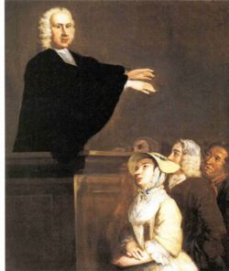
The Great Awakening
  Religious revival (1734-1750)
  A rhetoric of feeling and sensation: the only way to awaken people to the true faith and values.
  True believers feel God; they do not have to understand him.
  From “brotherly love” to fear:
    God
    The Devil
    Each other
    Ourselves

Slide 4
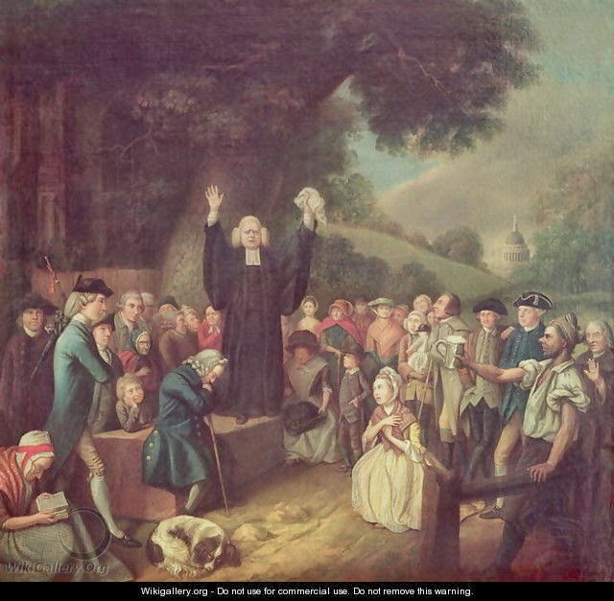
Oratory and Performance

Slide 5
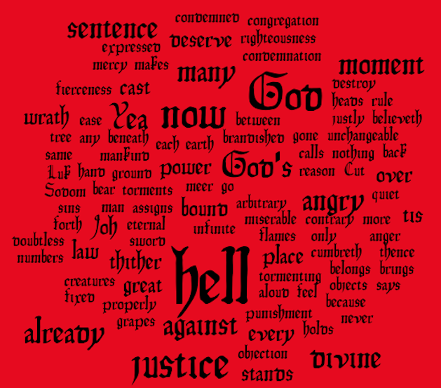
“Sinners in the Hand of an Angry God” – Word Cloud

Slide 6
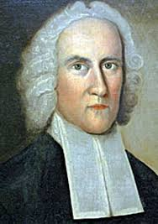
Edwards’s Persuasion
Repetition
Exhaustion
Rhythm

Slide 7
And there I found very many islands filled with people innumerable, and of them all I have taken possession for their highnesses, by proclamation made and with the royal standards unfurled, and no opposition was offered to me. Columbus, Letter of Discovery (45b)
The wrath of God burns against them, their damnation does not slumber; the pit is prepared, the fire is made ready, the furnace is now hot, ready to receive them; the flames do now rage and glow. The glittering sword is whet, and held over them, and the pit hath opened his mouth under them.
Jonathan Edwards, “Sinners” (194b)

Slide 8
And there I found very many islands filled with people innumerable, and of them all I have taken possession for their highnesses, by proclamation made and with the royal standards unfurled, and no opposition was offered to me. Columbus, Letter of Discovery (45b)
The wrath of God burns against them, their damnation does not slumber; the pit is prepared, the fire is made ready, the furnace is now hot, ready to receive them; the flames do now rage and glow. The glittering sword is whet, and held over them, and the pit hath opened his mouth under them.
Jonathan Edwards, “Sinners” (194b)

Slide 9
“And there I found very many islands filled with people innumerable, and of them all I have taken possession for their highnesses, by proclamation made and with the royal standards unfurled, and no opposition was offered to me.” Columbus, Letter of Discovery (45b)
The wrath of God burns against them,// their damnation does not slumber;// the pit is prepared, //the fire is made ready,’// the furnace is now hot, ready to receive them;// the flames do now rage and glow.// The glittering sword is whet, and held over them, //and the pit hath opened his mouth under them.
Jonathan Edwards, “Sinners” (194b)
→ Suspense, determinism, unalterable patterns

Slide 10
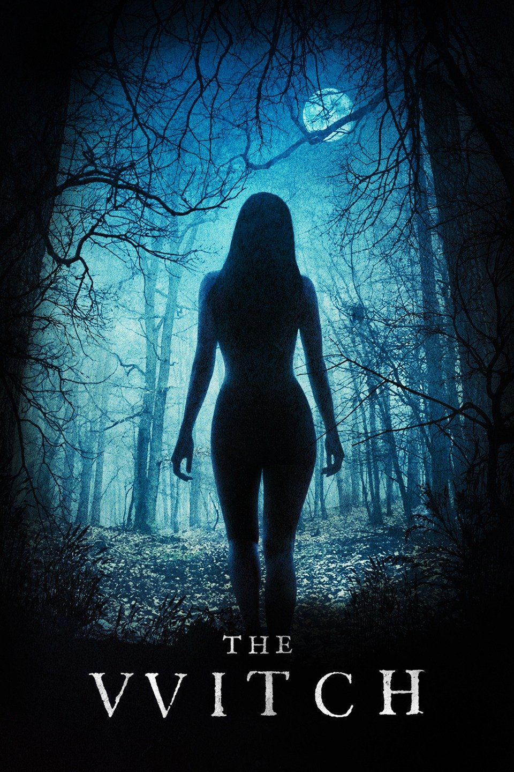
THE INVISIBLE WORLD
The Witch
(dir. Robert Eggers, 2015)

Slide 11
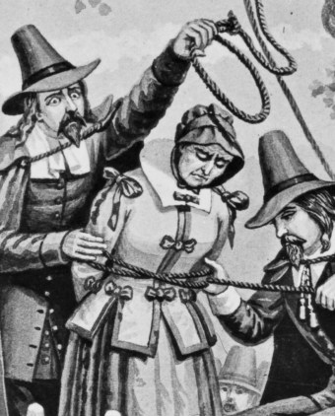
Salem’s Witch Trials (1692-1693)
One of the most traumatic and violent episodes in American history.
Puritans believed in witchcraft and witches.
A series of trials and hearings that resulted in 20 public executions by hanging or fire (14 women).
An example of mob violence and collective paranoia.
Neighbors settled territorial disputes by accusing each other of witchcraft, which could easily result in a death sentence by the public authorities of Salem.

Slide 12
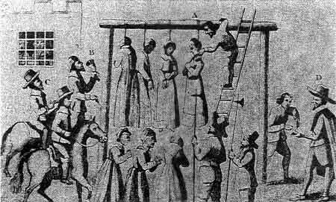

Slide 13
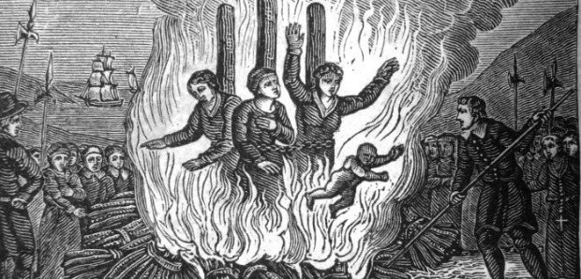

Slide 14
Authority and Epistemology
Epistemology: “the study of the nature of knowledge especially with reference to its limits and validity.”
Puritan epistemology
  Jonathan Edwards: “The devils watch them; they are ever by them at their right hand; they stand waiting for them” (194b).
  How does one see them?
  Cotton Mather: “We have a thousand preternatural things everyday before our eyes” (162t).
  How does one see the “Invisible World”? In a pre-scientific era, who has the authority to explain the world and its mysteries?

Slide 15
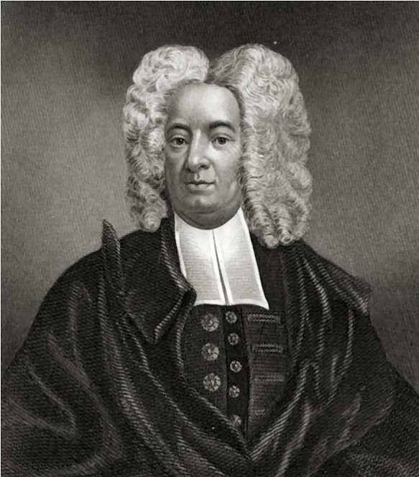
Contrasting strategies
Edwards derives his authority from scripture and exegesis.
  Deuteronomy 32.35
  Psalm 73.18
  Isaiah 57.20
  Luke 13.7
  Luke 11.12
  Ecclesiastes 2.16
  Proverbs 20.2
Mather relies on the law (deposition) and empirical methods of observation
  “I can do no other than shortly relate the chief matters of fact, which occurred in the trials… collected out of the court papers. You are to take the truth, just as it was” (162b).
  “I report matters not as an advocate, but as an historian” (162b).
  Pre-Enlightenment

Slide 16
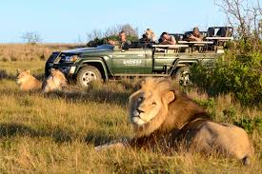
Rhetorical safari: hunting down figures of speech and rhetorical devices
Anaphora
Epistrophe
Alliteration
Oxymoron
Simile
Metaphor
Hyperbole
Rhetorical question
Image

Slide 17
    Anaphora
    Repetition of the first part of a sentence.
    “The greater part of those who heretofore have lived under the same means of grace, and are now dead, are undoubtedly gone to hell; and it was not because they were not as wise as those who are now alive: it was not because they did not lay out matters as well for themselves to secure their own escape” (196m).

Slide 18
    Epistrophe
    Repetition of the last part of a sentence.
    “… the devil is waiting for them, hell is gaping for them, the flames gather and flash about them, and would fain lay hold on them” (197t).

Slide 19
    Alliteration
    The occurrence of the same letter and/or sound in adjacent words
    “… it would immediately turn the soul into a fiery oven, or a furnace of fire and brimstone” (195).

Slide 20
    Oxymoron
    Contradictory terms that appear in conjunction
    “perfect despair” (203t)

Slide 21
    Simile
    An imaginative comparison or analogy
    “Your wickedness makes you as it were heavy as lead, and to tend downwards with great weight and pressure towards hell” (197).

Slide 22
    Metaphor
    A word or phrase acquires an additional meaning to its literal one. We call this figurative or metaphorical meaning.
    Example: black sheep.
    “… that every tree which brings not forth good fruit, may be hewn down and cast into the fire” (204m).

Slide 23
    Hyperbole
    Exaggeration, inflated language
    “God, …, would come upon you with omnipotent power; and if your strength were ten thousand times greater than it is, yea, ten thousand times greater than the strength of the stoutest, sturdiest devil in hell, it would be nothing to withstand or endure it” (198b).

Slide 24
    Rhetorical question
    Not a real question, since we already know the answer, but a question we ask for effect.
    “What will become of the poor worms that shall suffer it! Whose hands can be strong? And whose heart can endure?” (200m).

Slide 25
    Image
    A word or phrase that appeals to any of the reader’s five senses.
    “He will crush out your blood, and make it fly and it shall be sprinkled on His garments, so as to stain all His raiment” (201t).

Slide 26
Practice
  Making ten groups
  7 students maximum
  Go over the text and fill out “Rhetoric Safari” forms
    Anaphora
    Simile
    Metaphor
    Image
    Hyperbole
    Rhetorical questions

Slide 27
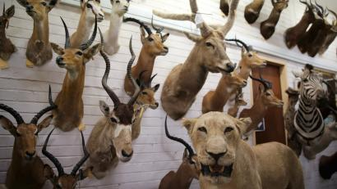
Why a “rhetorical safari”? And why it is not enough?
When we read literature, we are hunting down specific uses of language. This is the first step, known as close reading or literary analysis. However, collecting these is not enough.
Critical readers use these “safari trophies” to investigate further:
  What is the author trying to say?
  Why is she or he saying it in a particular way?
  How does the text work? How does it speak to us? How does it make us rethink a specific, theme, problem, or conflict?

Slide 28
For next week
  Discussion questions (NTU Cool)
  Hector St. John de Crèvecoeur, from Letters from an American Farmer (321-37)

