Slide 1
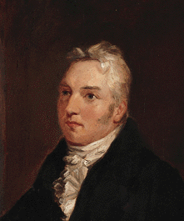
Coleridge: 1772-1834
1. “Frost at Midnight”
2. “Kubla Kahn”
3. “The Rime of the Ancient Mariner”
4. Biographia Literaria

Slide 2
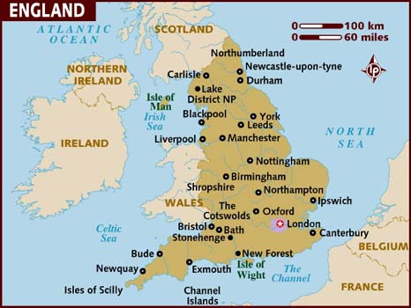

Slide 3
Lake District, Cumbria
Daily Telegraph Travel Guide: http://www.telegraph.co.uk/travel/destination/uk/69203/The-Lake-District-attractions.html

Slide 4
Coleridge_Q_1
1. Compare the childhood accounts and blessings for the silent auditor in “Frost at Midnight” and “Tintern Abbey.”
2. Read “the Wandering Jew” (Ahasuerus) as an archetype of the Ancient Mariner.
3. In which way does the meaning of “marriage” as sacramental, a form of holy communion, play a central role in “The Ancient Mariner”?
http://www.oed.com/view/Entry/169523?redirectedFrom=sacrement#eid

Slide 5
Coleridge_Q_2
4. Explain the three references to “slimy things” (l. 125, 238, 273) as marking the turning point of the poem.
5. Compare the “moral lesson” of “Nutting” and “The Ancient Mariner” and the way it is presented.
6. Explain the function of the framing device (i. e. the preface) of “Kubla Khan.”
7. Explain the image of the orient that is suggested in “Kubla Khan.” Why did Coleridge choose to write about a mythic China more than 300 years earlier when he could easily get information about contemporary China?

Slide 6
Coleridge_Q_3
8. Edward Said in Orientalism: Western Conceptions of the Orient (1978) acknowledges how representations of the East enable a "Western style for dominating, restructuring and having authority over the Orient." Explain your views on whether (to what degree) “Kubla Khan” coheres with or diverges from what Said calls “Orientalism.”

Slide 7
Coleridge_Q_4
Q2. How does the interaction between the “thin blue flame” and the “Idling spirit” serve as a miniature model of the mind that is at once creative and perceiving the universe, and of the process of composition? Please connect it with the idealized model of composition as designated in “Kubla Khan” and what Wordsworth describes in the Preface to the Lyrical Ballads, “spontaneous overflow of powerful feelings,” and what Coleridge calls the primary and secondary imagination in Biographia Literaria.

Slide 8
Coleridge (1) pp. 441ff
1.Pantisocracy, with Robert Southey (1794), collapsed, but still married to Sara Fricker
2.Lyrical Ballads (1798) joint venture with Wordsworth;
3. Translation of German aesthetics
4.“Dejection: An Ode” (1802) (in love with Sara Hutchinson, decline in creativity, and health), a reply to the opening of WW’s “Immortality Ode”

Slide 9
Coleridge (2)
6. The Sage of Highgate since 1816 (p. 442); with hypnotic power in “conversation”
see Hazlitt, “My First Acquaintance with Poets”
(STC’s reading of “AM”)
7. Heir to Edmund Burke, as an Anglican elitist (p. 443), “clerisy”;
8. Great in promise but short in performance, charge of plagiarism
9. Legacy of STC vs. Bentham’s utilitarianism 功利主義、效益主義(p. 443): CULTURE as a force to combat the fragmented, market-driven modern society;
influencing Thomas Carlyle, Matthew Arnold, John Ruskin

Slide 10
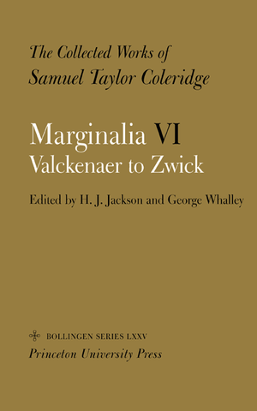
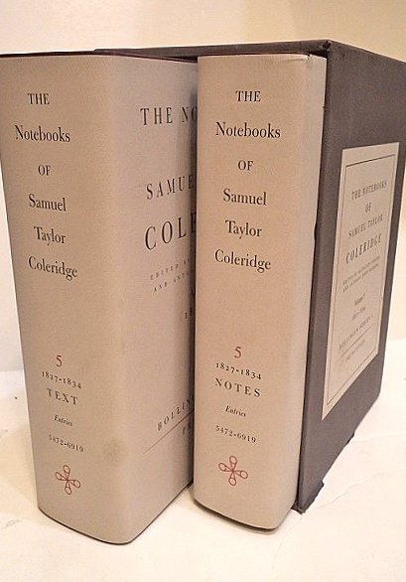
Marginalia and Notebooks

Slide 11
“Frost at Midnight” (pp. 482-83)
Q1. Compare the childhood accounts and blessings for the silent auditor in “Frost at Midnight” and “Tintern Abbey.”

Slide 12
Q_Frost
Q2. How does the interaction between the “thin blue flame” and the “Idling spirit” serve as a miniature model of the mind that is at once creative and perceiving the universe, and of the process of composition? Please connect it with the idealized model of composition as designated in “Kubla Khan” and what Wordsworth describes in the Preface to the Lyrical Ballads, “spontaneous overflow of powerful feelings,” and what Coleridge calls the primary and secondary imagination in Biographia Literaria.

Slide 13
Conversation Poem
“a sustained blank-verse lyric of description and meditation, in the mode of conversation addressed to a silent auditor” (see note to “The Eolian Harp,” p. 444, n.)

Slide 14
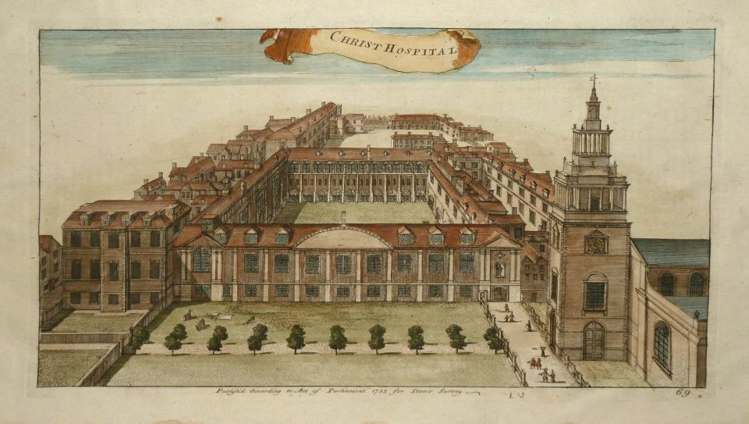
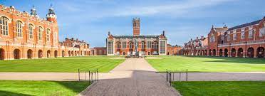
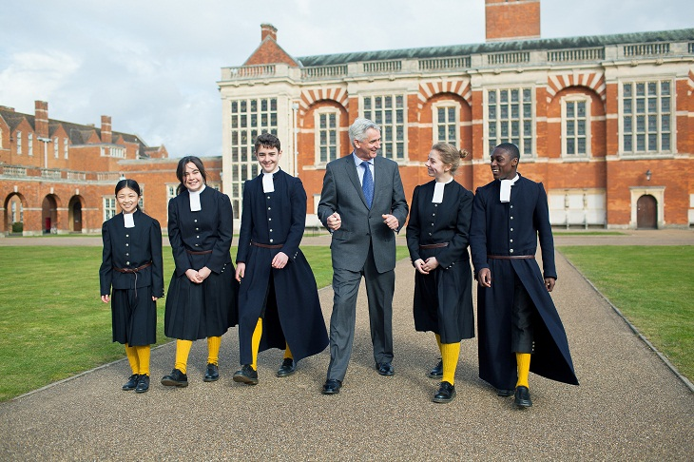
Christ’s Hospital, founded by Edward VI in 1552

Slide 15
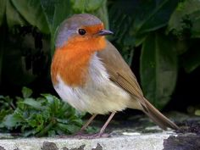
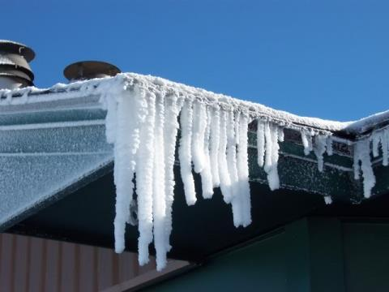
Eave-drops
Redbreast (robin)

Slide 16
“Kubla Khan” (p. 464-66)

Slide 17
Q_KK
6. Comment on the framing device (i. e. the preface) of “Kubla Khan.”
7. Explain the image of the orient that is suggested in “Kubla Khan.” Why did Coleridge choose to write about a mythic China more than 300 years earlier when he could easily get information about contemporary China?

Slide 18
Q_KK
8. Edward Said in Orientalism: Western Conceptions of the Orient (1978) acknowledges how representations of the East enable a "Western style for dominating, restructuring and having authority over the Orient." Explain your views on whether (to what degree) “Kubla Khan” coheres with or diverges from what Said calls “Orientalism.”

Slide 19
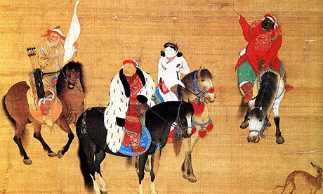
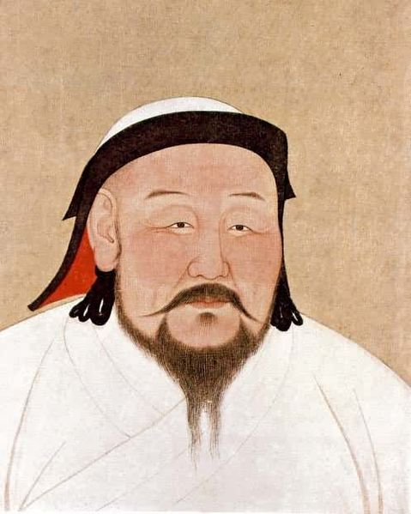
Kubla Khan Hunting. National Palace Museum, Taipei

Slide 20
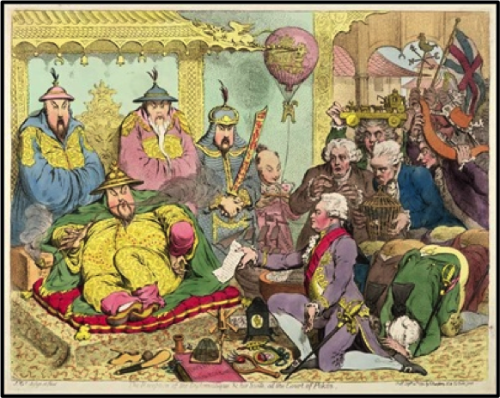
Macartney Embassy (1793)
James Gillray. The Reception of the Diplomatique & his Suite at the court of Pekin. 1792.

Slide 21
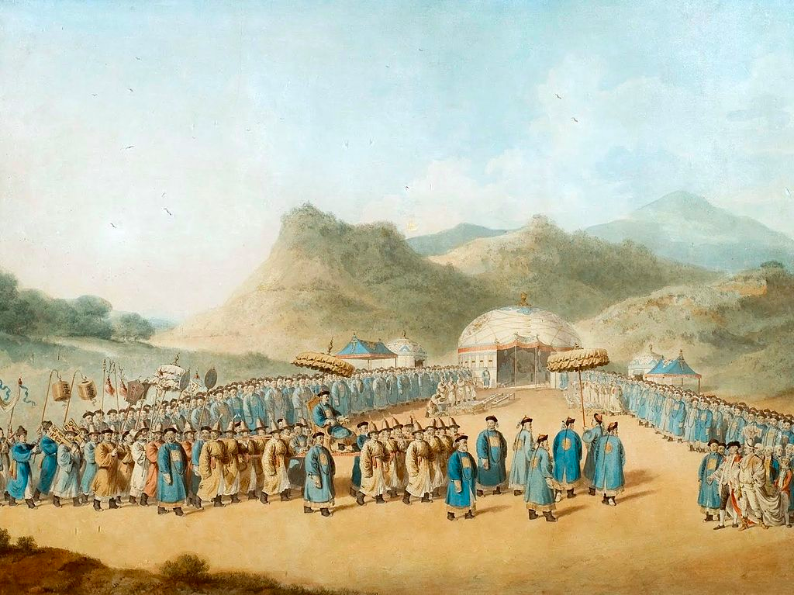
The Approach of the Emperor of China to His Tent in Tartary to Receive the British Ambassador, by William Alexander (1793)

Slide 22
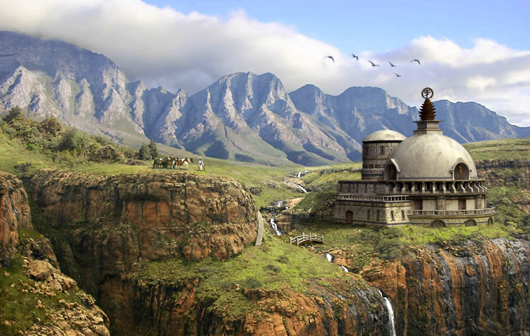
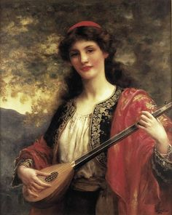
Xanadu （上都）
“A damsel with a dulcimer”
Mount Abora (or Amara in Milton), in nowadays Ethiopia
Notes:
http://www.betterlivingthroughbeowulf.com/?attachment_id=16259

Slide 23
“Kubla Khan” 1
1. Fragment: stimulating thought in two temporalities
A. (past) once completed, now in ruin
ex. Parthenon marbles: We lament what could have been there if it was preserved better.
B. (future) yet to be completed: We imagine what could be there if it were finished.
C. Friedrich Schlegel: “All Romantic poetry is the poetry of becoming”

Slide 24
“Kubla Khan” 2
Two types of fragment:
A. intentional
B. accidental
The “composition” in a dream:
4. Liminal (threshold) state between sleep and awakening ( “when we are laid asleep / In body, and become a living soul,” Wordsworth’s “Tintern Abbey,” ll. 46-47)

Slide 25
The Romantic Fragment Poem
STC published only three poems in 1816: “Kubla Khan,” “Christabel,” “The Pain of Sleep” (all fragments)
Poetic theories of language
Shelley’s “Ozymandias,” though a complete sonnet, expressing a sense of insecurity of poetic permanence
See Janowitz, Anne. “The Romantic Fragment.” A Companion to Romanticism. Edited by Duncan Wu, Blackwell, 1998, pp. 442-51.

Slide 26
Reference books on reserve
Burwick, Frederick, editor. Romanticism: Keywords. Wiley-Blackwell, 2015. [Ref PN 603 B86 2015]
Butler, Marilyn. Romantics, Rebels, and Reactionaries. English Literature and its Background, 1760-1830. Oxford University Press, 1982. [PR146 B82]
McCalman, Iain, Gillian Russell, and Clara Tuite, editors. Oxford Companion to the Romantic Age: British Culture, 1776-1832. Oxford University Press, 2001. [PR447 R64 1999]
Roe, Nicholas. Romanticism: An Oxford Guide. Oxford University Press, 2005. [PR457 R4575 2005]
Please also consult Cambridge Companion to William Wordsworth; Cambridge Companion to William Blake, and to all the other major authors.

Slide 27
“Kubla Khan” 3: Plato’s Parable of the Cave
“all the images rose up before him as things, with a parallel production of the correspondent expressions”(p. 464-65)
Plato: Idea Form Pattern Logos 理型 | “thing” Concrete object | “image”: mental picture of that object | “expression”: Linguistic representation of that object
Chairness | A chair | A mental picture of a chair | “chair” -- the word

Slide 28
*”daemon”
*Genesis and Apocalypse (lines 20-24)
Taroko Gorge 太魯閣

Slide 29
Harvest, the Time of Judgment
Let both grow together until the harvest: and in the time of harvest I will say to the reapers, Gather ye together first the tares, and bind them in bundles to burn them: but gather the wheat into my barn (Matthew 13:30)

Slide 30
Discussion
Comment on the framing device (i. e. the preface) of “Kubla Khan”: why does Coleridge present this poem in this manner? How does it function?

Slide 31
“The Rime of the Ancient Mariner”

Slide 32
Q_AM
2. Read the legend of “the Wandering Jew” (Ahasuerus) as an archetype of the Ancient Mariner.
3. In which way does the meaning of “marriage” as sacramental, a form of holy communion, play a central role in “The Ancient Mariner”?
4. Explain the three references to the “slimy things” (l. 125, 238, 273) as marking the shifts of the poem.
5. Compare the “moral lesson” of “Nutting” and “The Ancient Mariner” and how it is presented in the two poems.

Slide 33
“The Rime of the Ancient Mariner” pp. 448ff
The first poem in the Lyrical Ballads (1798)
1798 poem proper, 1816 glossary and epigram from Thomas Burnet, Archaeologiae Philosophicae (1692), see p. 448, n.
influences Mary Shelley’s Frankenstein
https://www.youtube.com/watch?v=RGH4p4z4s5A (Richard Burton-the Am, Robert Hardy-the WG, John Neville-the narrator), Part I and II (11 min.)

Slide 34
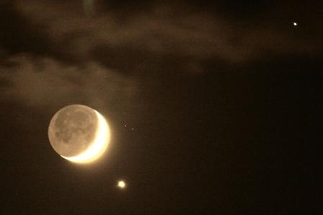
The plot
The horned moon with a star (3 Dec. 2008)
I. the Wedding Guest detained, sailing south, stranded, welcoming and shooting the albatross
II. Stranded again, the Bloody Sun, a painted ship upon a painted ocean, hung with the dead albatross; “slimy things”;
III. Life-in-Death wins the game; “the horned moon,
he alone survives; every men cursed him with their eyes
IV. Blessing the slimy things; praying
V. rain comes; sailing forth; a ghastly crew; two spirits comment; more penance
VI. A Seraph band; pilot and hermit
VII. Rescue; confession and absolution; back to the Wedding Guest

Slide 35
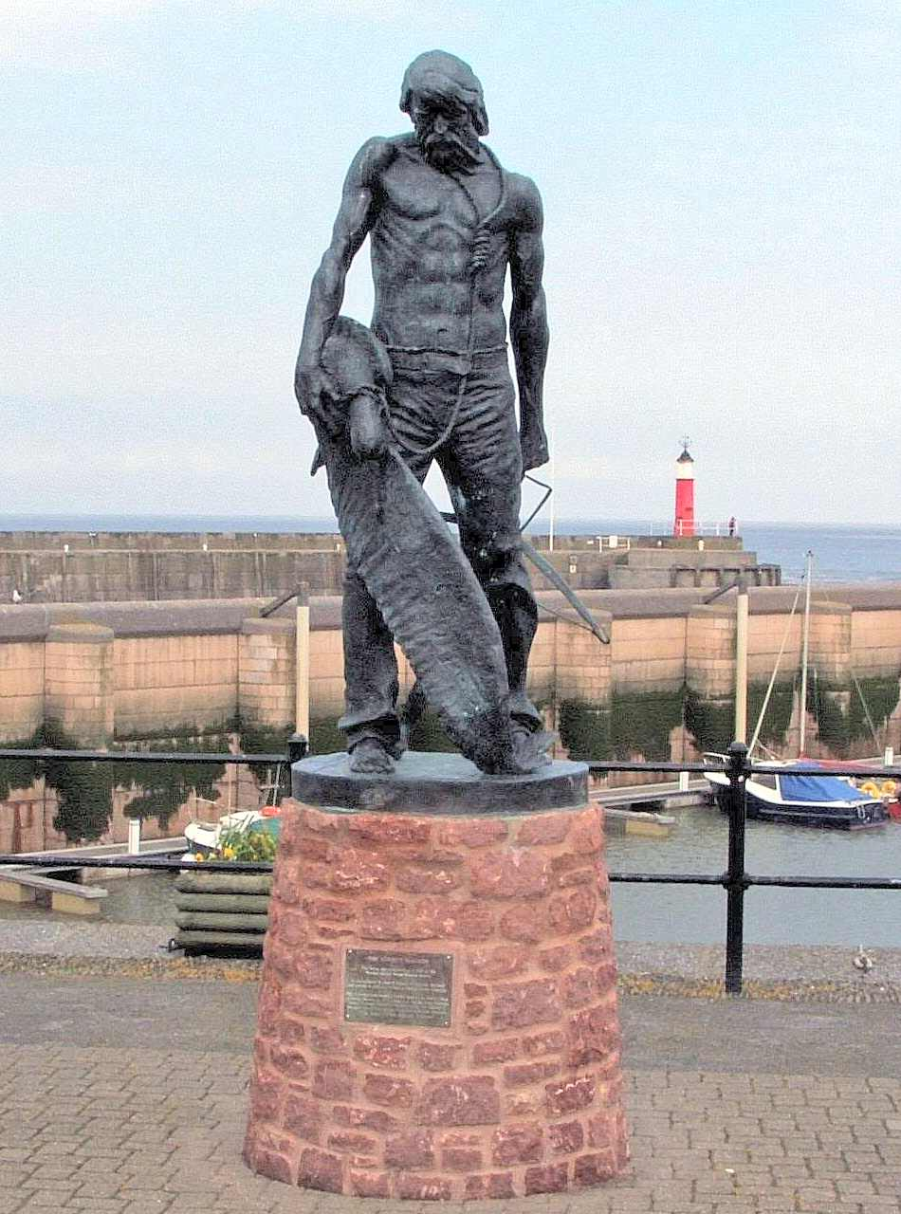
Albatross
A sculpture of the Ancient Mariner, Watchet, Somerset, UK

Slide 36
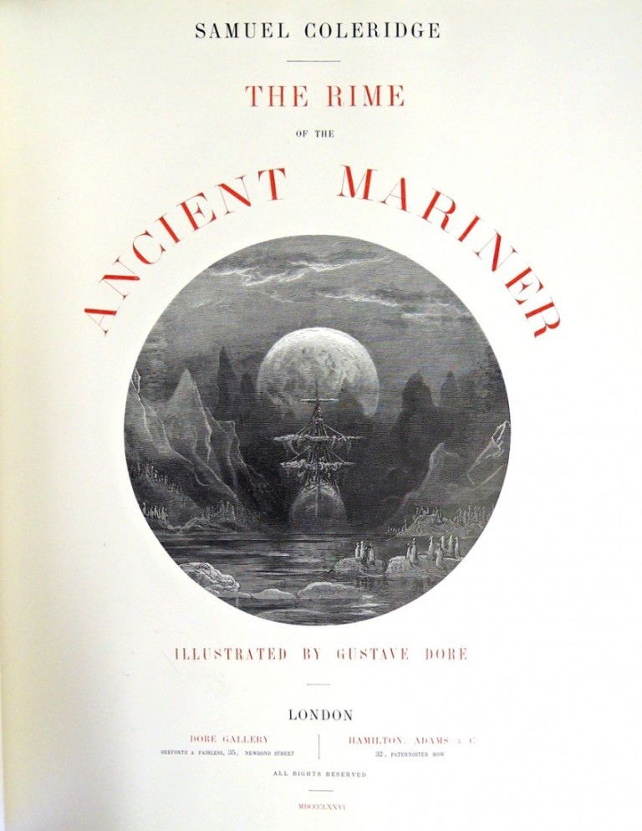
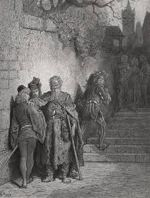
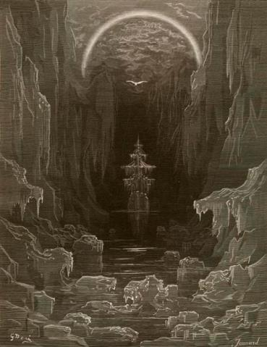
“The Rime of the Ancient Mariner” illustrated by Gustave Doré (1870s)
Notes:
https://www.bl.uk/collection-items/the-ancient-mariner-illustrations-by-dore; https://graphicarts.princeton.edu/2016/03/02/coleridge-and-dore/

Slide 37
Post hoc ergo propter hoc: after this therefore because of this
[killing the Albatross]
[the Sun hid in the mist]
the crew blaming AM for killing the bird who had brought good luck
[the fog cleared]
the crew justifying AM’s cruelty with the bird who had brought the mist; they are all accomplices
Notes:
37

Slide 38
The Wandering Jew
The Wandering Jew, a Christian legend, doomed to live until the Second Coming of Christ because he taunted Jesus on the way to the Crucifixion (John 18:20–22). Jesus replied, “I go, and you will wait till I return.”
Revived in 1602 in a German pamphlet, with the belief that the Antichrist would appear in 1600 and be aided by the Jews.

Slide 39
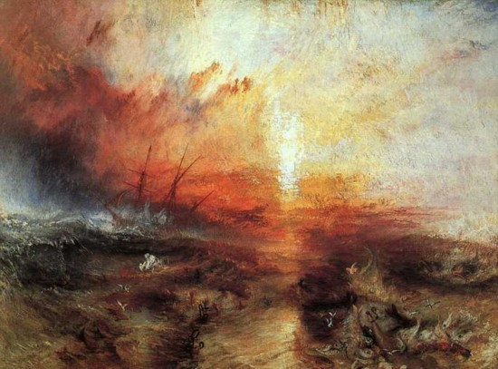
J. M. W. Turner. Slavers throwing overboard the Dead and Dying—Typhon coming on c. 1839. in Ruskin’s collection
www.freerepublic.com/focus/fr/1630734/posts

Slide 40
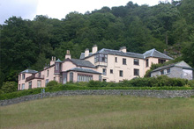
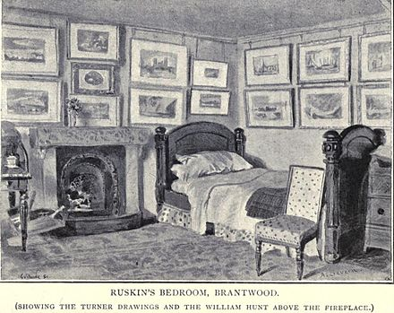
John Ruskin and Turner
Brantwood, Lake District

Slide 41
Abolition of slavery
Abolitionist badge/plate, made by Wedgwood

Slide 42
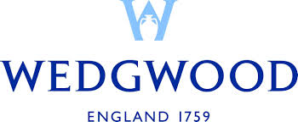
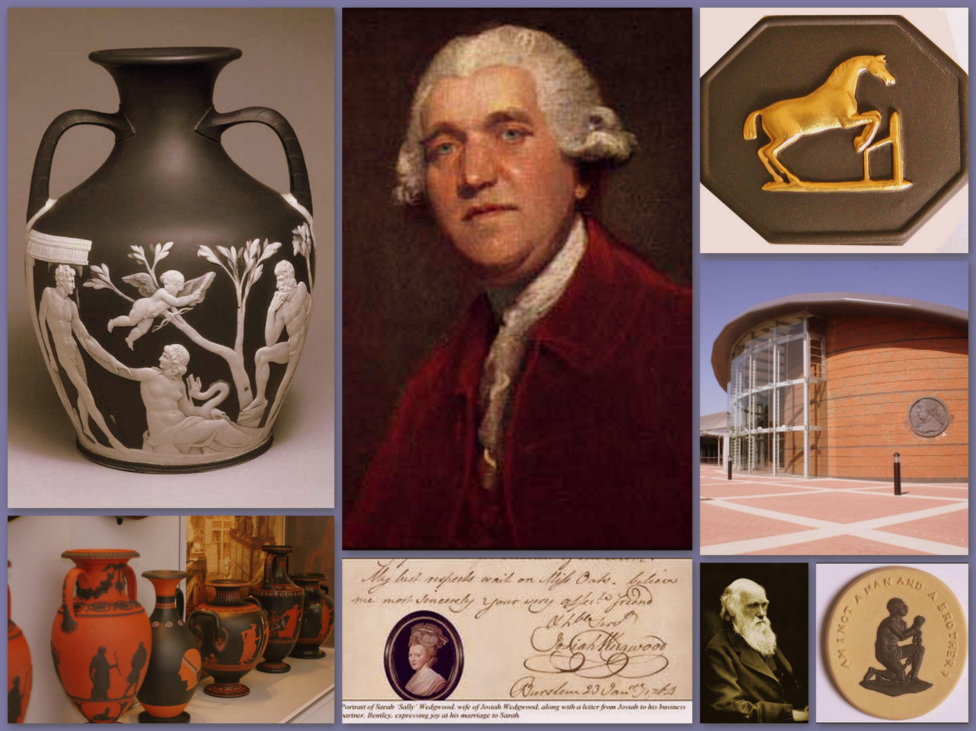
*Domestic production of porcelain, changing the ruling style of porcelain, Eritria
*a pioneer of modern industrialization
*Sponsored Coleridge;

Slide 44
Biographia Literaria
The Theory of Imagination
The Cult of Shakespeare

Slide 45
Romantic Theory of the Imagination (1)
I. 17th century Scottish philosophical school of “Common Sense” (physical sensation + mental sentiment)
II. Ex. Adam Smith, David Hume, moral sentiments

Slide 46
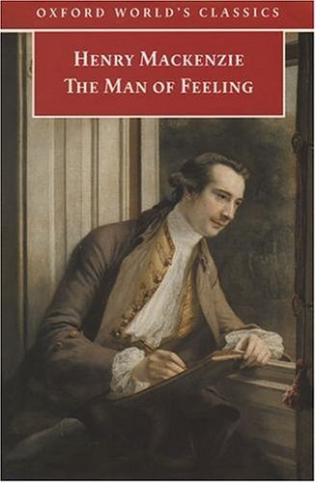
David Hume and Adam Smith, Scottish National Portrait Gallery, Edinburgh

Slide 47
Romantic Theory of the Imagination (2)
III. Imagination as the basis of social morality:
A. as the foundation of a coherent individual identity:
I of yesterday--I of today--I of tomorrow
B. as the premise of morals
ex. I am afraid of fire, which might also be feared by others. 己所不欲，勿施於人；人飢己飢，人溺己溺；惻隱之心 of Mencius, possibly transmitted through 17th Missionaries’ accounts

Slide 48
Romantic Theory of the Imagination (3)
IV. Coleridge’s theory (pp. 496) in Biographia Literaria, chapter 13
A. Primary imagination: ordinary perception shared by all
B. Secondary imagination: poetic imagination
C. Fancy

Slide 49
Mechanic vs. organic form p. 506
Exalts Shakespeare against Voltaire’s criticism
An living body is an organized one—each part is at once end and means
The organic form is innate; it shapes as it develops itself from within, and the fullness of its development is one and the same with the perfection of its outward form

Slide 50
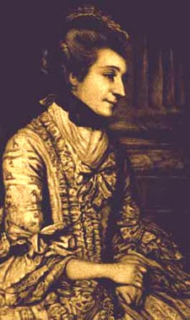
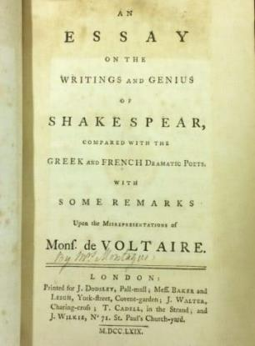
Elizabeth Montagu, “The Queen of the Bluestockings,” defending Shakespeare against Voltaire (1750)
BBC Radio 4 “In our time” https://www.bbc.co.uk/programmes/b045c0h9
Notes:
https://chawtonhouse.org/2017/05/woman-writer-month-elizabeth-montagu/

Slide 51
Supplements

Slide 52
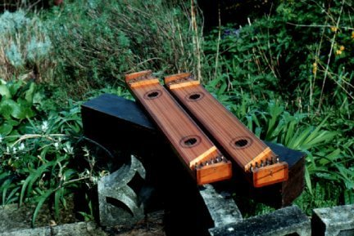
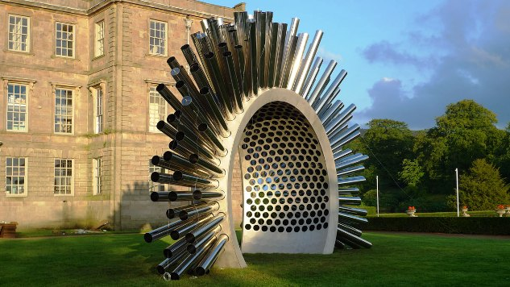
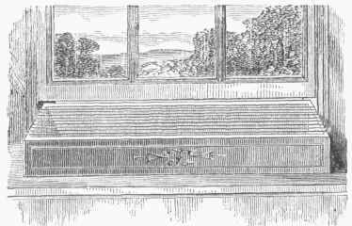
“The Aeolian Harp”
Synaesthesia:
production, from a sense-impression of one kind, of an associated mental image of a sense-impression of another kind
Unitarianism is a theological movement, named for its understanding of God as one person, vs. Trinitarianism, which defines God as three persons coexisting consubstantially as one being. Unitarians maintain that Jesus was a prophet, and in some sense the "son" of God, but not God himself.

Slide 53
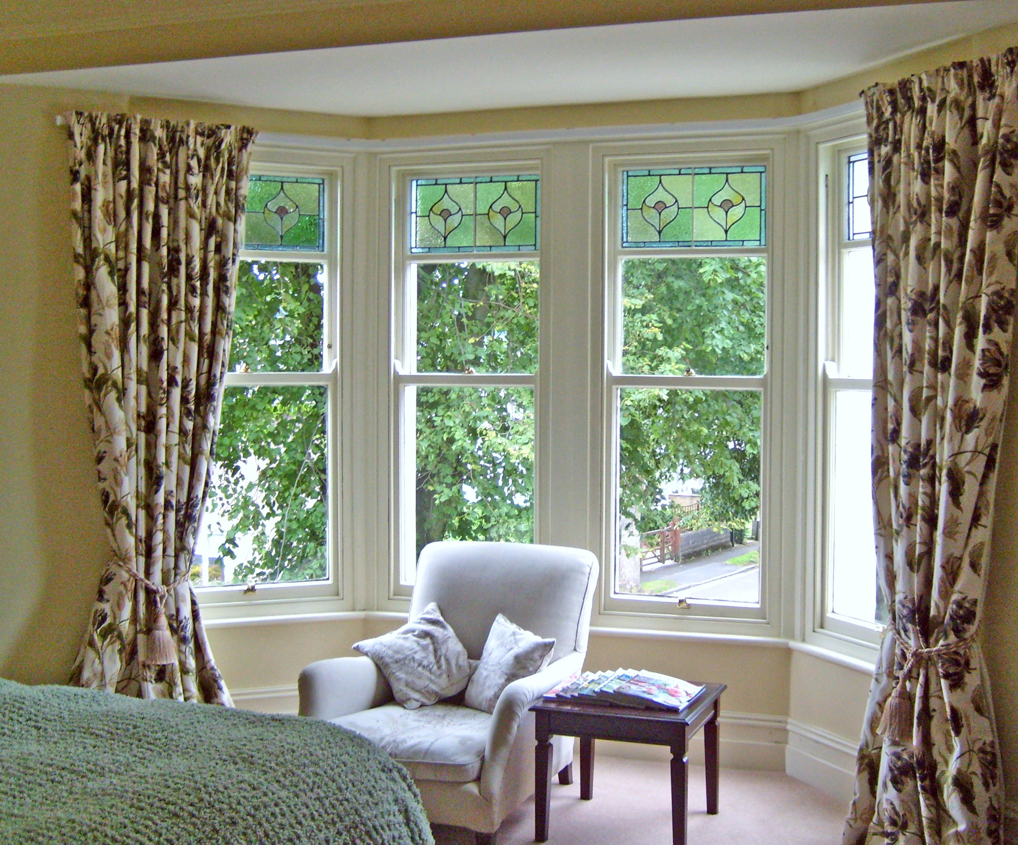
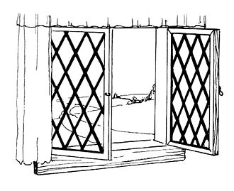
Sash window, (Georgian and Victorian periods)
Casement window

Slide 54
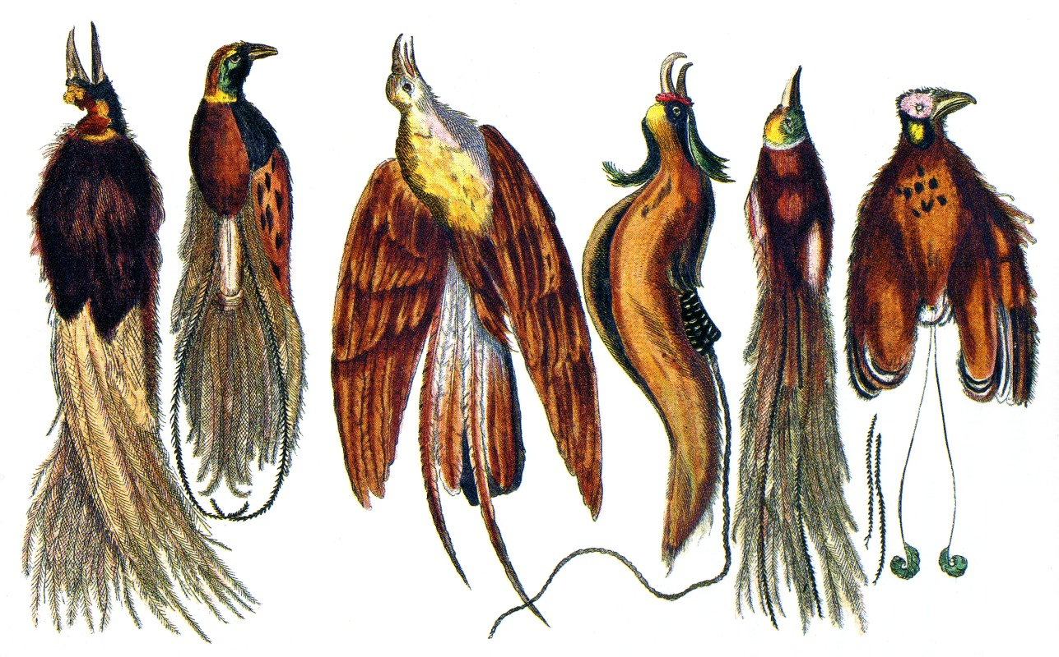
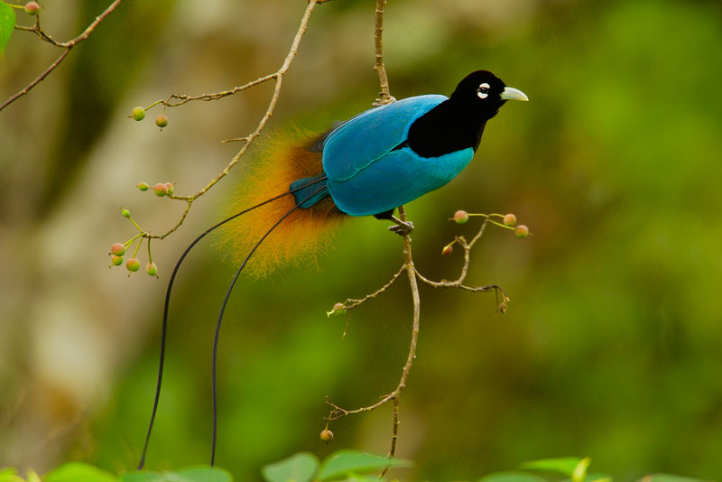
Birds of Paradise

Slide 55
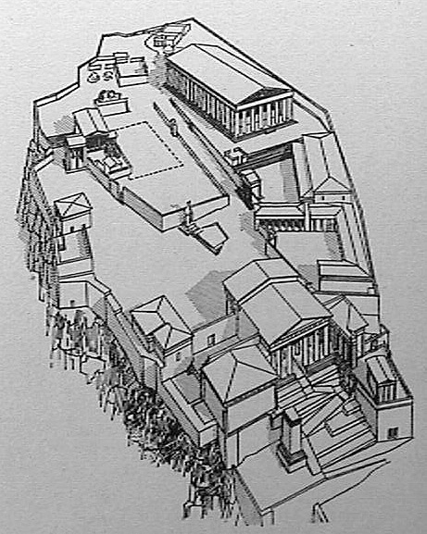
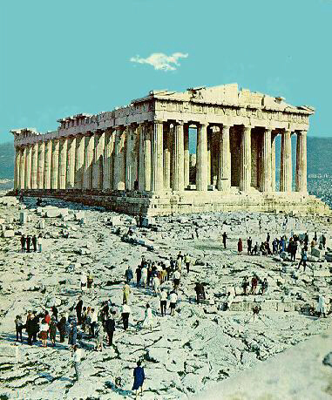
Parthenon Temple, Acropolis, Athens
Notes:
http://kenney-mencher.com/pic_old/classic_early_christian_byzantine/acropolis_parthenon.htm

Slide 56
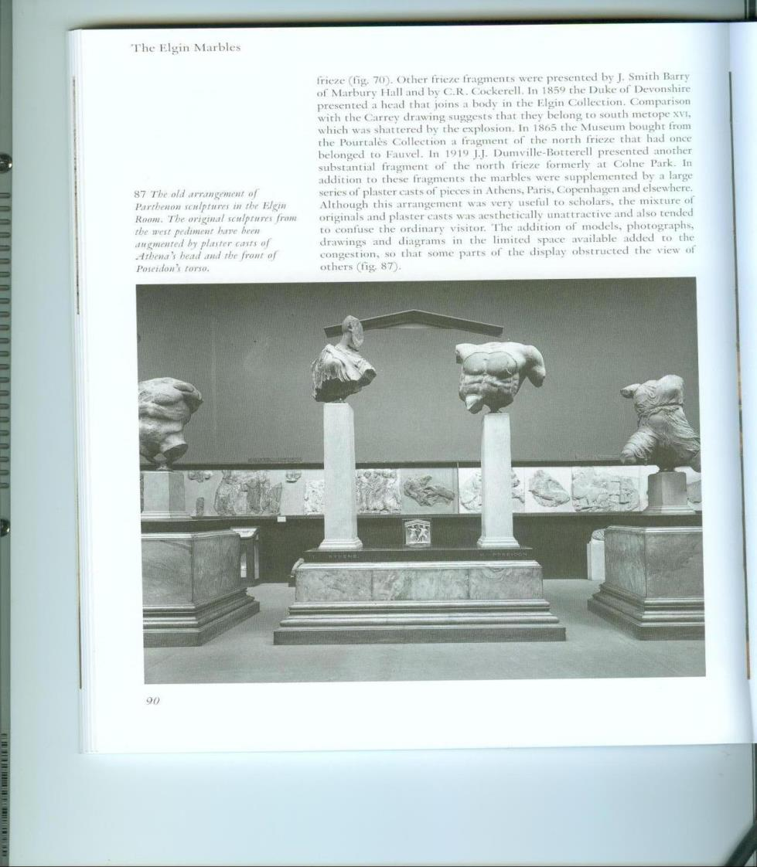

Slide 57
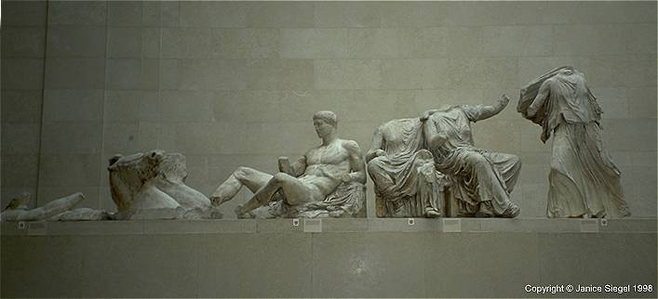
East pediment

Slide 58
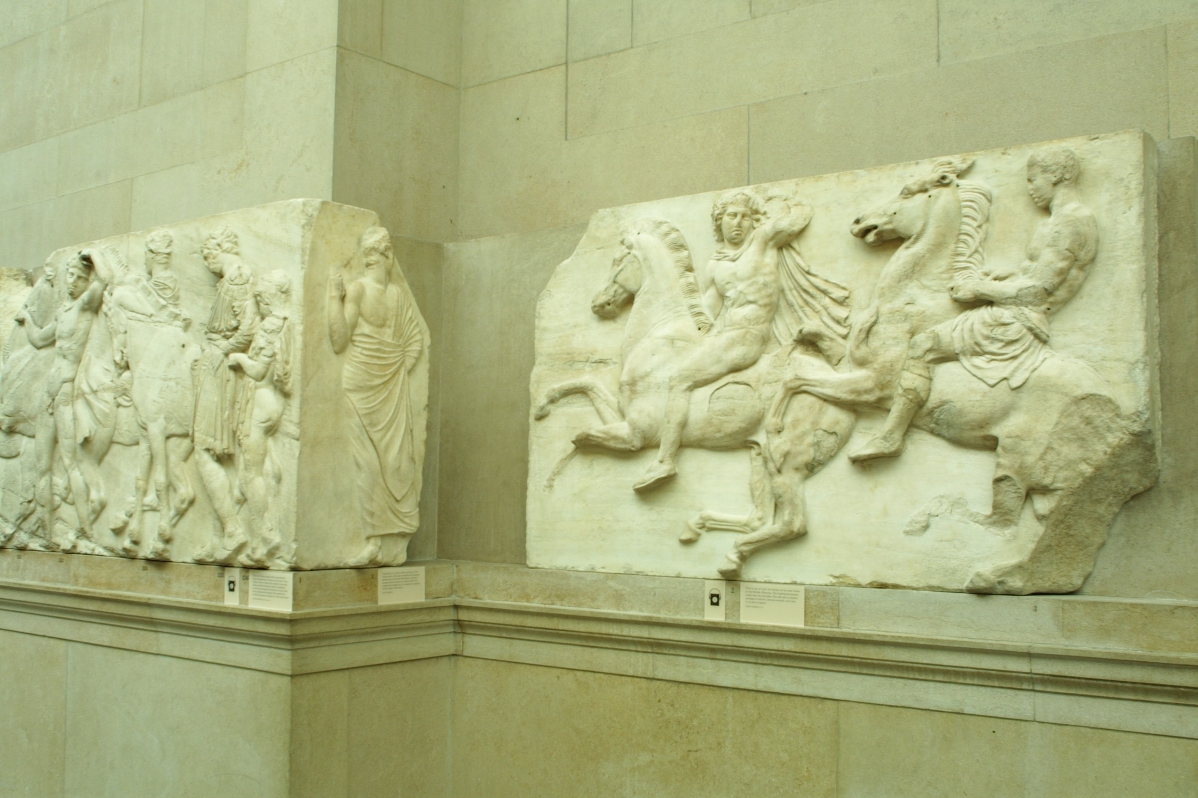
Notes:
http://ict.debevec.org/~debevec/Parthenon/ShotByShot/sequence01/

Slide 59
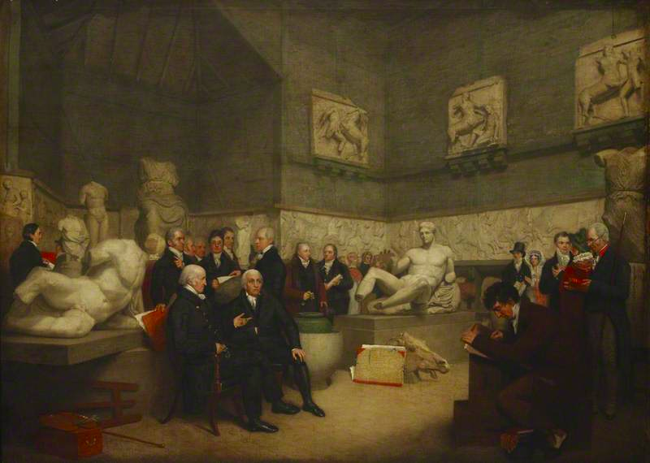
The Temporary Elgin Room. Archibald Archer. Oil on canvas 1819.
Haydon: Benjamin West (President of RA), Joseph Planta (Principal Librarian)

Slide 60
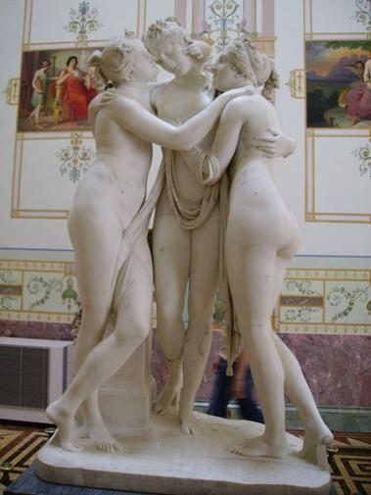
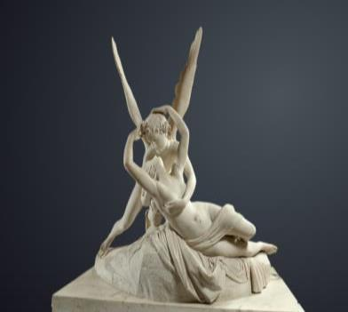
Antonio CANOVA (1757 – 1822)
Psyche Revived by Cupid’s Kiss. Louvre.
The Three Graces (1814-17). Hermitage, St. Petersburg

Slide 61
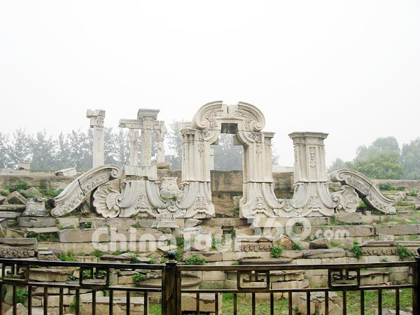
西洋樓, Summer Palace, Beijing

Slide 62
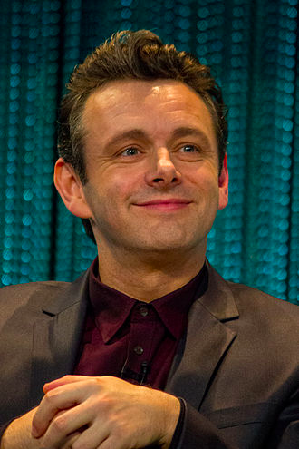
http://www.metacafe.com/watch/7309560/samuel_taylor_coleridge_kubla_khan/

