Slide 1
British Romanticism (1785-1832)
1785 William Cowper’s The Task
1832 The first Reform Bill
From Mrs. Barbauld to L. E. Landon (L.E.L)

Slide 2
Definition
Named after (and reevaluating) the medieval romance: magic, love, chivalry, quest (p. 4)
a second Renaissance in English literature (p. 10)
The Age of Revolution:
A. Politics (pp. 5,6)
B. Economics and industrial (p. 7)
C. Literature (pp. 10ff)
D. Science (Natural History): Geology, Botany, chemistry, etc.

Slide 3
The Political-Economic Context
1775-83 American War of Independence
1789 French Revolution
1793-1815 Napoleonic War
1807 Abolition of Slave Trade
1819 Peterloo Massacre
1832 the first Reform Bill
(see Texts and Contexts pp. 28-30)
The entanglement between aesthetics and politics, art and activism (pp. 4-5) [Romantics were never escapists]

Slide 4
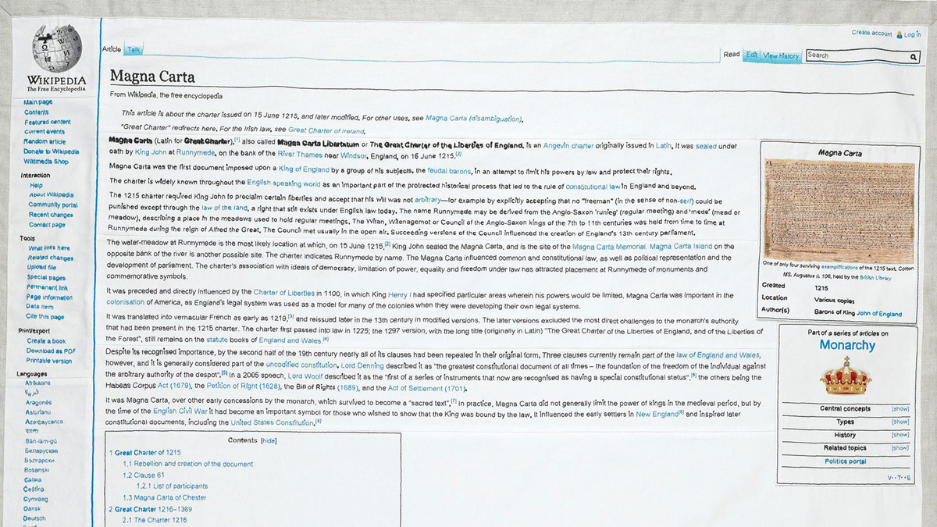
Political background (1)
The Whiggish historiography sees the English Liberty as an Anglo-Saxon legacy (vs. Tory)
1. Magna Carta (1215)
2. Glorious Revolution (1689)
Magna Carta Wikipedia page embroidery. Designed by Cornelia Parker (2015)

Slide 5
Political background (2.1)
B. The French Revolution
1. 1789 Storming of Bastille
2. 1793 Reign of Terror
a. General euphoria | b. Debate:
Wordsworth, The Prelude (6.352-54; p. 390): “But Europe at that time was thrilled with joy, France standing on the top of golden hours, And human nature seeming born again.” | Conservative caution: Burke, Reflections on the Revolution in France (1791)
 | Radical campaign: 1. Mary Wollstonecraft, Vindication of the Rights of Man (1792) 2. Tom Paine, Rights of Man (1792) 3. Godwin, Political Justice (1793) **the Revolution controversy (pp. 183-207), satirical cartoons

Slide 6
Political background (2.2)
C. Napoleonic War (1793-1815)
1. Napoleon, a paradox:
The Son of Revolution vs the Emperor
2. Defeat of Napoleon, triumph of reactionary power: the Holly Alliance
3. Repressive domestic politics
a. abolitionism failed in 1791 (slaver trade ended 1807, slavery ended 1833)
b. habeas corpus (free from arbitrary imprisonment) was suspended

Slide 7
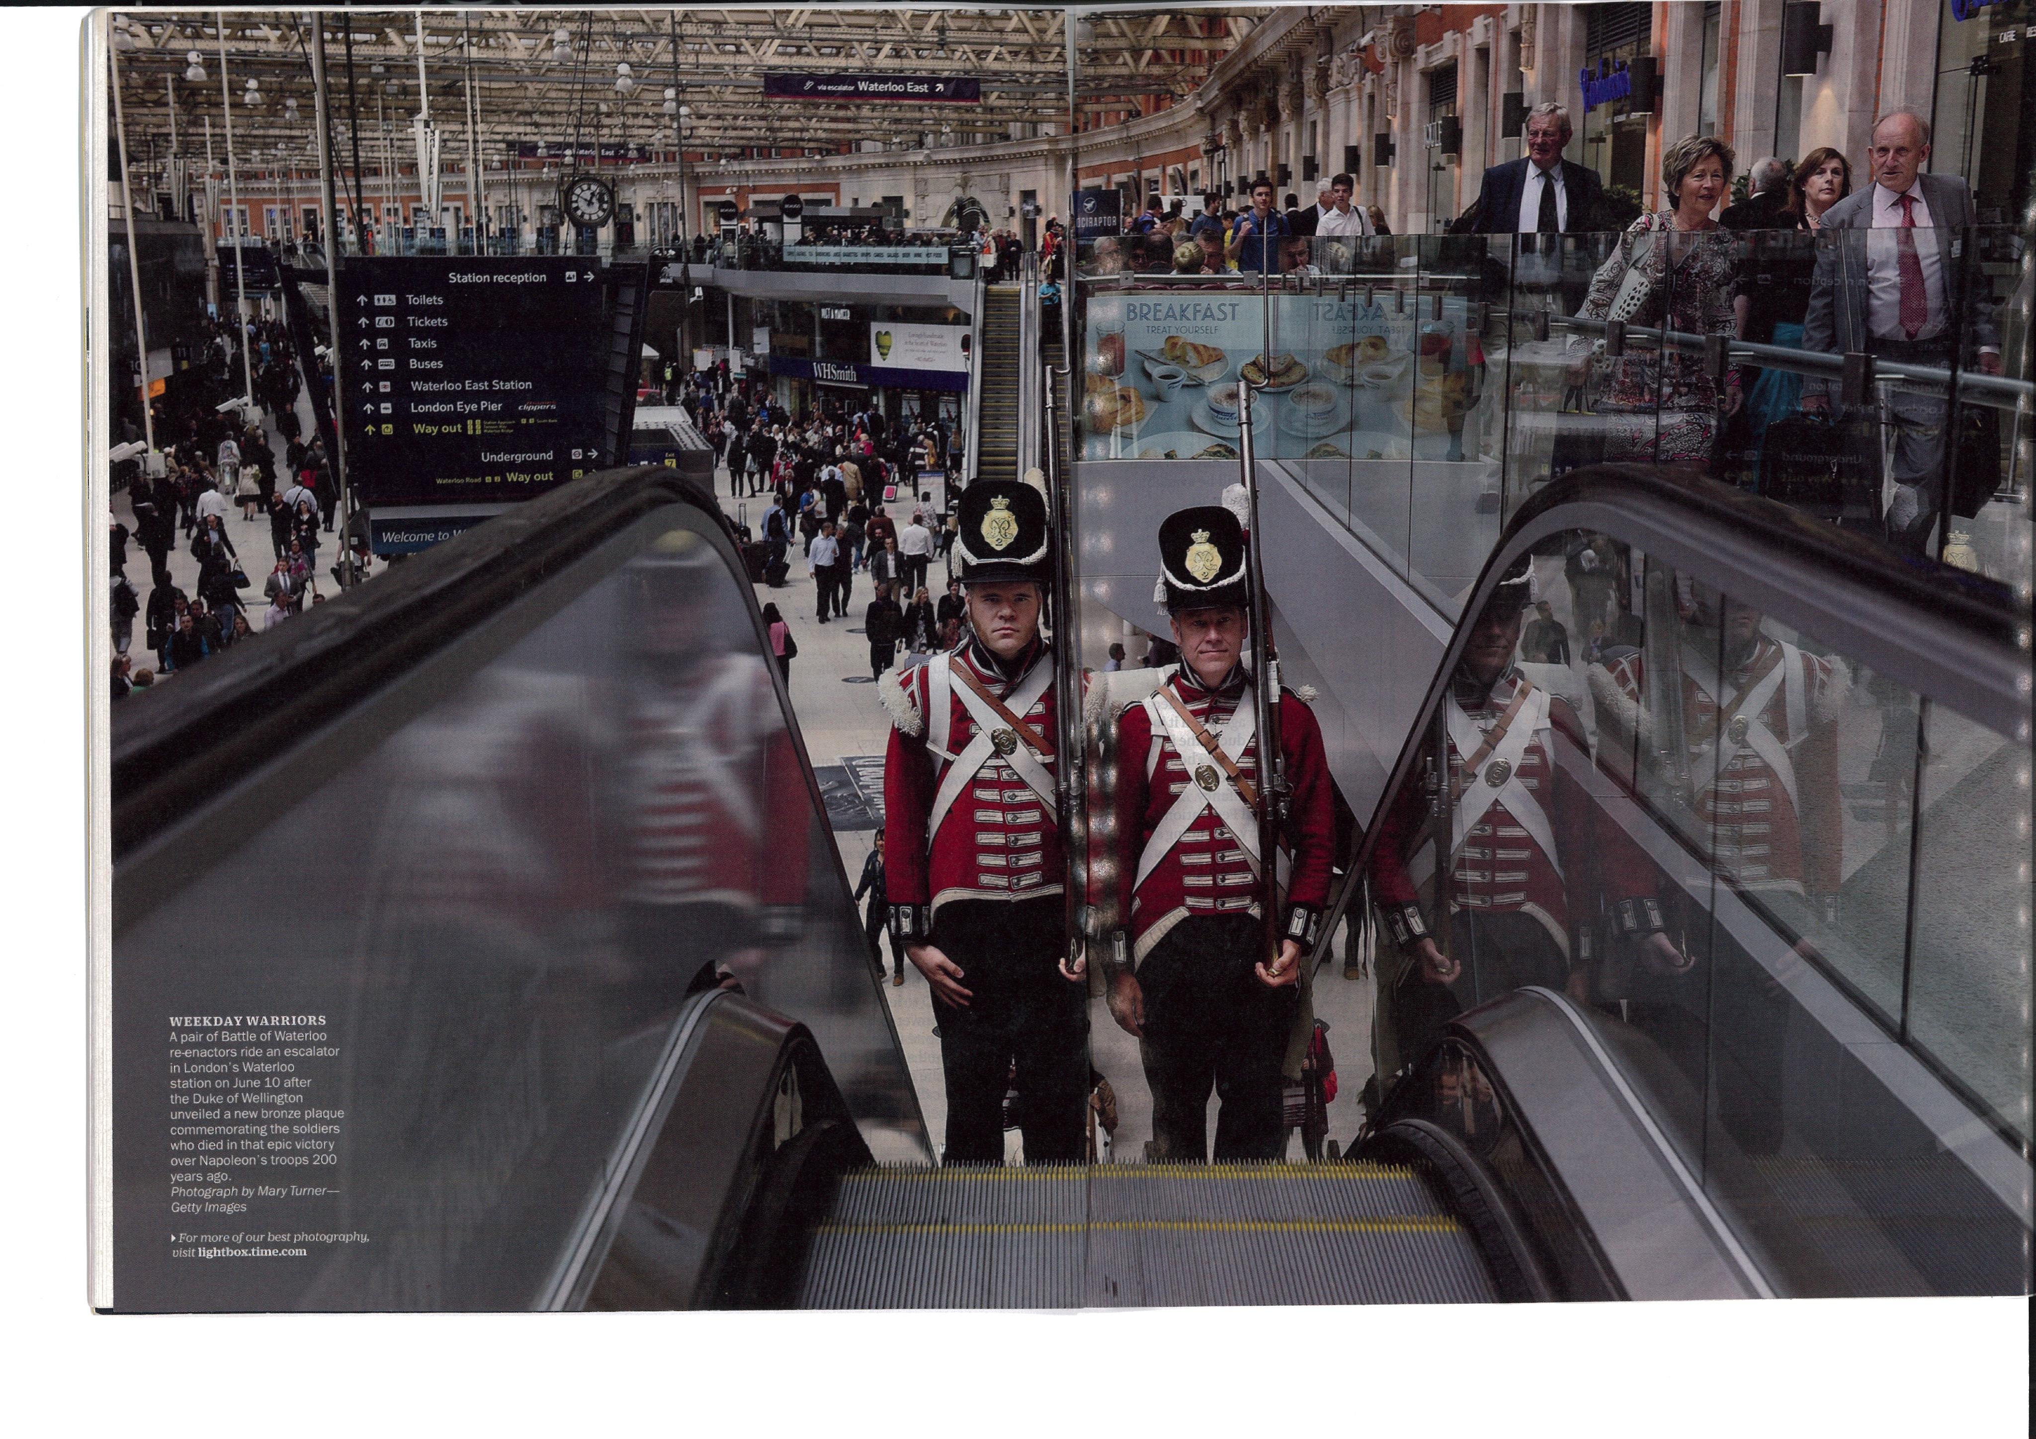
Weekday Warriors at Waterloo Station, London, bound for Waterloo, Belgium

Slide 8
Political background (3)
Peterloo massacre, August 1819 (p. 8)
an assembly at St. Peter’s Fields, Manchester,
petition against Corn Law, clamped down by cavalry, 9 killed and several hundreds injured
Reform Bill passed 1832 (p. 10)
a. Abolishing rotten borough
b. Extending the franchise to industrial cities
c. Yet no universal male adult suffrage until 1918

Slide 9
Peterloo
Peterloo, a film made by Mike Leigh (2018)
https://www.youtube.com/watch?v=Dj5h1kKjVYc (1’21’’)
Realist style with Mancurian accent, local details, empathy

Slide 10
Economic background (1)
A. Industrial Revolution, the new mode of production (p. 7)
1. James Watt in 1765 remodeled steam engine
2. Urban sprawl, ex. Manchester
3. Rural decline, enclosure of “commons” (p. 7), checkerboard landscape with hedges and walls
4. Adam Smith (1776) The Wealth of Nation: laissez-faire (the unseen hand of the market), widened the disparity of wealth
5. Polarized Two Nations—the capital Vs. the labour
6. Luddite destroying machines (p. 8)

Slide 11
Economic background (2)
B. Consumer society (p. 8)
Commodities from abroad: sugar, tea, muslin, laudanum
C. (Bourgeois) Idealization of home: the domestic ideology (pp. 8-9)
the home front of imperial expansion;
new pressures and new opportunities:
proper femininity the foundation of women’s missions as moral guardians;
the Bluestockings

Slide 12
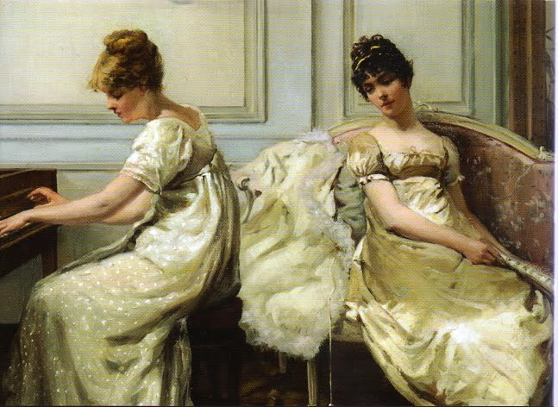
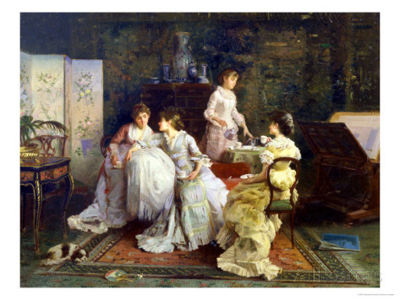
Colonial commodities and the English Identity
Afternoon Tea. By Alexander Rossie (19th C)
Regency dress
Notes:
http://www.allposters.co.uk/-sp/Afternoon-Tea-Posters_i2831497_.htm?awc=2884_1442308108_c0043de1db6d7d5cbe048c8cbfb011a6&aw_affid=75963&aw_gid=0&aw_bid=0&aw_pid=0&aw_cr=&aw_sitename=AfternoonTea&AID=479487044

Slide 13
Film
In-Class Discussion: 10 min. and one question, elect one presenter to summarize

Slide 14
1.1 Film viewing
History of Ideas: Romanticism (1750-1900) (10 min.) https://www.youtube.com/watch?v=OiRWBI0JTYQ
Key dates and keywords:
1762 Marais, Paris: Rousseau, Émile, The Child, seed of creativity
1770 Brooks Street, London: Thomas Chatterton; The cult of sensitive, doomed genius; The secular Christ figure, the noble loser
1774 Leipzig, Germany: Goethe, The Sorrows of Young Werther
1798 Madrid, Spain: Goya, Sleep of Reason
1799 Lake District, England: Wordsworth and Dorothy, Hatred toward industrialization
1799 Niagara, USA: Thomas Cole, sublime scenery with native Indians
1847 Westminster: Pugin, the new Parliament building, Gothic Revival The cult of the medieval age
1863 St. Germaine, Paris: Baudelaire, flâneur
1863 Le Havre: Gauguin to Tahiti

Slide 15
Question on the film:
[In-class Discussion for 10 min., Choose one question for your group]
1. Which aspect of Romanticism that most appeals to you, a reader at the 21st century, and why?
2. Do you notice a note of irony especially toward the end of this film? Please explain the irony and whether you agree with the film maker’s opinion or not.

Slide 16
To resume

Slide 17
The Spirit of the Age: Zeitgeist (1) (*Only for the sake of distinction)
A. Rebel against ancien regime
Romanticism | Neo-classicism
chaos | order
excess | moderation
imagination | reason
The particular | The general
The individual | The society

Slide 18
The Spirit of the Age (2)
B. Individualism (self-sufficiency, self-reference) (p. 19)
1. the mind creates the universe it perceives, ex. Kant
2. disinheritance from traditions:
ex. Wordsworth: the mind, “creator and receiver both”
3. The Faustean figure (Streben nach dem Unendlichen): ceaseless striving for the unattainable (p. 9)
4. The nonconformist, the exile, the outcast, (the loser) in danger of solipsism and melancholy (p. 20):
ex. Cain, the Wandering Jew, Satan, Prometheus, Napoleon
Notes:
http://commons.wikimedia.org/wiki/File:Alkaios_Sappho_Staatliche_Antikensammlungen_2416_full.jpg
http://en.academic.ru/dic.nsf/enwiki/17053

Slide 19
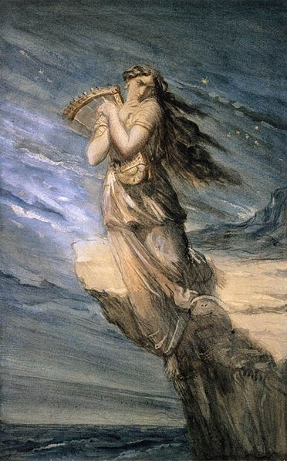
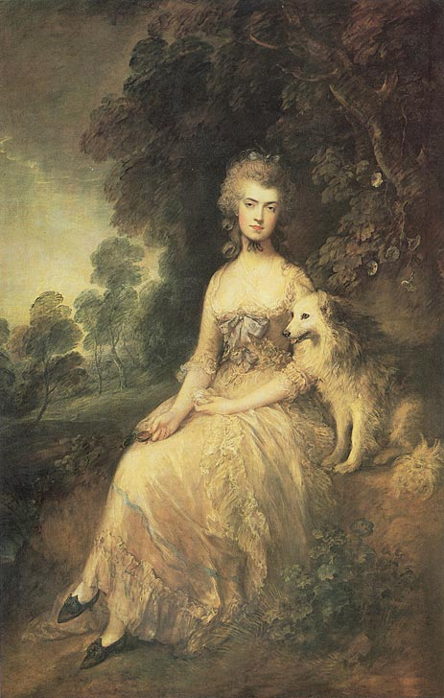
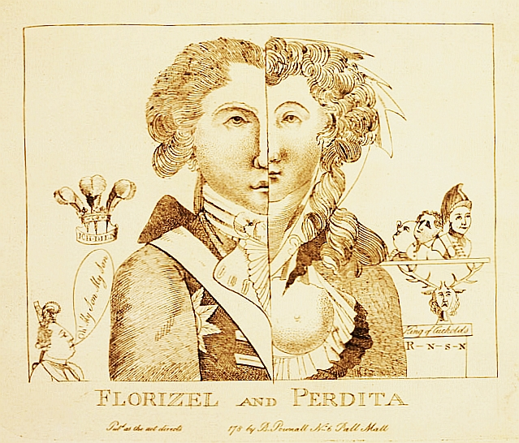
5. Modern women of genius, Variations of Sappho (p. 20)
The Prince of Wales as Florizel and Mary Robinson as Perdita (1783）
Sappho Leaping into the Sea from the Leucadian Promontory, by Theodore Chasseriau, (c. 1840)
Mary Robinson by Gainsborough (1781)
Notes:
http://commons.wikimedia.org/wiki/File:Chass%C3%A9riau,_Th%C3%A9odore_-_Sappho_Leaping_into_the_Sea_from_the_Leucadian_Promontory_-_c._1840.jpg

Slide 20
The Spirit of the Age (3)
F. The Cult of Sensibility
Scottish philosophy: the school of Common Sense: human nature is everywhere the same, based on shared sensory experience of the external world
ex. David Hume, A Treatise of Human Nature (1739)
Adam Smith, The Theory of Moral Sentiments (1759)
Henry MacKenzie, The Man of Feeling (1771)

Slide 21
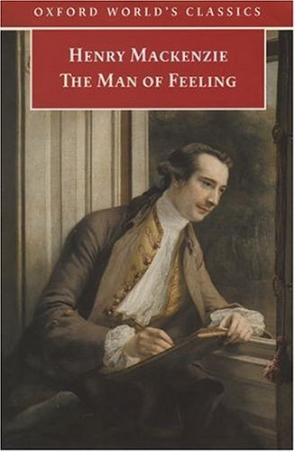
David Hume and Adam Smith,
by David W. Stevenson, Scottish
National Portrait Gallery, Edinburgh

Slide 22
Poetry and the poet (1)
A. Master theme—the French Revolution
Inverting hierarchy of genres, subjects, styles (p. 17)
B. Three schools of poetry (p. 10)
1. The Lake School: Wordsworth, Coleridge, Robert Southey
2. The Satanic School: Byron, Shelley
3. The Cockney School: Keats, Leigh Hunt

Slide 23
Poetry and the poet (2)
C. Poetry and poet
New paradigm set by the Preface to 2nd edn. of The Lyrical Ballads (1800)
The Four paradigms of literary criticism:
1. the Text: New Criticism, Deconstruction theory
2. the Reader: Reader-response theory
3. the World: Neo-classical mimesis (the poet as the mirror)
4. ***the Author: Romantic emphasis on personal expression, ex. Abrams’s The Mirror and the Lamp

Slide 24
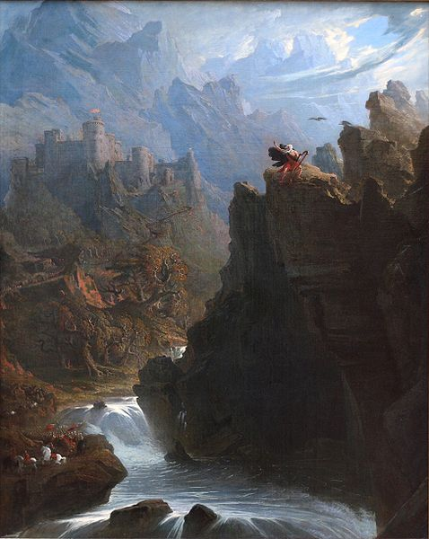
Poetry and the poet (3)
The Bard: poet-prophet: modeled on Ossian, Milton, the biblical prophets; improvisators of Italy (pp. 14-15);
the double image of the poet: solitary genius vs. the Grubb Street hack (p. 12, see illus.)
The Bard, by John Martin (c. 1817)
Notes:
http://en.wikipedia.org/wiki/Bard
http://en.wikipedia.org/wiki/Ossian

Slide 25
Poetry and the age (4)
D. Sources of inspiration
1. The Self:
ex. Wordsworth’s The Prelude; Byron’s Childe Harold’s Pilgrimage (p. 14)
ex. Coleridge: “deep thinking” is attainable only by a man of “deep feeling”
2. Nature: (p. 13)
a. a site of freedom from society (p. 20); “commune” between nature and men;
b. “nature poetry”: more meditative than descriptive (p. 13);

Slide 26
Poetry and the age (5)
3. The Past: origin (individual, collective)
A. Autobiography as a central motif
B. medieval revival [before and beyond Enlightenment] (pp. 4; 11-12; 15; 17)
a. adventures to distant past
b. reclaiming the national heritage of untrammeled imagination, as in Spenser and Shakespeare
ex. Walpole, Byron
c. psychological investigation:
ex. Keats, “La Belle Dame Sans Merci”

Slide 27
Poetry and the age (6)
4. The foreign land, primitivism, noble savage (Rousseau), cp. Montaigne’s relativist view of the Cannibals
5. the common place and the everyday (pp. 16-17); a. Wordsworth: to choose incidents from common life and to use “a language really spoken by men” Vs. “poetic diction”
Influencing May Fourth Movement, ex. 胡適「文學改良芻議」
b. to create a sense of wonder in the familiar; shattering the lethargy of custom (p. 17)

Slide 28
Poetry and the age (7)
6. the Supernatural, the occult (p. 17-18)
7. Death and the Gothic: legacy of Graveyard Poetry, ex. Blair, Thomas Gray (the Dark Romanticism)

Slide 29
Poetry and the age (8)
E Form:
1. Lyric (p. 13): the lyric “I”—reversing hierarchy
2. Fragment, trace of a grand original conception
3. Hybrid genres: new principles of organization and style, ex. Elegiac sonnet, lyrical ballad, historical novel, illuminated printing

Slide 30
Poetry and the age (9)
Criteria: the organic theory (p. 14): self-originating and self-organizing process; parallel to the growth of a plant, beginning with a seed-like idea and grows by assimilating both the feelings and the materials of sensory experience, and evolves into an organic whole
Good poetry as “spontaneous overflow of powerful feelings”; originating from “emotion recollected in tranquillity” (Wordsworth; pp. 13)

Slide 31
Poetry and the age (9)
Coleridge’s defense of Shakespeare’s natural genius against Voltaire’s criticism (pp. 499-501)
Fragment poems: (F. Schlegel), poetry should forever be becoming, defiant of limits ex. “Kubla Khan”(p. 19)

Slide 32
The Marketplace (1)
Spread of literacy (pp. 11, 20-22), our age of the New Media, news feed
A. printing press powered by steam engine, circulating libraries, creating modern celebrity, ex. Byron; Landon (LEL)
pirated edition, ex. Percy Shelley; Southey

Slide 33
The Marketplace (2)
B. conservative reaction: a “republic of letters” (p. 23) vs. the public readership (mistrust of the popular)
1. Coleridge: a modern readership a “misgrowth” (p. 21)
2. charges of sedition (Tom Paine), blasphemy (William Hone)
3. Bowdlerized edition of The Family Shakespeare (1807), regulating the reading of women and children

Slide 34
Romantic Prose: essay, review, pamphlet
Pamphlets of the 1790s (pp. 183--) and Magazines of the 1820s
D. Familiar essay: intimate-feeling commentaries, prompted by incidents in the author’s life, and on a range of subjects, turning toward the subjective, different from the urbane style of Addison and Hume (pp. 23-24)
Ex. Hazlitt, De Quincey, Lamb
E. The critic endowed with cultural authority: Criticism as/ vs. Literature
Edinburgh Review (1802); Quarterly Review (1809)
London Magazine (1820)
Ex. Coleridge, Hazlitt
Victorian critics as important leaders of culture:
Ex. Carlyle, Ruskin, Walter Pater

Slide 35
Romantic drama
Demotion of words (p. 24)
1. theatre as a site of social mixing, mirroring social order, incurring censorship
2. legitimate (spoken word) drama performed only in two royal theatres: Drury Lane and Covent Garden
3. spectacle, multi-media
Closet drama, to be read, not performed (p. 24)
The most successful pieces
1. Coleridge, Remorse (1813)
2. Percy Shelley, The Cenci (1820)

Slide 36
Novel of the period (p. 25)
I. The Gothic Novel: Walpole, Ann Radcliff, Lewis
The Novel of Purpose:
A. Jacobin novel: Godwin
B. Loyalist novel
III. The Historical Novel: Edgeworth’s Castle Rackrent; Scott’s Waverley series
The Novel of manners (時尚小說) : Jane Austen
depicts the revolutions of the mind, records workings of the mind in flux
V. First Science Fiction: Mary Shelley’s Frankenstein

Slide 37
Homework 1: Introduction

Slide 38
Homework: Compare the two paintings
Please access the two pictures at the following websites:
https://www.tate.org.uk/art/artworks/wright-sir-brooke-boothby-n04132
https://en.wikipedia.org/wiki/Mr_and_Mrs_Andrews#/media/File:Thomas_Gainsborough_-_Mr_and_Mrs_Andrews.jpg
Describe their different composition (in terms of figure 人物 and ground 背景).
Infer the different modes of relationship between humans and nature which are implied in these two pictures.
Please upload your homework to NTU Cool in Word file by midnight 28 Sept.

Slide 39
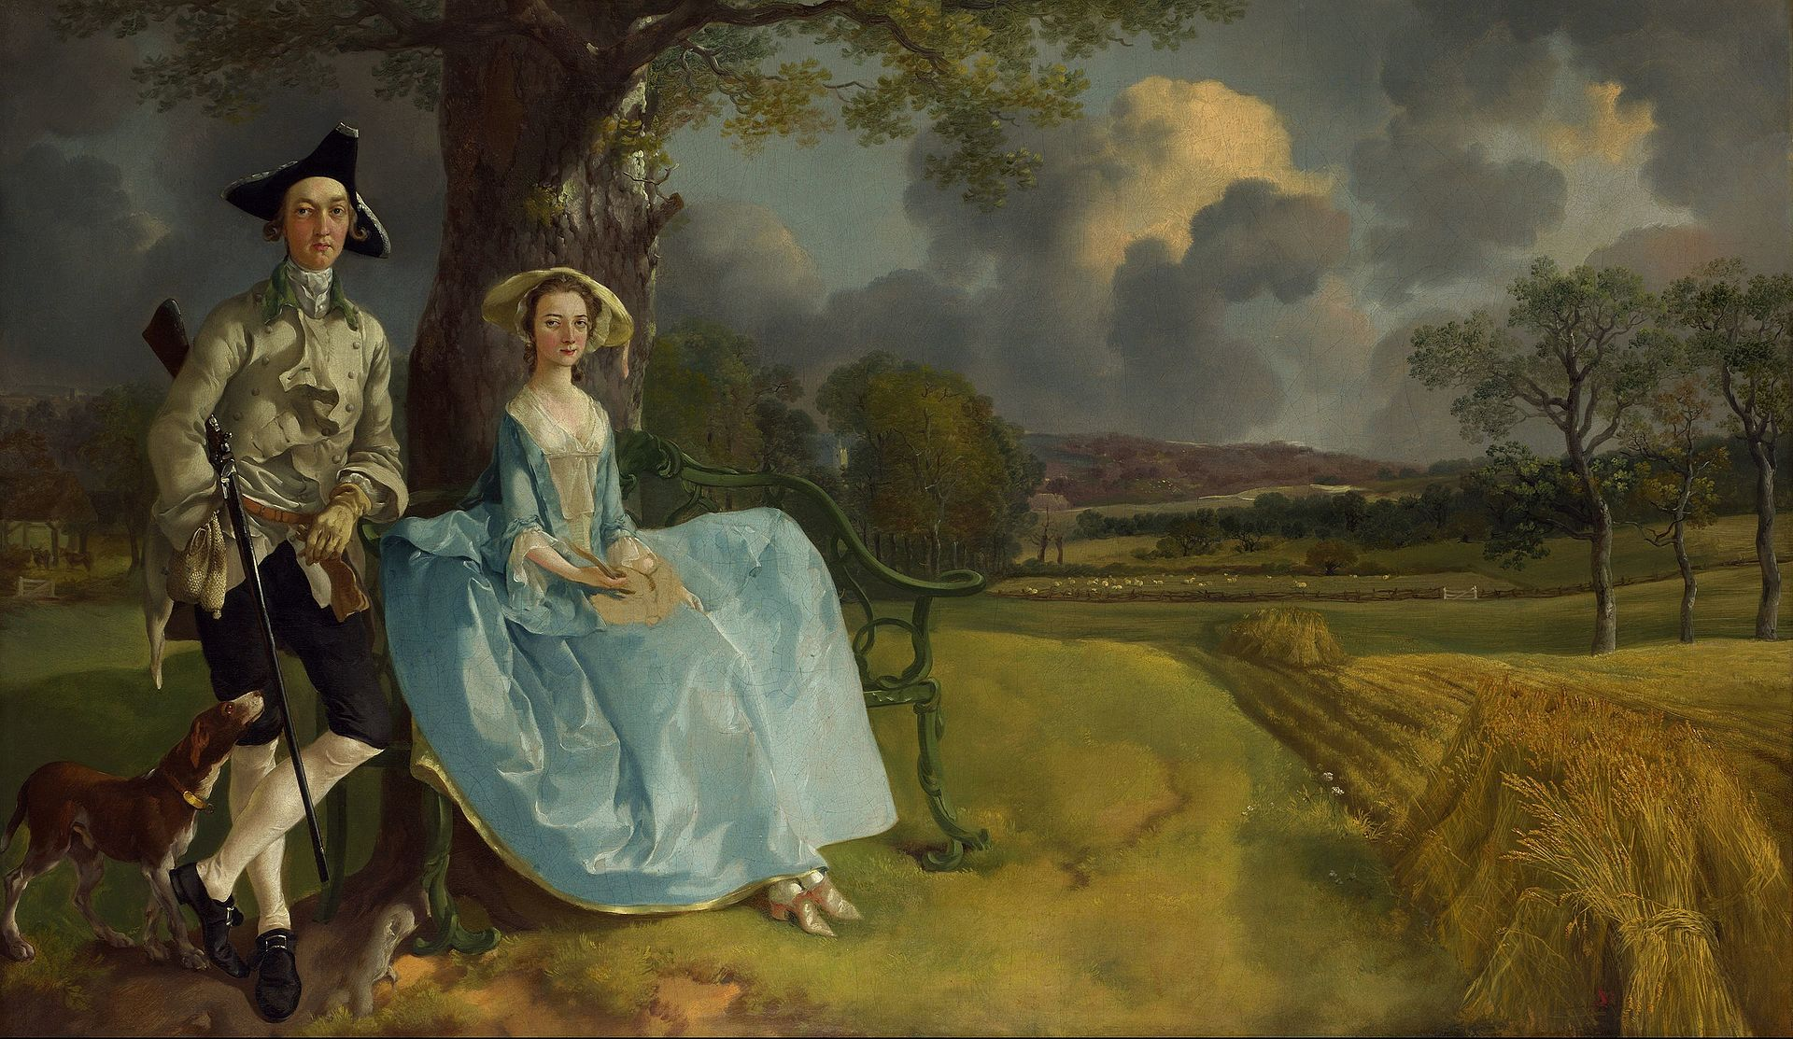
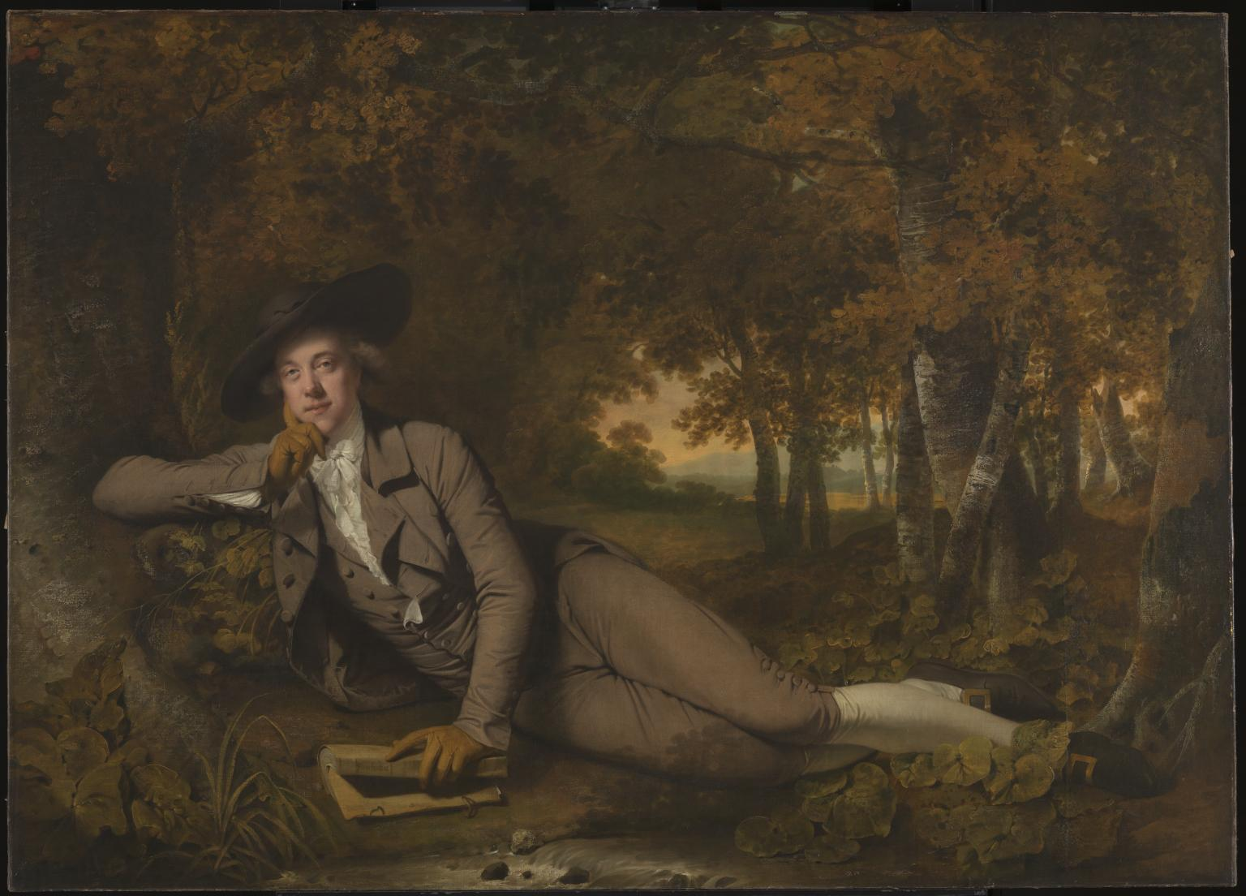
Mr. and Mrs. Andrews (1750), by Thomas Gainsborough.
Sir Brooke Boothby (1781), by Joseph Wright of Derby.

Slide 40
Reminder
Thanks for staying with us.
Please have your textbook ready.
Look forward to reading your homework by next Tues.
See you next week.

