Slide 1
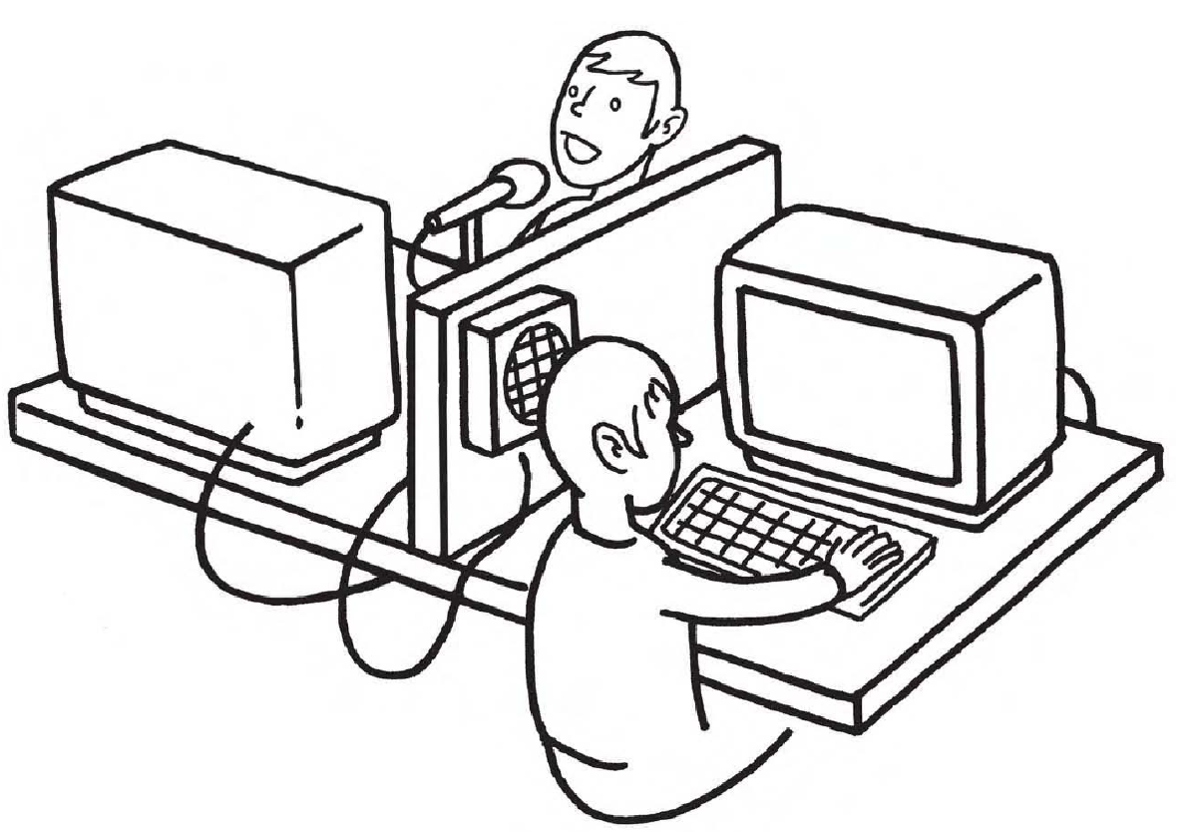
https://www.sli.do/
#073374
Pseudo-Labelling
Learning Objectives
Learn the gold standard: make use of unlabeled data to train the semi-supervised learning model.

Slide 2
SSL
( Semi-supervised Learning )

Slide 3
Label the unlabeled data using trained model
Train the model on labeled dataset until we reach certain accuracy
Label the unlabeled data using trained model
Select the data that model predicted label with higher confidence
Merge the unlabel data with label data and retrain the model
Repeat 1 ~ 4
arXiv:2001.06001

Slide 5
Improvement of SSL

Slide 6
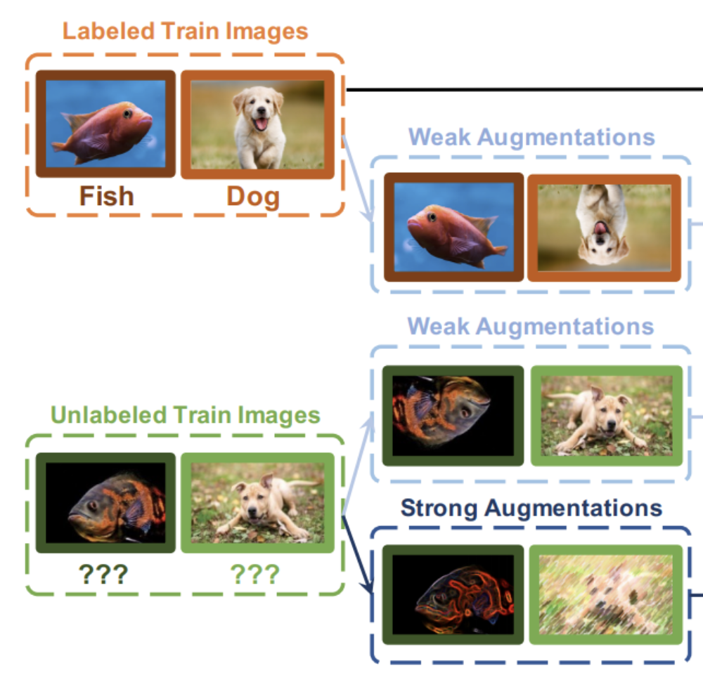
SimPLE
Data Augmentation
We do the augmentation on both labeled data and unlabeled data
There’s two types of augementaion, Weak Augmentaion and Strong Augmentation
Weak Augmentation
MixMatch, ReMixMatch, FixMatch
Strong Augmentation
RandAugmentation

Slide 7
SimPLE
Psudo-Labeling Shparpen
We Sharpen the probability of psudo-label
MixMatch

Slide 8
SimPLE
Different Loss Functions
Supervised Loss
Unsupervised Loss
Pair Loss
Supervised Loss
Simply calculate the cross entropy on weak augmentation and no augmentation of labeled data

Slide 9
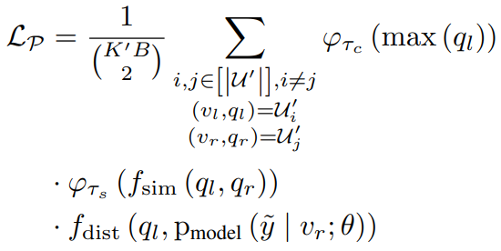
SimPLE
Unsupervised Loss
Calculate the L2 distance between Strong Augmentation and Weak Augmentation of unlabeled data
Pair Loss
Minimize the distance between all the unlabeled data

Slide 10
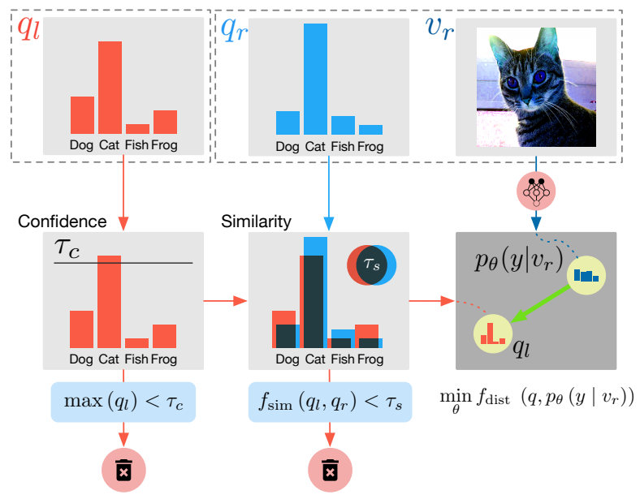
SimPLE
Pair Loss
ql is the output probability of one sample, if the output p is higher than threshold we will set this sample as anchor
qr is the probability of all the other image
If the similarity is high between ql and qr, we will minimize the distance between ql and qr

Slide 11
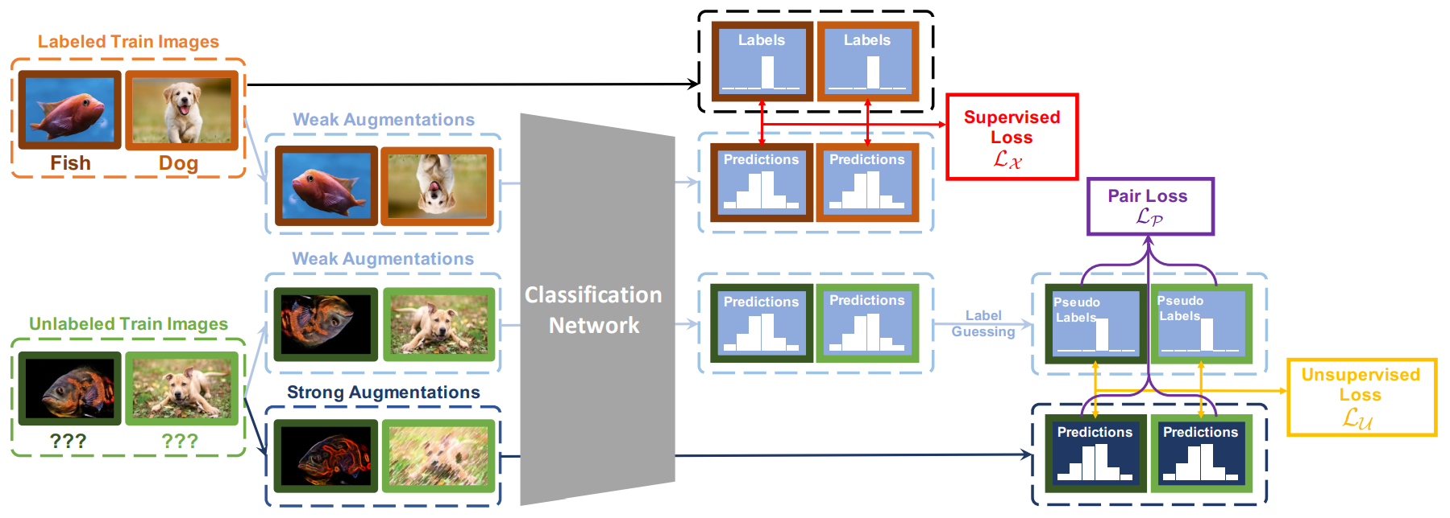
SimPLE
arXiv:2103.16725

