Slide 1
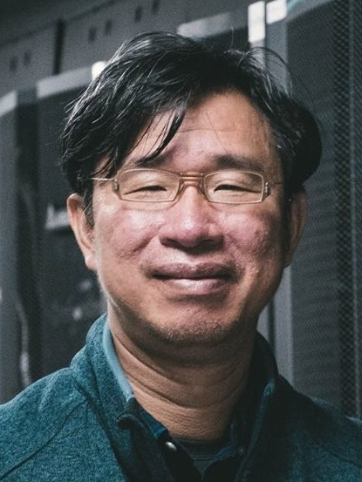
Introduction (2024)
Shih-Hao Hung, Ph.D.
Dept. of Computer Science and Information Engineering
National Taiwan University

Slide 2
Who Can Take This Course?
Dept of CSIE is short of resources
We are not going to find a bigger classroom in this building, so we have an upper limit: ~100 students

Slide 3
由於這門課是資工系大三的必修課，所以我們優先讓資工系大三或大三以上的學生修課。根據原定的教室容量和目前的預選狀況，以及往年退選的人數，我估計最多還可以讓30位學生在開學後加選，將總修課人數控制在100位左右，但還是要看實際的狀況。
我們提供一個線上表格讓想加選的同學在第一堂課當天（9/3）結束之前填寫，連結如下：
https://docs.google.com/forms/d/e/1FAIpQLSeaZjkJihZt5LLcNcAP41dYCh2tua_DSKweqFvr5Fo6k4PJfA/viewform

Slide 4
如果想加選的人數過多，那麼我們就按照以下的優先次序接受加選：
1. 台大資工系大三或大三以上的大學部、台大資工研究所、台大網媒研究所學生
2. 台大資工系大一、大二的學生
3. 台大電資學院、台大重點科技學院的學生
4. 台大學生
5. 台大以外的學生
萬一同一類別的人數過多，則抽籤決定。如果能提出讓我接受的特殊原因的話，我可以另外提供名額。
如果加選之後還有名額，才開放旁聽。

Slide 5
Computer Organization
Q: Why do you want to learn about computer organization?
A1: To know how computers work
A2: To learn the concept of engineering
A3: To be able to design computer systems
A4: To be able to optimize computer software
A5: To become a good computer architect

Slide 6
The Hardware/Software Interface
Understanding the computer organization means that you are familiar with
  The interface between hardware and software
  The HW/SW components near the interface
  The costs of the HW components
  The interactions between these HW/SW components
  The events occur in these HW/SW components
  How these events affect the performance
  How to improve the performance

Slide 7
Approach
Modern computer organization is very complex
  Design space is huge
  Many important design principles
  Real implementations to illustrate design principles
  Apply the principles in design projects
Computer performance is very complex, too
  Can be affected by many factors
  Few can be calculated with equations in real world
  Tools and guidelines to improve performance with HW/SW techniques
Lots of things to learn, but the more you learn, the faster you learn. Experience matters.

Slide 8
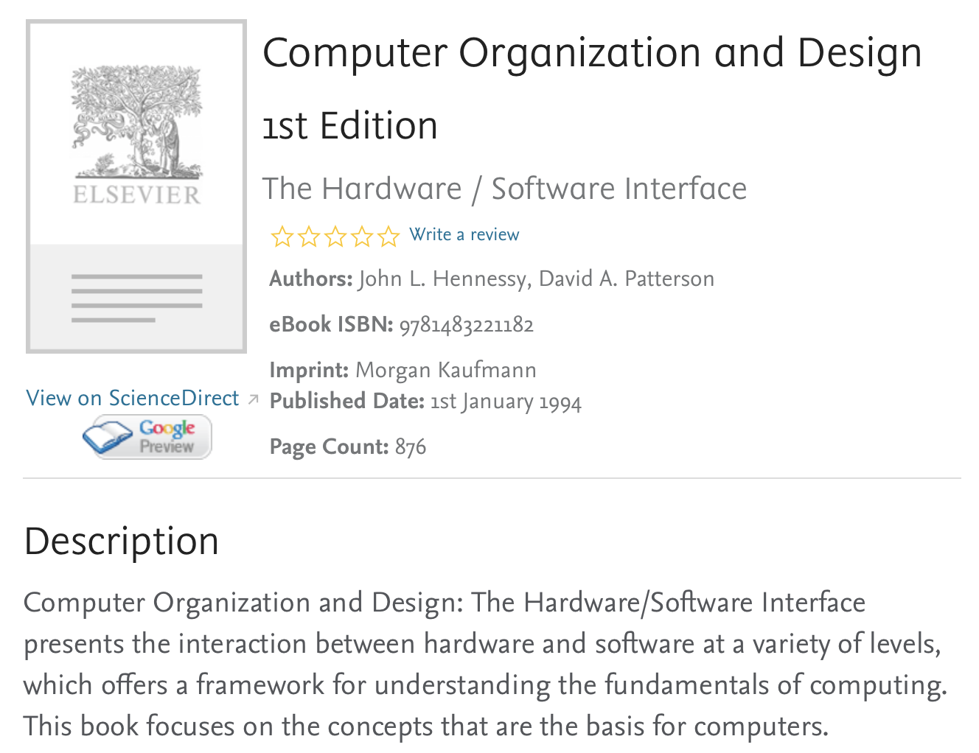
The Original Textbook
1994

Slide 9
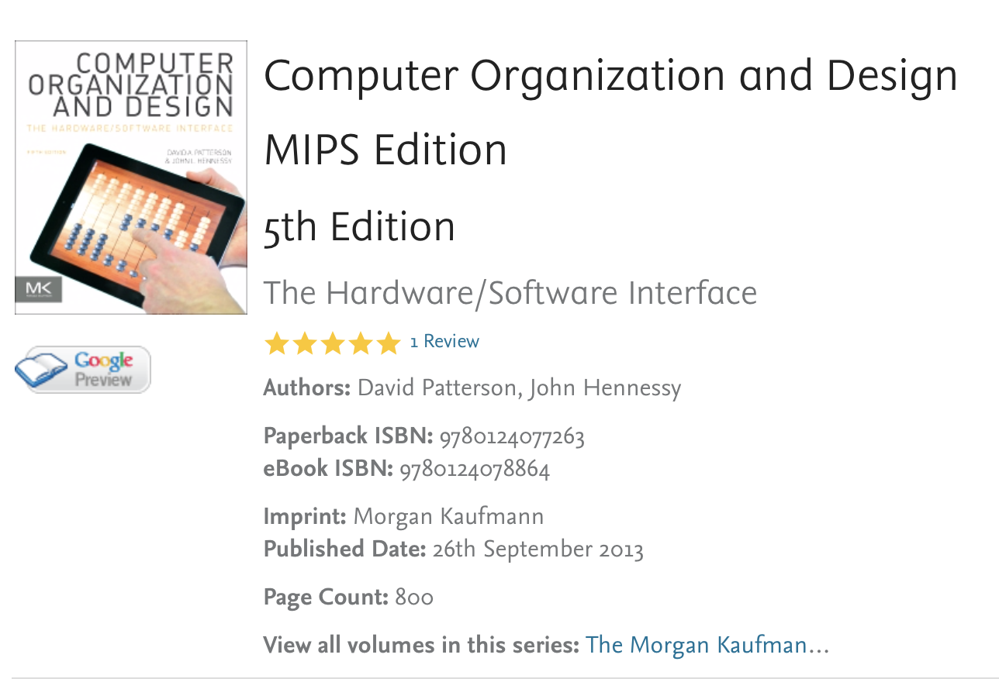
Fifth Edition in 19 Years!
2013

Slide 10
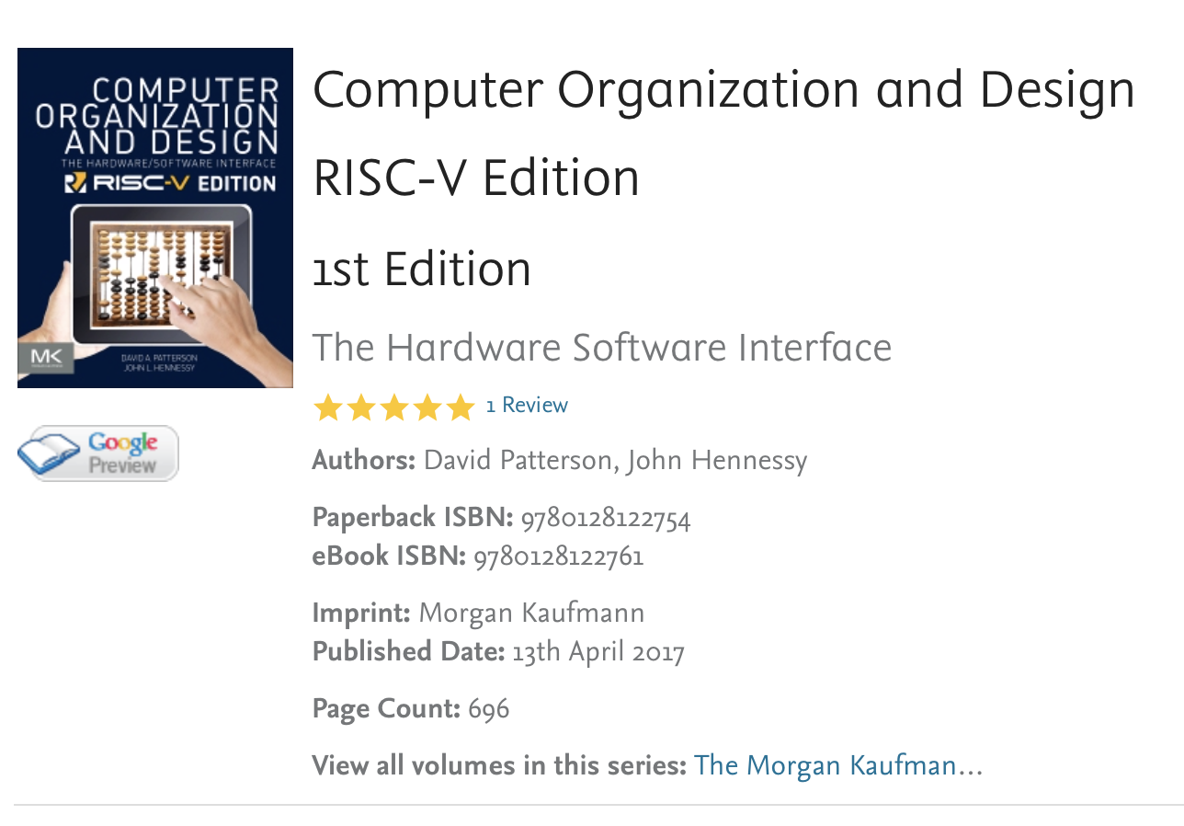
RISC-V Edition (~5th Ed.)
2017

Slide 11
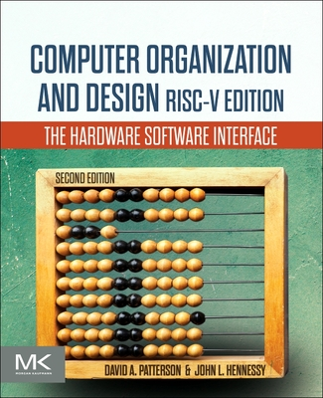
Latest version in 2020/12
Mostly bug fixes and updates

Slide 12
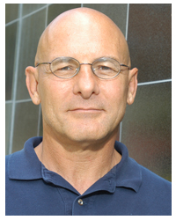
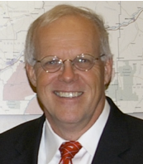
About the Authors
David Patterson
  https://en.wikipedia.org/wiki/David_Patterson_(computer_scientist)
  https://www.eecs.berkeley.edu/Faculty/Homepages/patterson.html
John Hennessy
  https://en.wikipedia.org/wiki/John_L._Hennessy
  http://web.stanford.edu/~hennessy/

Slide 13
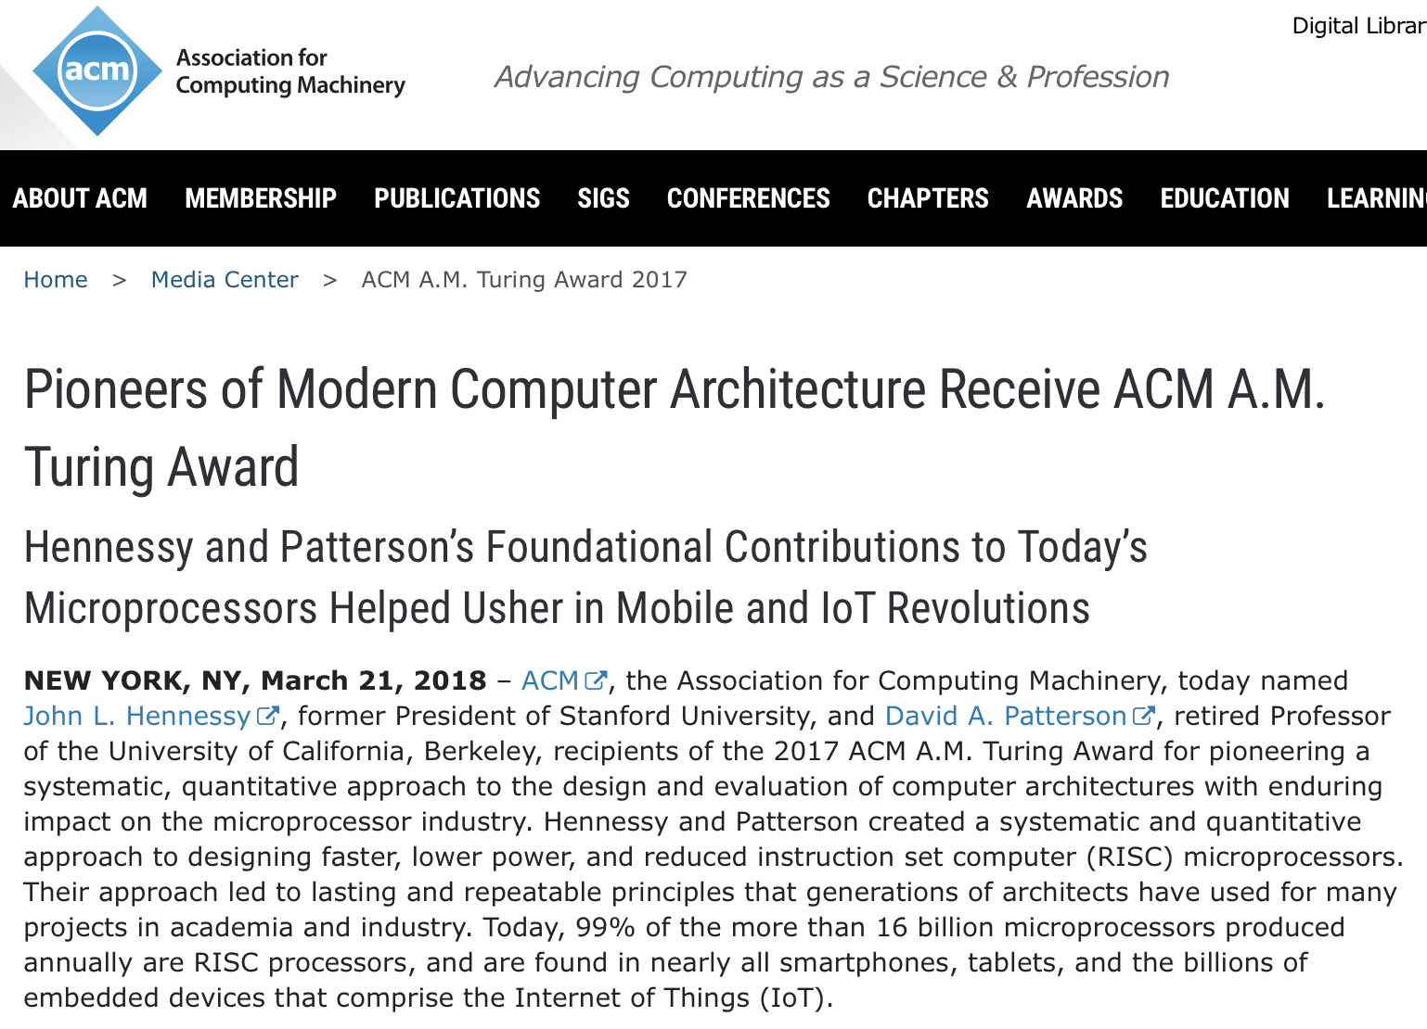

Slide 14
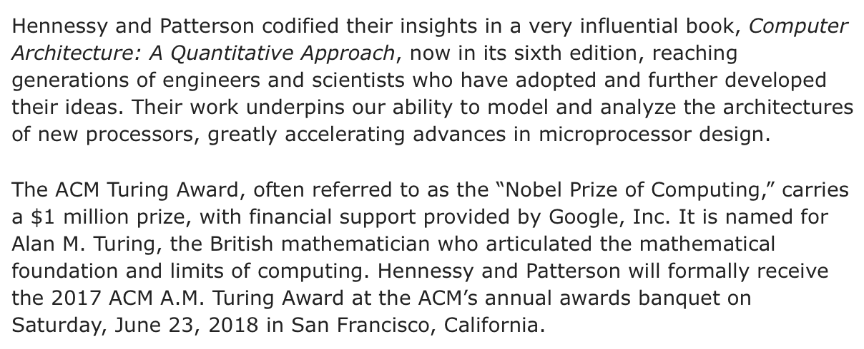
ACM Turing Award

Slide 15
Job Opportunities
If you are really good, jobs are abundant
Well-trained computer architects are wanted in the industry
Not just the knowledge, but also
  Practical skills
  Creativity
  Methodology
  Communication skills
  …

Slide 16
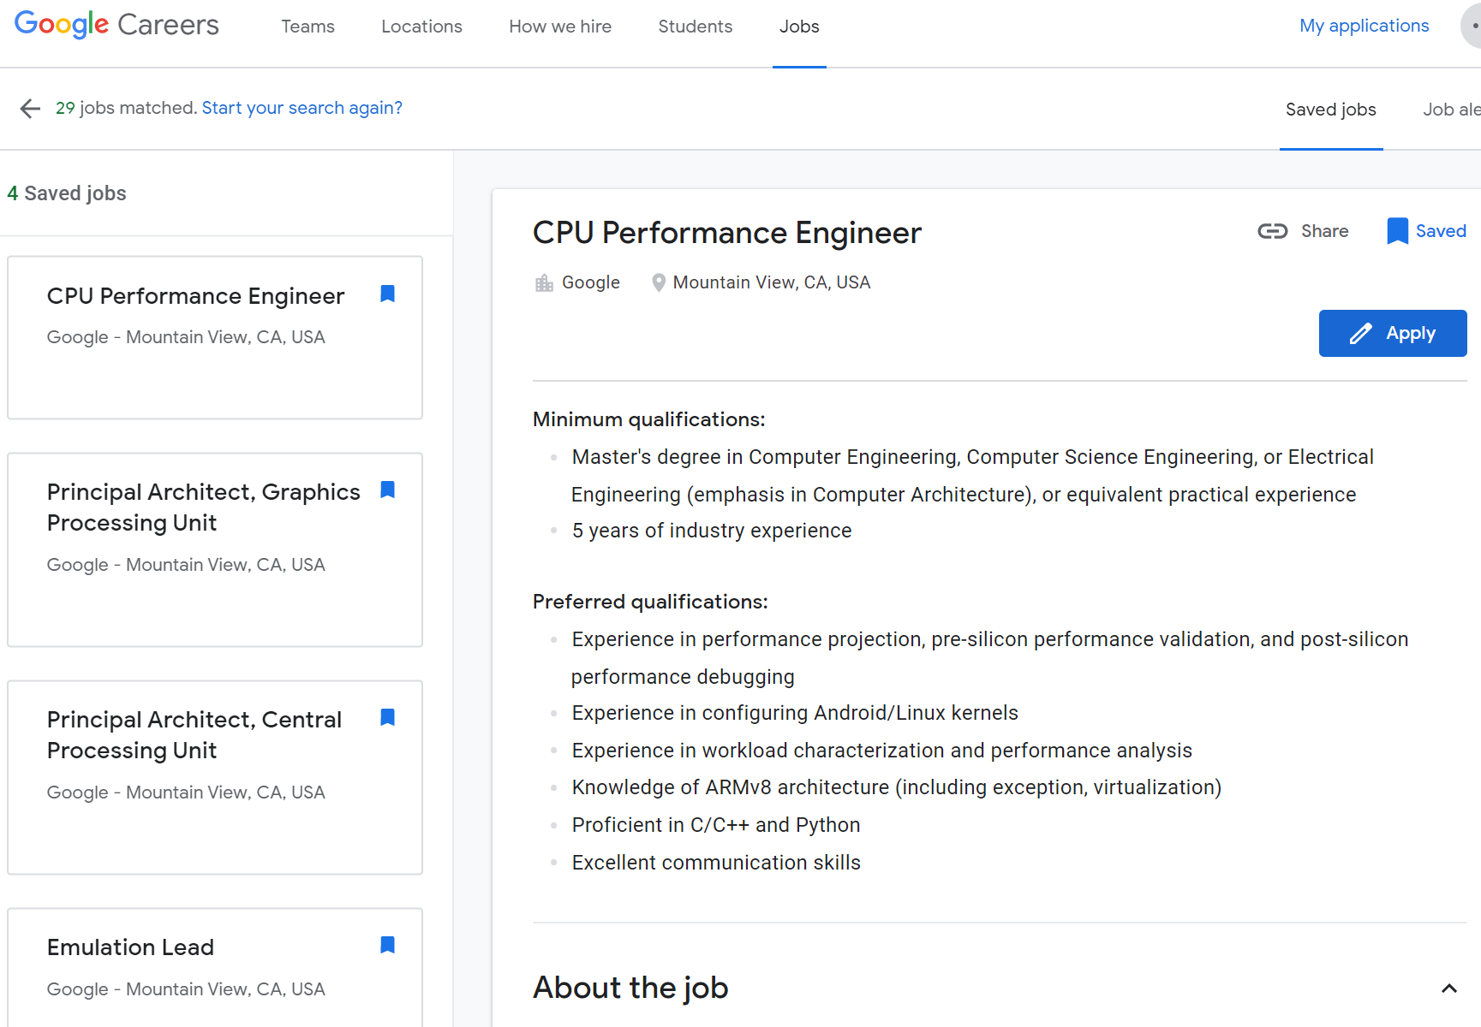
https://careers.google.com/jobs/

Slide 17
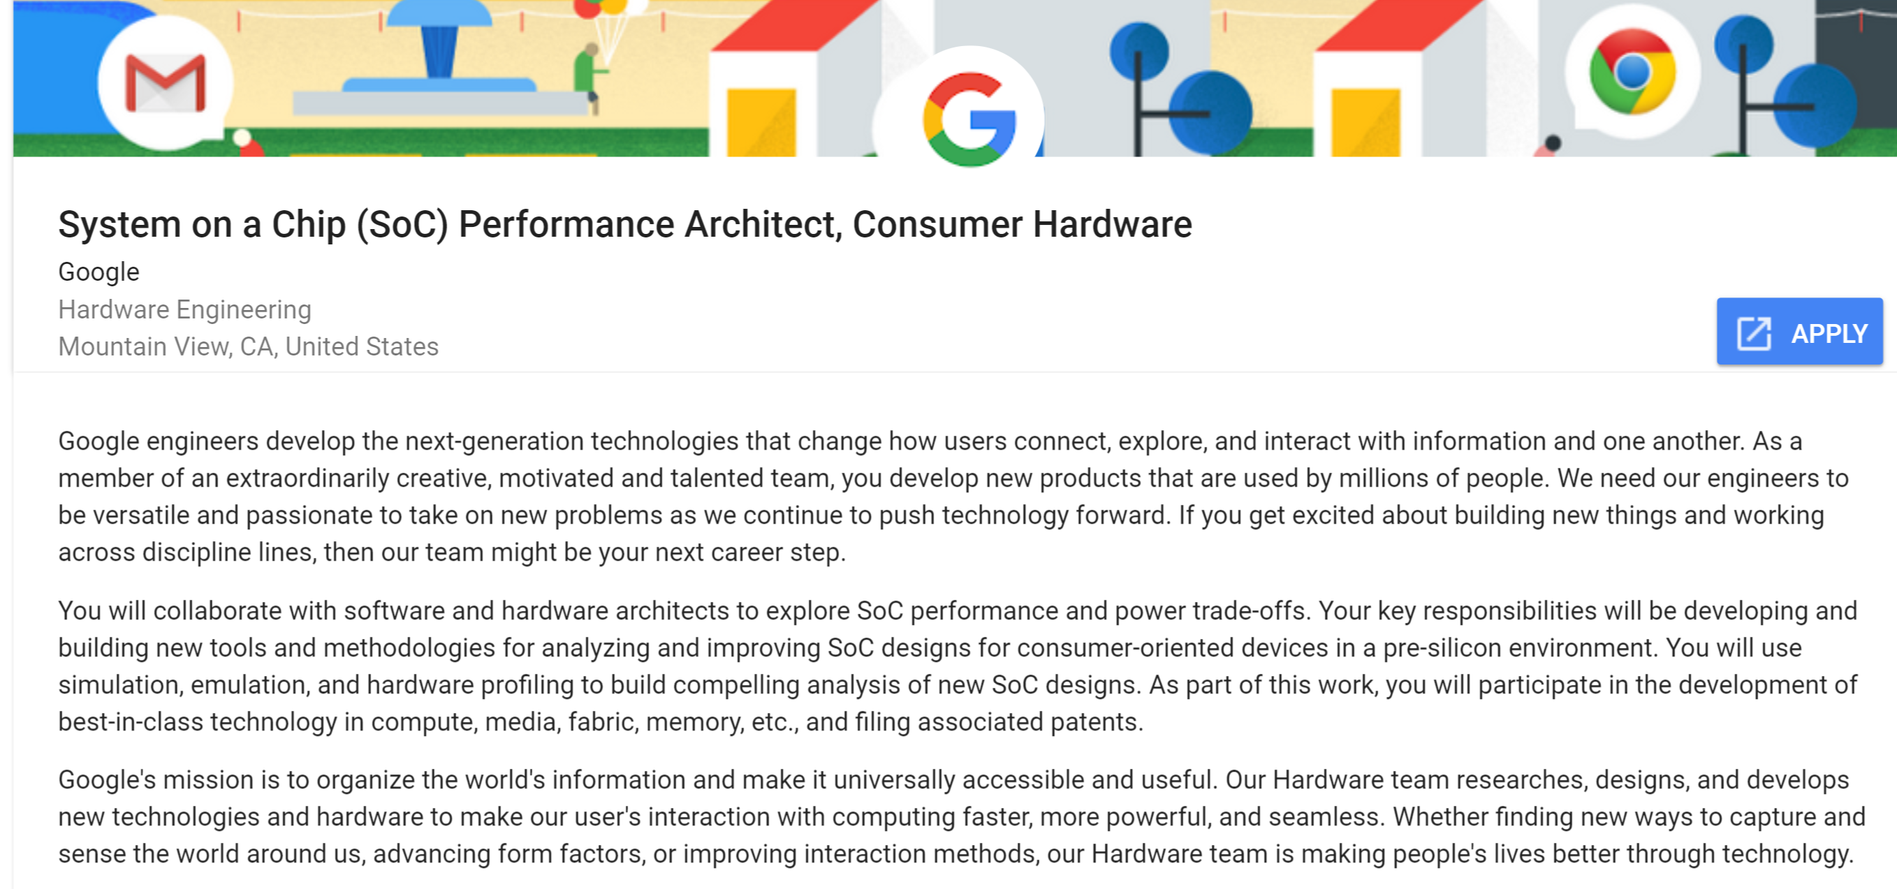
Performance Architect
https://careers.google.com/jobs#!t=jo&jid=/google/system-on-a-chip-soc-performance-1600-amphitheatre-pkwy-mountain-view-ca-3407250819&f=true&
We need our engineers to be versatile and passionate to take on new problems as we continue to push technology forward.
You will collaborate with software and hardware architects to explore SoC performance and power trade-offs... You will use simulation, emulation, and hardware profiling to build compelling analysis of new SoC designs… development of best-in-class technology in compute, media, fabric, memory, etc., and filing associated patents.

Slide 18
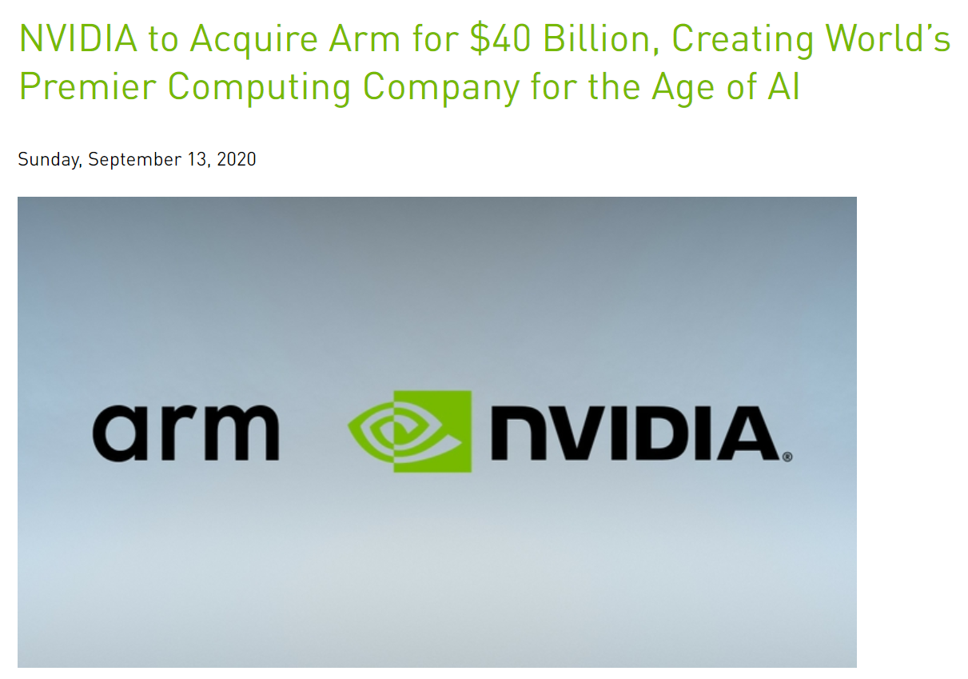
Recent Industrial Trends

Slide 19
Deep Learning x Computer Architecture
Deep Learning and Deep Neural Network were nearly impossible in ‘90s, due to intensive computational requirements
Even fastest multicore CPUs in early ‘00s could not satisfy the requirements
GPUs came to rescue in late ‘00s, reducing training time from weeks to days
Google designed a special-purpose processor, called TPU, to make deep learning far more affordable
Apple, Qualcomm, Huawei, etc. also designed special-purpose processors, a.k.a. neural engines, for mobile phones

Slide 20
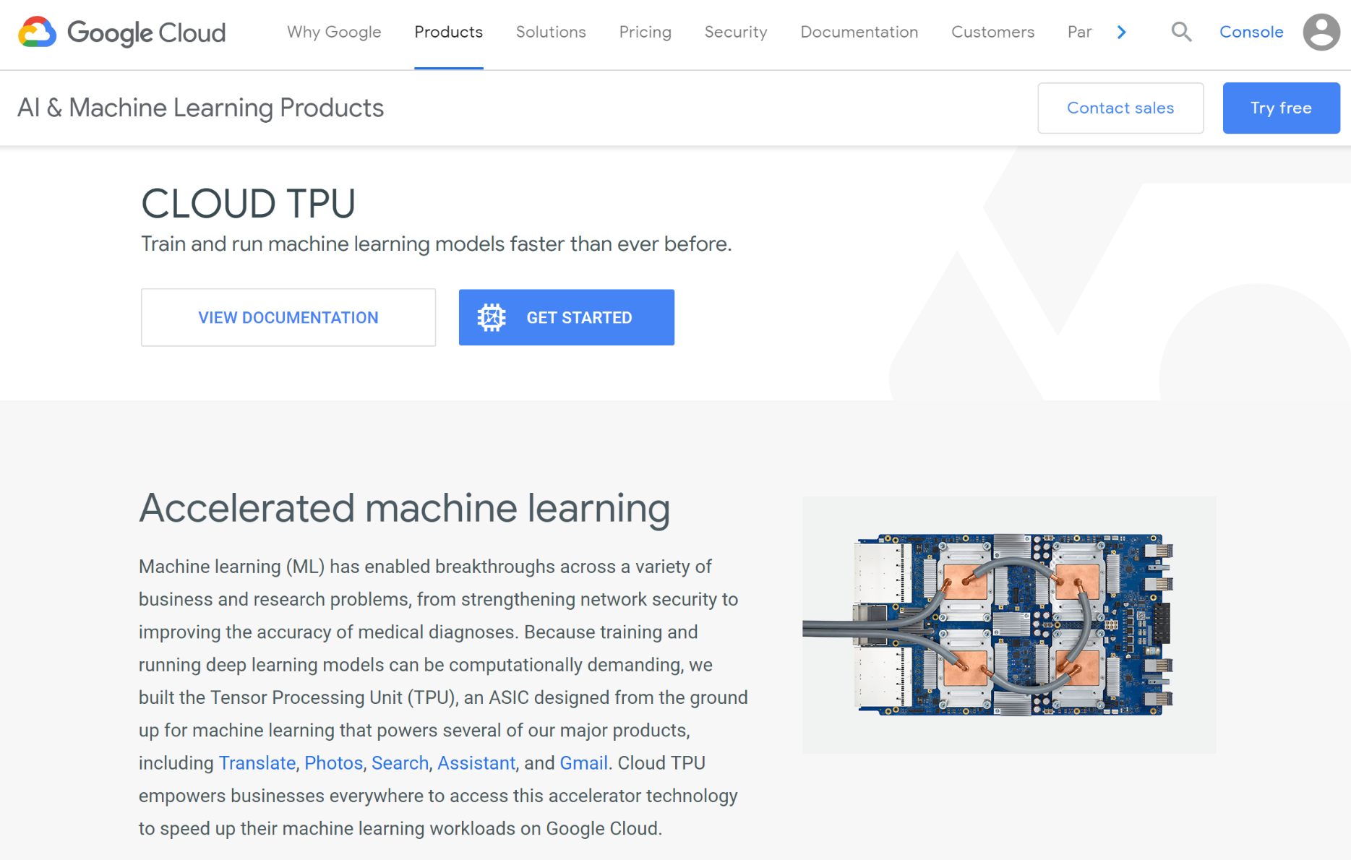
Core Technology#1: Processor Architecture

Slide 21
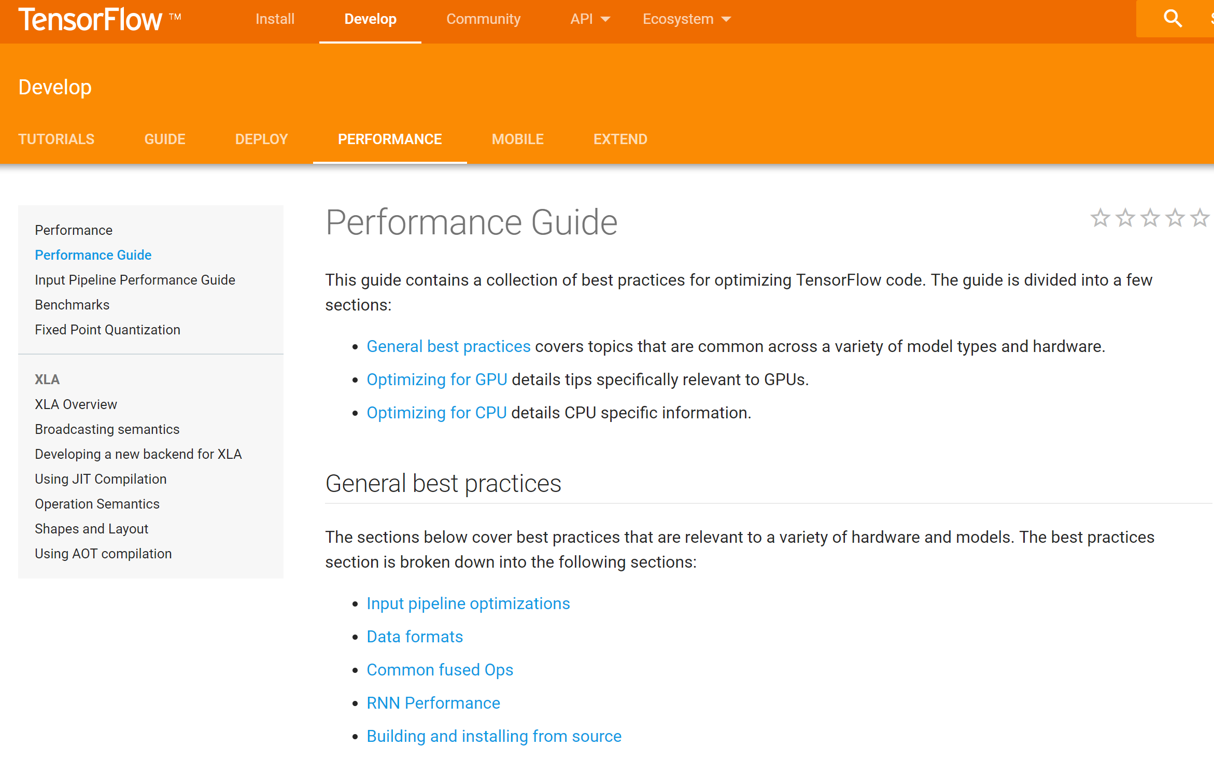
Core Technology#2: Software Optimization

Slide 22
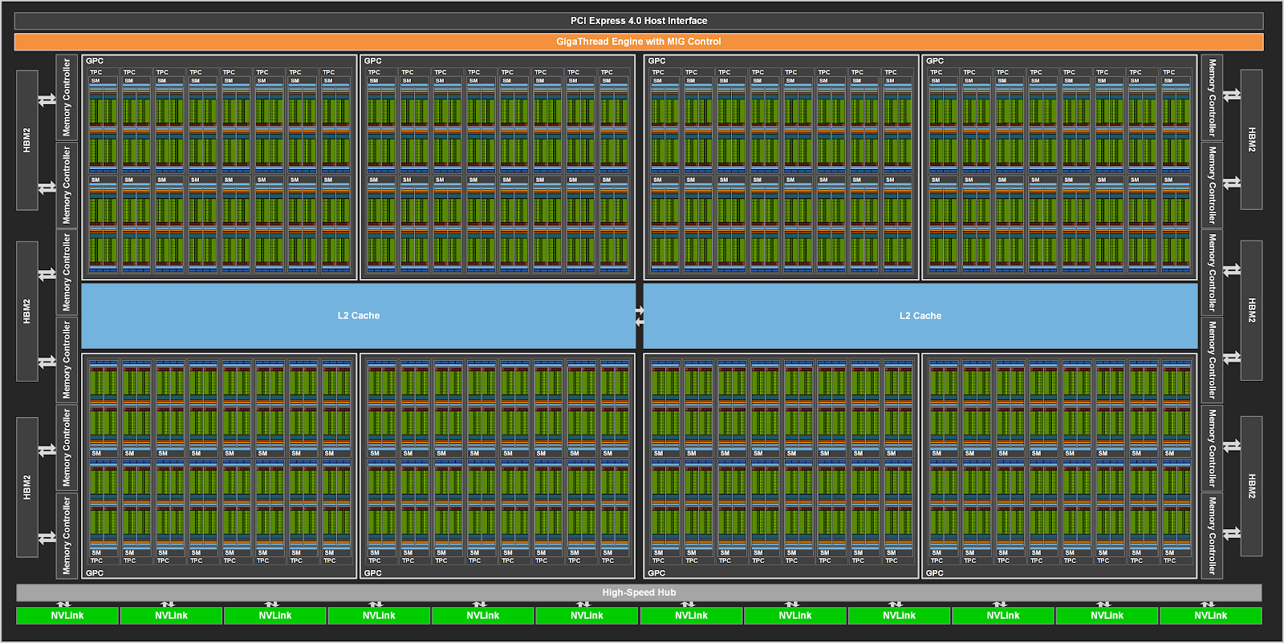
Core Technology#3: Parallel Computing
https://developer.nvidia.com/blog/nvidia-ampere-architecture-in-depth/

Slide 23
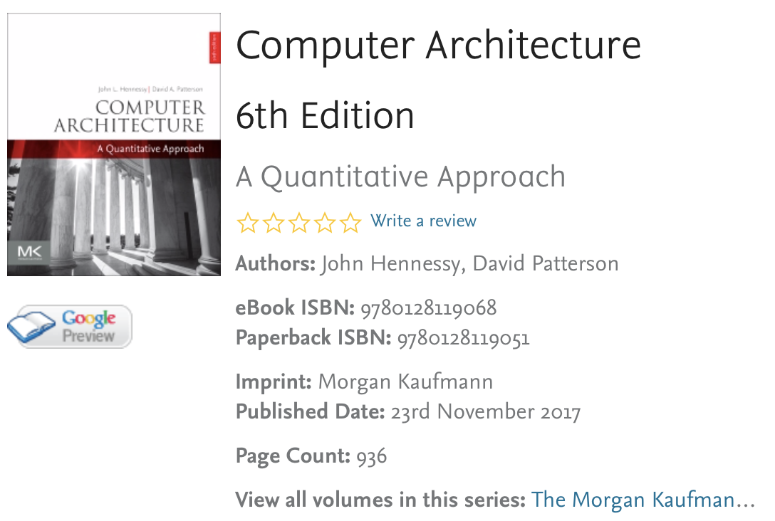
Advanced Contents
2000~2017
6 editions
in 17 years

Slide 24
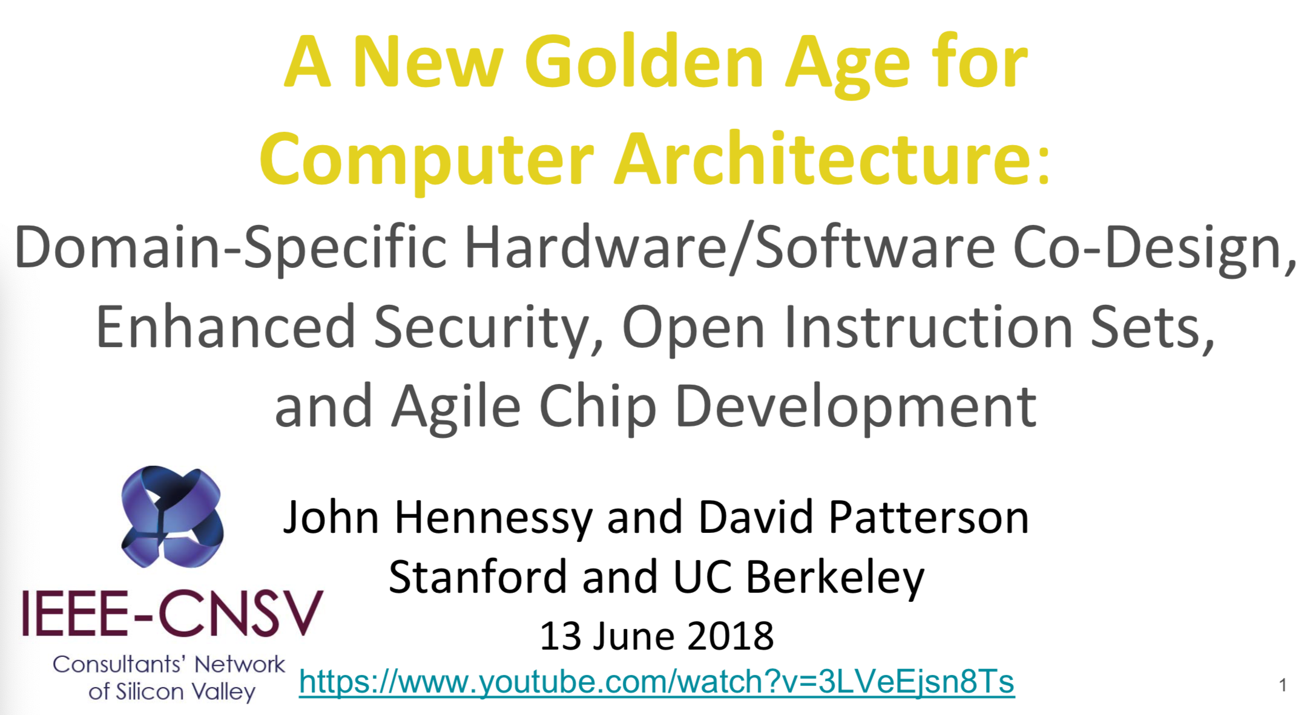

Slide 25
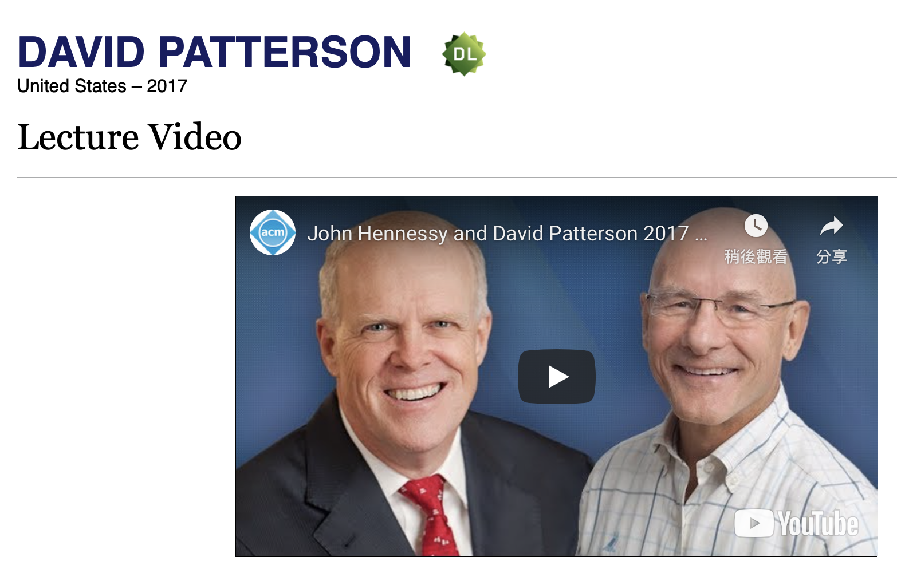
https://amturing.acm.org/vp/patterson_2316693.cfm

Slide 26
Course Outline
NTU Cool:
  Presentation Files
  Exercises

Slide 27
QURESTIONS?

