Slide 1
‘Sonnet 64’ by William Shakespeare
戲劇碩一 李亞潔

Slide 2
‘Sonnet 64’ by William Shakespeare
When I have seen by Time’s fell hand defaced
When I have seen by Time’s fell hand defaced
The rich-proud cost of outworn buried age;
When sometime lofty towers I see down-razed,
And brass eternal slave to mortal rage;
When I have seen the hungry ocean gain
Advantage on the kingdom of the shore,
And the firm soil win of the watery main,
Increasing store with loss and loss with store;
When I have seen such interchange of state,
Or state itself confounded to decay;
Ruin hath taught me thus to ruminate,
That Time will come and take my love away.
This thought is as a death, which cannot choose
But weep to have that which it fears to lose.

Slide 3
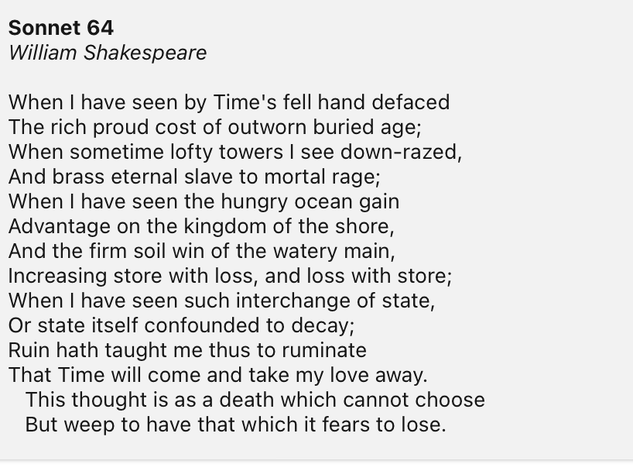
‘Sonnet 64’ by William Shakespeare
Personification & Imagery
  Time consumes everything.
  The forces of nature(sea and land) battle for dominance.
  The poet’s lover is eventually going to decease.
  He mourns this future and admits to fear of that day arriving.
Alliteration
  “buried” and “brass” in lines two
  “win” and “watery” in line seven.

Slide 4
‘Sonnet 64’ by William Shakespeare
“Time’s fell hand” destroys beautiful and important creations.
These are “lofty towers,” or monuments/buildings of men of the past. They are “down-razed”.
  Things would never expect to see destroyed have been destroyed.
  Destructions of these things at the hands of “mortal rage,” or human beings.

Slide 5
‘Sonnet 64’ by William Shakespeare
The constant battles between the land and the sea
  Claiming and reclaiming for territories.
  Increasing and losing.
  Hungry for gain.

Slide 6
‘Sonnet 64’ by William Shakespeare
The force of time
  take away his love’s beauty and good graces
  remove the Fair Youth from the earth
  the larger, worldly influences of time.
Self-reflective
  the speaker’s personal sorrow.
  His loss
  His profound love

Slide 7
‘Sonnet 64’ by William Shakespeare
老師指點和建議
He thinks of the death of his youthful love and the thought itself feels like death. It makes him “weep” over that which knows he must eventually lose.
This thought = only thinking of his lover will decease someday
This thought is unbearably painful and deadening

Slide 8
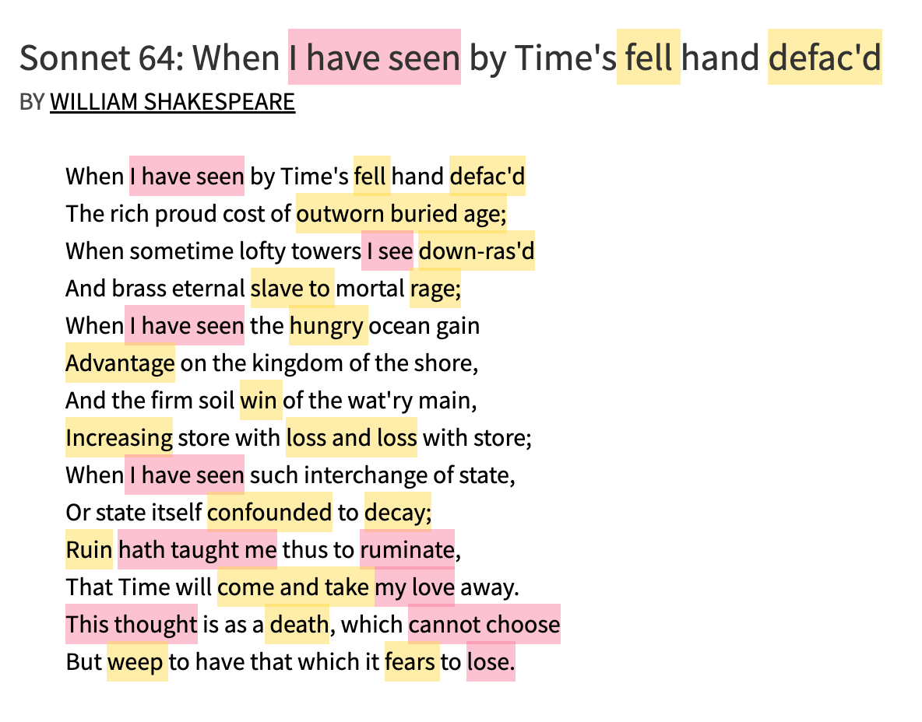
Pink
  Self-reflection
  Subjectivity
Yellow
  Draws out a landscape of the loss and the destruction of time

Slide 9
‘Sonnet 64’ by William Shakespeare
Structure
  Sonnet
  Iambic pentameter
Poetic techniques
  Personification
  Imagery
  Alliteration
Themes
  Time
  Inevitable changes
  Eternal love for the fair youth

Slide 10
‘Sonnet 64’ by William Shakespeare
戲劇碩一 李亞潔

