Slide 1
No-arbitrage Term Structure Models
Chapter 32
No-Arbitrage Models of the Short Rate
A no-arbitrage model is a model designed to fit today’s term structure of interest rates

Slide 2
Developing No-Arbitrage
Model for r
A model for r can be made to fit the initial term structure by including a function of time in the drift

Slide 3
Ho-Lee Model
dr = θ(t)dt + σdz
Many analytic results for bond prices and option prices
Interest rates normally distributed
One volatility parameter, σ
All forward rates have the same standard deviation

Slide 4
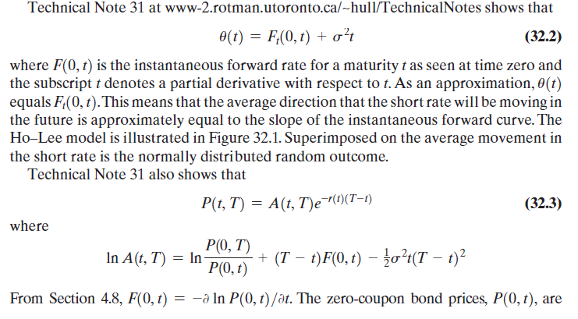

Slide 5
Diagrammatic Representation of Ho-Lee (Figure 32.1)
Short Rate
r
r
r
r
Time

Slide 6
Hull-White Model
dr = [θ(t ) – ar ]dt + σdz
Many analytic results for bond prices and option prices
Two volatility parameters, a and σ
Interest rates normally distributed
Standard deviation of a forward rate is a declining function of its maturity

Slide 7
Diagrammatic Representation of Hull and White (Figure 32.2)
r
Short Rate
r
Forward Rate
Curve
r
r
Time

Slide 8
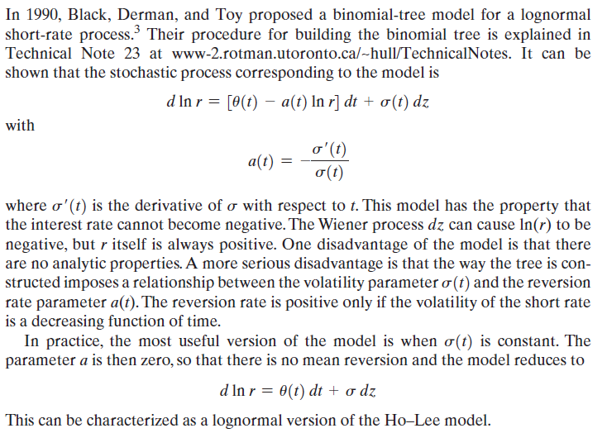
BDT Model

Slide 9
Options on Zero-Coupon Bonds (equation 32.10)
In Vasicek and Hull-White model, price of call maturing at T on a zero-coupon bond lasting to s is
LP(0,s)N(h)−KP(0,T)N(h−σ_{P})
Price of put is
KP(0,T)N(−h+σ_{P})−LP(0,s)N(h)
where

Slide 10
Options on Coupon-Bearing Bonds
In a one-factor model a European option on a coupon-bearing bond can be expressed as a portfolio of options on zero-coupon bonds.
We first calculate the critical interest rate at the option maturity for which the coupon-bearing bond price equals the strike price at maturity
The strike price for each zero-coupon bond is set equal to its value when the interest rate equals this critical value

Slide 11
4. Two-Step Tree Example (Figure 32.4)
Payoff after 2 years is max[100(r – 0.11), 0]
p_{u}=0.25; p_{m}=0.5; p_{d}=0.25; Time step=1yr
14% 3
12% 1.11*
12% 1
10%
0.35**
10% 0.23
10% 0
8% 0
8% 0.00
6% 0
*: (0.25×3 + 0.50×1 + 0.25×0)e^{–0.12×1}
**: (0.25×1.11 + 0.50×0.23 +0.25×0)e^{–0.10×1}

Slide 12
Alternative Branching Processes in a Trinomial Tree (Figure 32.5)
(a)
(b)
(c)

Slide 13
Example
σ = 0.01
a = 0.1
Δt = 1 year
Maturity | Zero Rate
0.5 | 3.430
1 | 3.824
1.5 | 4.183
2 | 4.512
2.5 | 4.812
3 | 5.086

Slide 14
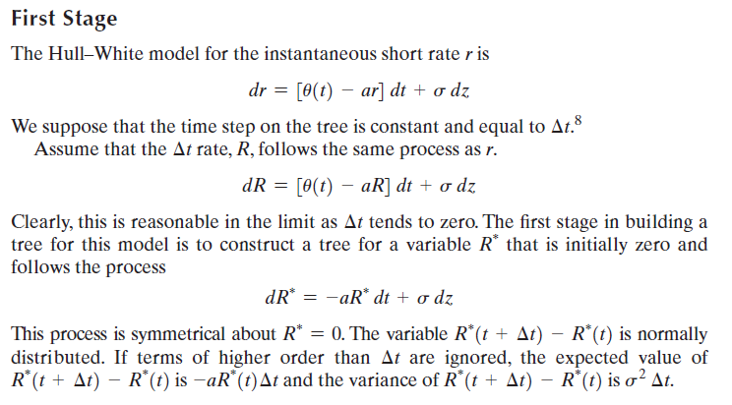

Slide 15
Building the First Tree for the Δt rate R
Set vertical spacing:
Change branching when j_{max} nodes from middle where j_{max} is smallest integer greater than 0.184/(aΔt)
Choose probabilities on branches so that mean change in R is -aRΔt and S.D. of change is

Slide 16
The First Tree
(Figure 32.6)
E
B
F
C
G
A
D
H
I
Node
A
B
C
D
E
F
G
H
I
R
0.000%
1.732%
0.000%
-1.732%
3.464%
1.732%
0.000%
-1.732%
-3.464%
p
u
0.1667
0.1217
0.1667
0.2217
0.8867
0.1217
0.1667
0.2217
0.0867
p
m
0.6666
0.6566
0.6666
0.6566
0.0266
0.6566
0.6666
0.6566
0.0266
p
d
0.1667
0.2217
0.1667
0.1217
0.0867
0.2217
0.1667
0.1217
0.8867

Slide 17
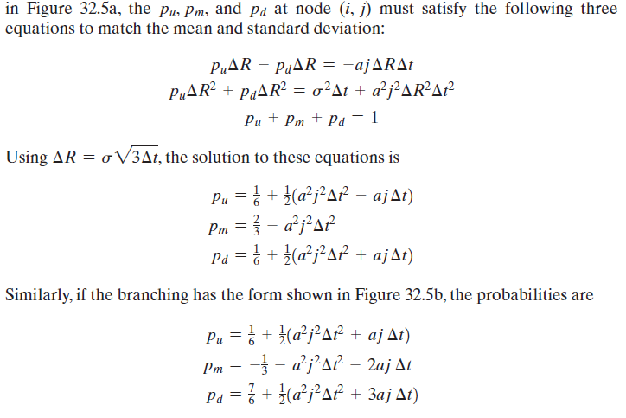

Slide 18
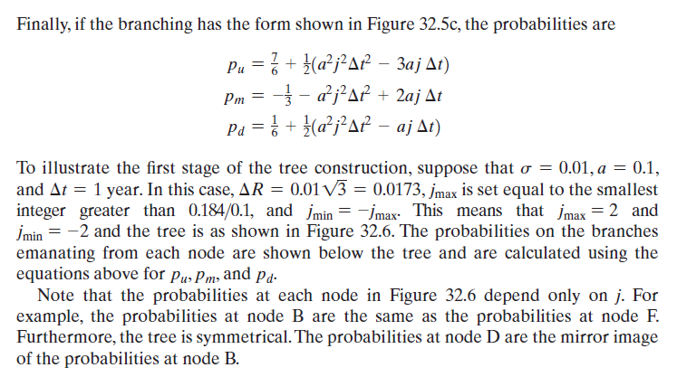

Slide 19
Shifting Nodes
Work forward through tree
Remember Q_{ij} the value of a derivative providing a $1 payoff at node j at time iΔt
Shift nodes at time iΔt by α_{i} so that the (i+1)Δt bond is correctly priced

Slide 20
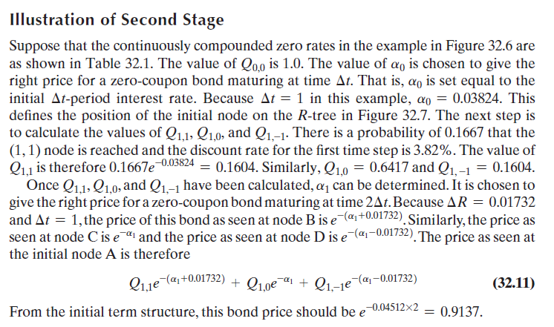

Slide 21
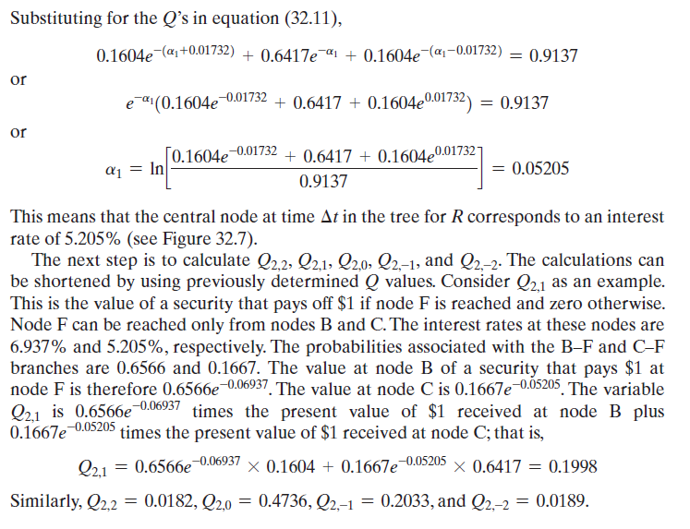

Slide 22
The Final Tree
(Figure 31.7)
E
F
B
G
C
A
H
D
I
Node
A
B
C
D
E
F
G
H
I
R
3.824% 6.937%
5.205%
3.473%
9.716%
7.984%
6.252%
4.520%
2.788%
p
u
0.1667
0.1217
0.1667
0.2217
0.8867
0.1217
0.1667
0.2217
0.0867
p
m
0.6666
0.6566
0.6666
0.6566
0.0266
0.6566
0.6666
0.6566
0.0266
p
d
0.1667
0.2217
0.1667
0.1217
0.0867
0.2217
0.1667
0.1217
0.8867

