Slide 1
Trigonometric Functions (3-1)
Definition of Trigonometric Functions 2

Slide 2
Outline
Trigonometric Functions on the Unit Circle
數學系 蔡雅如老師

Slide 3
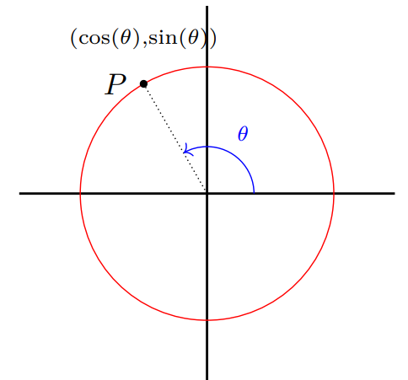
Unit Circle
Definition (Unit Circle 單位圓).
  Question
  How does one define trigonometric functions
  on the unit circle?

Slide 4
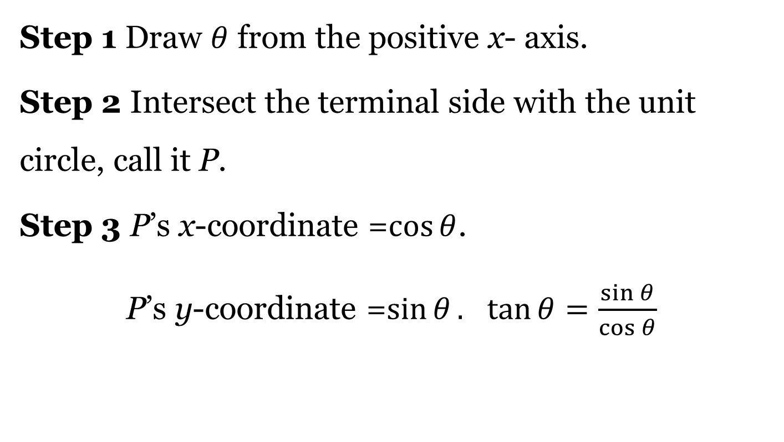
Unit Circle
  Define trigonometric functions on a unit circle

Slide 5
Unit Circle
Example

Slide 6
Unit Circle
Example

Slide 7
Review
How do we define trigonometric functions on a unit circle?
數學系 蔡雅如老師

