Slide 1
Trigonometric Functions (1)
Definition of Trigonometric Functions 1

Slide 2
Outline
Angles
Trigonometric functions in a right-angled triangle
Special angles
Reciprocal trigonometric functions
數學系 蔡雅如老師

Slide 3
Outline
Angles
Trigonometric functions in a right-angled triangle
Special angles
Reciprocal trigonometric functions
數學系 蔡雅如老師

Slide 4


Angles
An angle is formed when two rays are emitted from a common point. Think of an angle as an ‘oriented’ measurement that we measure from the initial side to the terminal side.
terminal side (終止邊)
initial side (起始邊)
initial side (起始邊)
terminal side (終止邊)
anticlockwise
clockwise

Slide 5
Outline
Angles
Trigonometric functions in a right-angled triangle
Special angles
Reciprocal trigonometric functions
數學系 蔡雅如老師

Slide 6

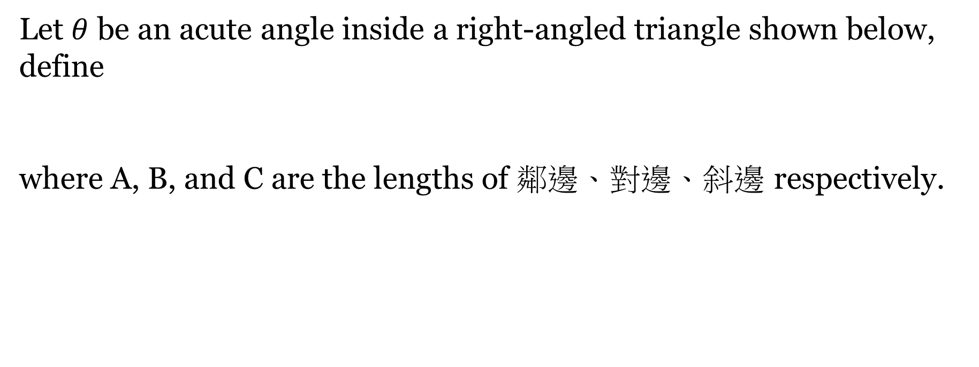

Trigonometric functions in a right-angled triangle
Definition (Trigonometric functions 三角函數).
hypotenuse(斜邊)
C
B
opposite side
(對邊)
A
adjacent side (斜邊)

Slide 7
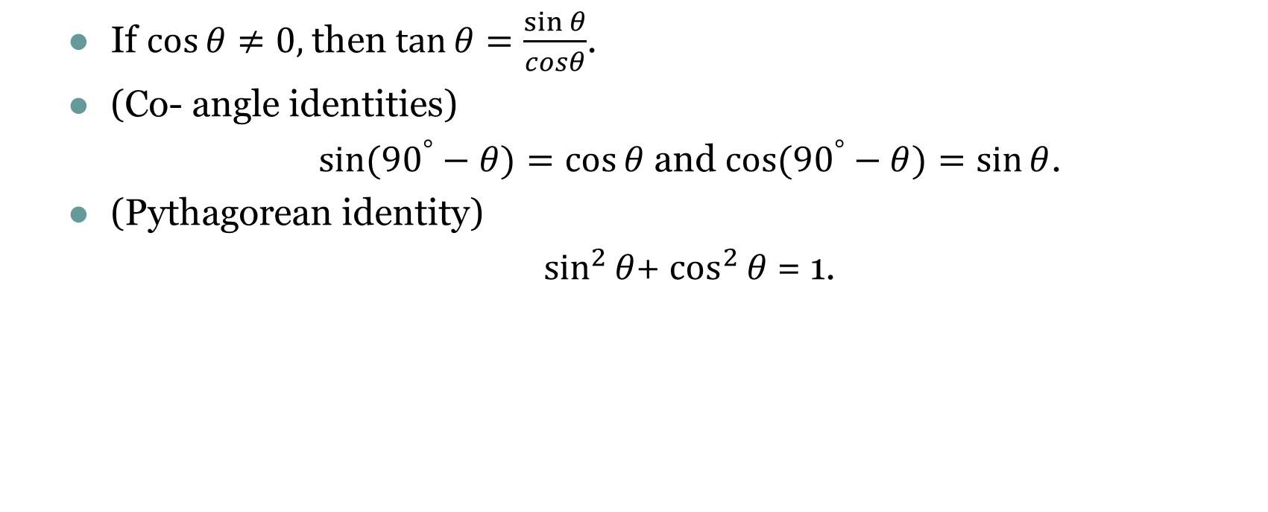
Trigonometric functions in a right-angled triangle
Proposition

Slide 8
Outline
Angles
Trigonometric functions in a right-angled triangle
Special angles
Reciprocal trigonometric functions
數學系蔡雅如老師

Slide 9


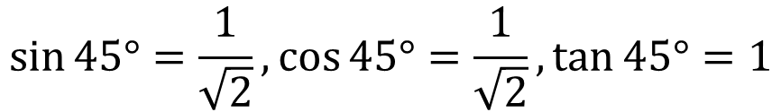

Special Angles
1
1
Isosceles right triangle (等腰直角三角形)

Slide 10
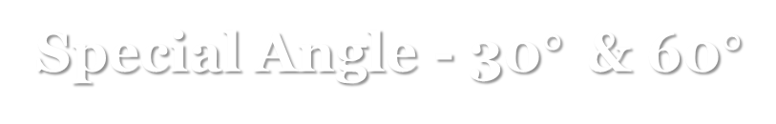
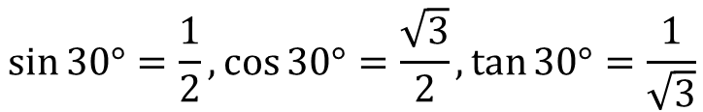

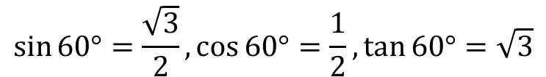


Special Angles
2
2
2
2
Equilateral triangle (正三角形) & 30-60-90 traingle

Slide 11
Outline
Angles
Trigonometric functions in a right-angled triangle
Special angles
Reciprocal trigonometric functions
數學系蔡雅如老師

Slide 12

Reciprocal trigonometric functions
Definition (secant, cosecant, cotangent).
The secant, cosecant and cotangent functions are defined as
respectively.

Slide 13
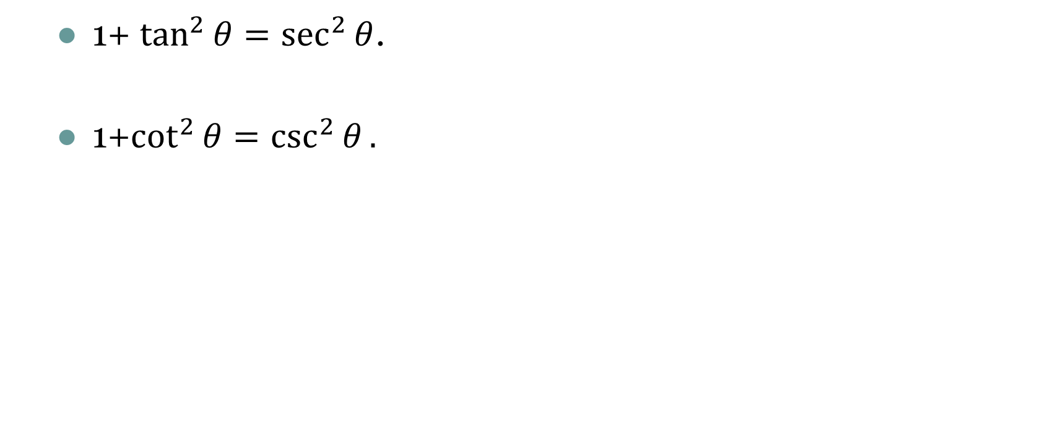
Reciprocal trigonometric functions
Proposition

Slide 14
Review
What is an angle?
What are trigonometric functions?
How do we evaluate trigonometric functions at special angles?
What are reciprocal trigonometric functions?
數學系 蔡雅如老師

