Slide 1
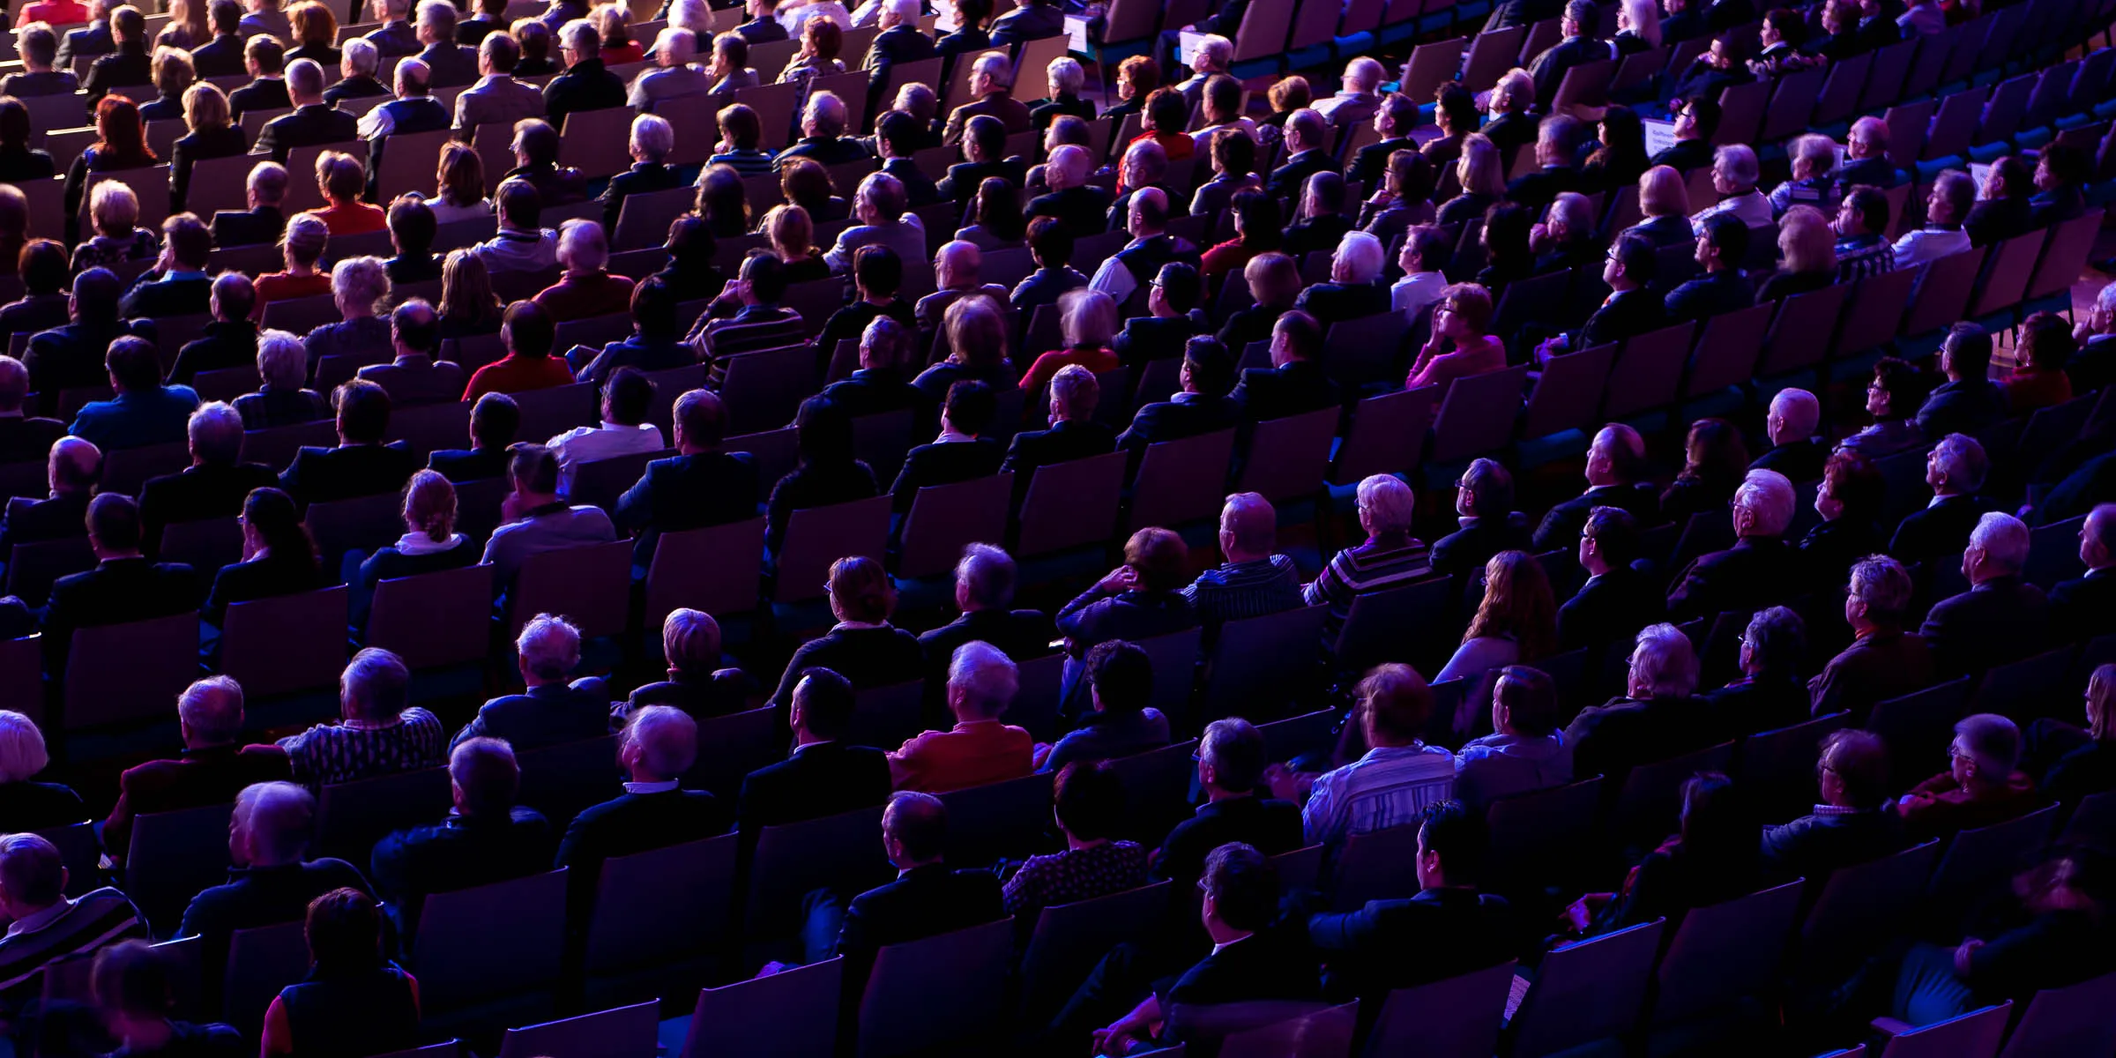
Write 7015
English Writing for Academic Purposes
Presentation Skills Day 3
Notes:
Image used in the preview file : https://unsplash.com/photos/16eva2FRETo
To insert the picture, just drag the image from your file explorer to the this template placeholders

Slide 2
English for Academic Writing (with Kevin) - Schedule
Date | Topic
3/3 | What is the Three Minute Thesis Presentation Basics
3/10 | Scriptwriting Voice Technique Slide Design
3/17 | 3MT Workshop Scriptwriting Voice Technique
3/24 | Scriptwriting with AI 3MT Workshop Poster Presentation Design
3/31 | Three Minute Thesis Presentations Conference Presentation design

Slide 3
Evaluation
3/31
  3 Minute Thesis Presentation
    3 minutes
    Targeted at a general audience
    Present your graduate research
      Or any other research…
    Engage the audience

Slide 4
Schedule Today
Period 3 (10:20-11:10)
  3MT Workshop
    共同303
    共同402
    共同401

Slide 5


Slide 6
How to make your voice more dynamic and expressive
Regulating / Chunking
Emphasis
Intonation

Slide 7
Regulating / Chunking
The artificial control over speaking in which the speaker breaks up the spoken line into smaller parts and puts silent beats between them

Slide 8

Levels of Emphasis
Stressing certain words to highlight importance

Slide 9

Levels of Emphasis
Conveying importance or seriousness in other ways besides just stress

Slide 10
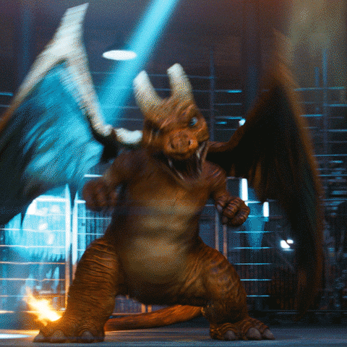
Levels of emphasis
Expressing your own opinions or feelings, or expressing your audiences feelings or reactions

Slide 11
Intentional Intonation
Yeah, that’s right. = Statement
Yeah, that’s right. = Sarcasm
Yeah, that’s right? = Question

Slide 12


Slide 13
Agenda
Poster Presentation Design
3MT Workshop
Scriptwriting with AI

Slide 14
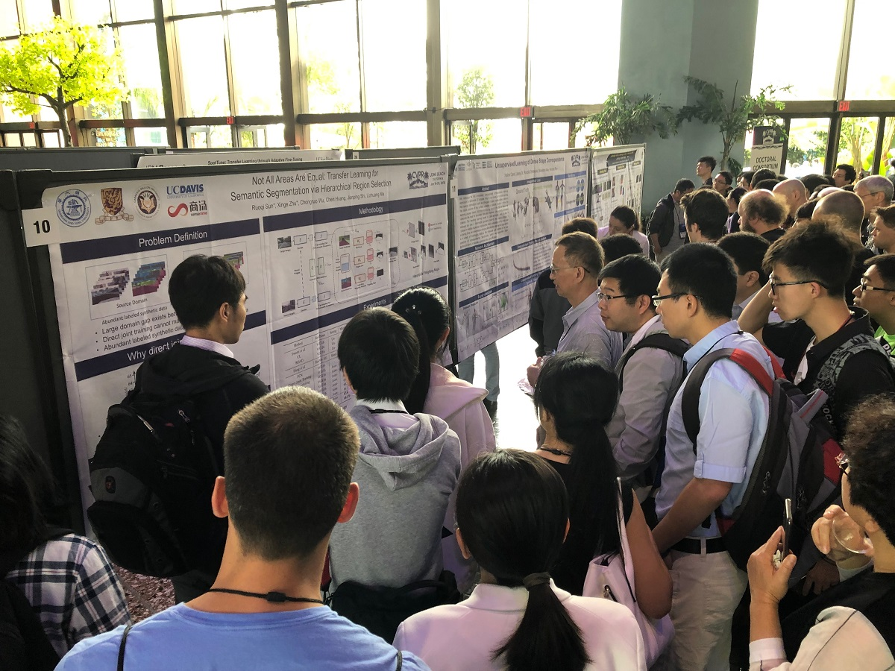
01
Poster Presentation Design
Notes:
Image used in the preview file : https://unsplash.com/photos/ZqLeQDjY6fY

Slide 15



Slide 17


Slide 18


Slide 19
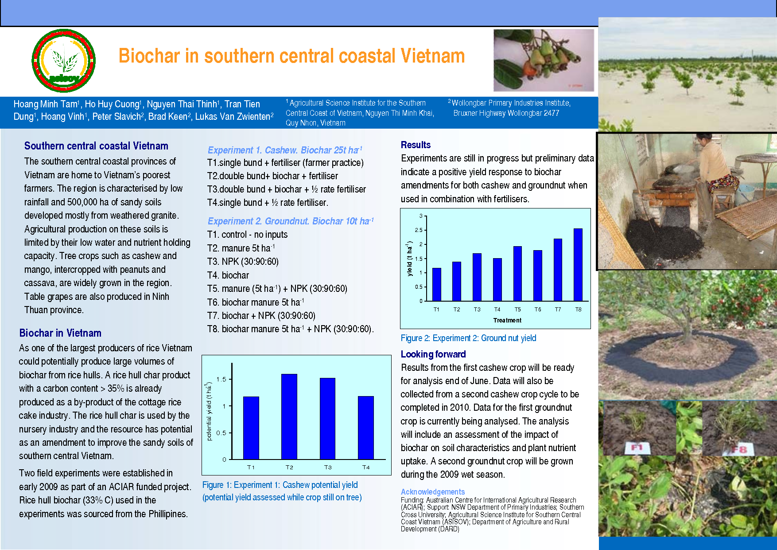

Slide 20
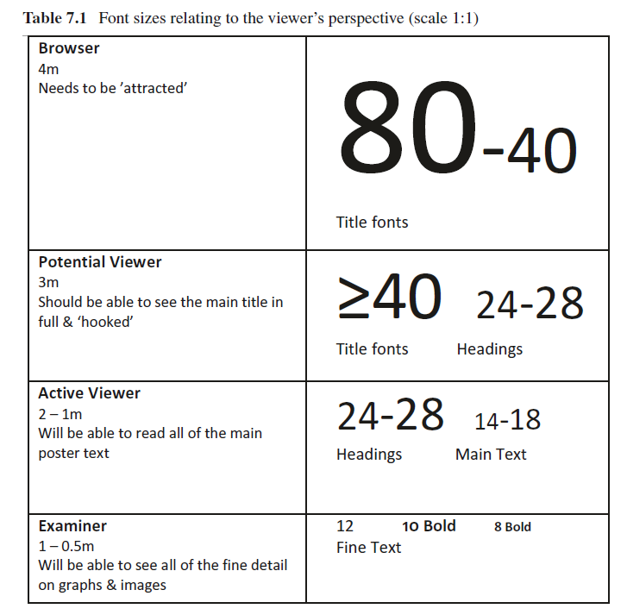

Slide 21
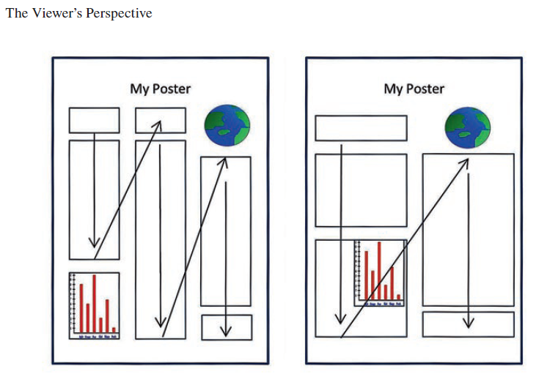

Slide 22
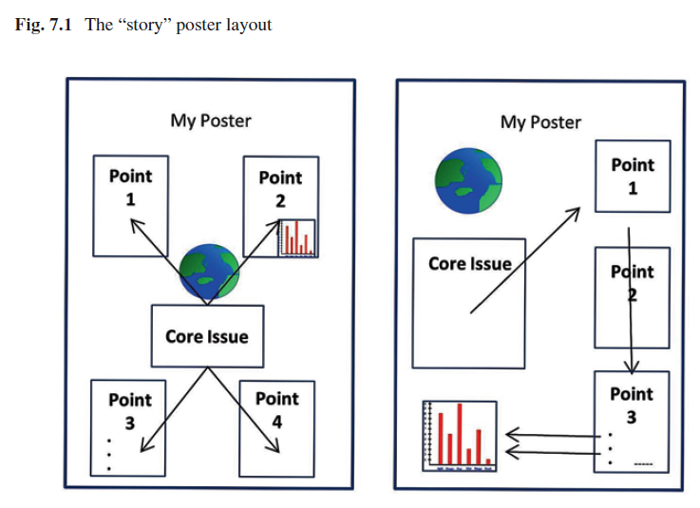

Slide 23
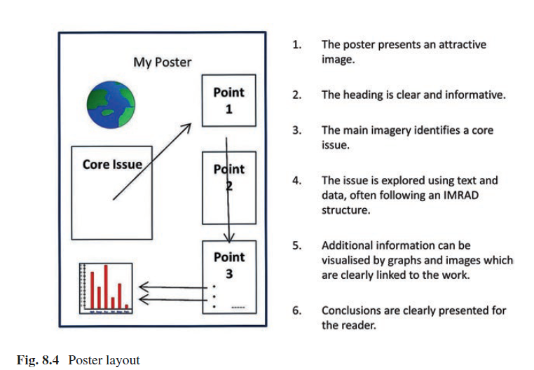

Slide 24
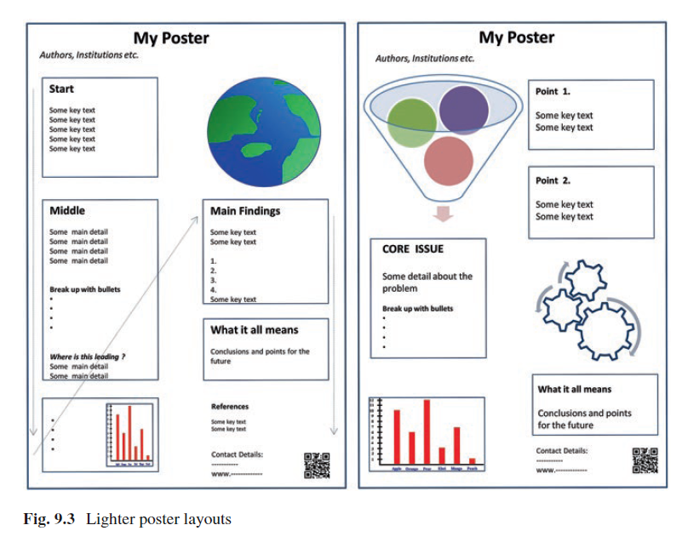

Slide 25
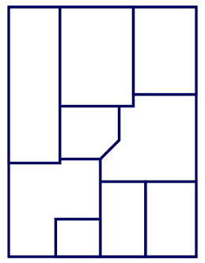
How would you read this?
Discuss with a partner and label with numbers

Slide 26
B
C
A
D
E
F
H
I
G

Slide 27
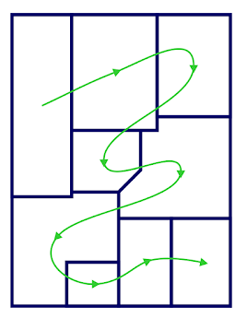

Slide 28
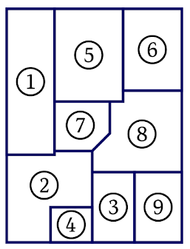
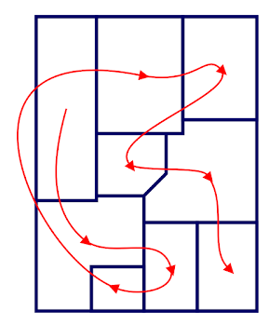

Slide 29


Slide 30
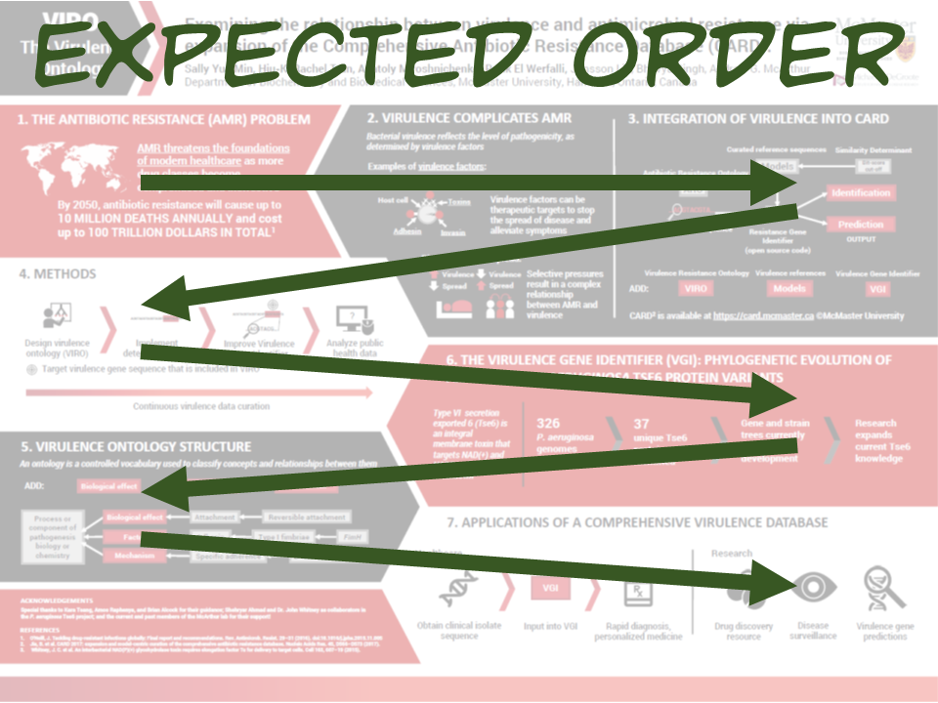

Slide 31
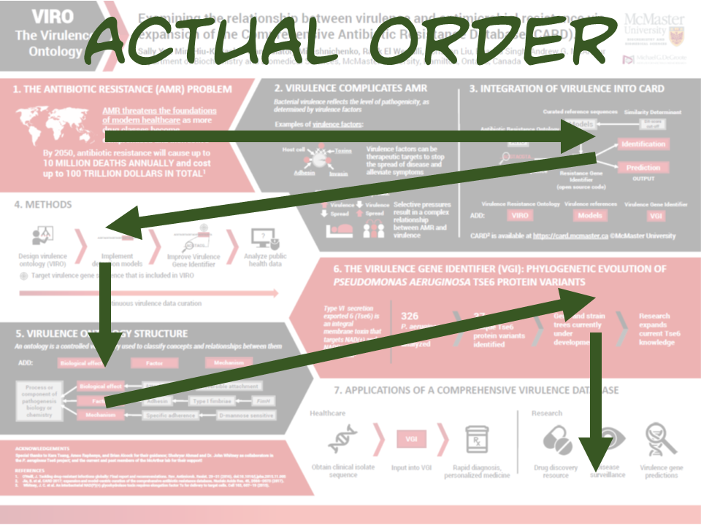

Slide 32
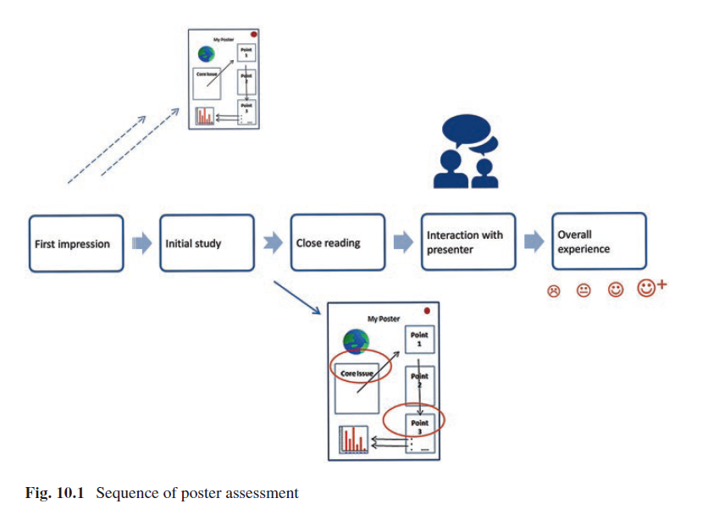

Slide 33
Poster Design Critique
We will look at some posters
Discuss with a partner
  What do you like/dislike?

Slide 34


Slide 35
Poster Design Critique
Good
  Solid three column layout with most things correctly aligned

Slide 36
Poster Design Critique
Bad
  So much grey (from too much text)
  Title Bookends
    Maybe ok because there are at least larger graphics…
  Abstract is not usually shown on the poster
  Lines dividing text instead of white space
    Clear indication of trying to put too much information

Slide 37


Slide 38
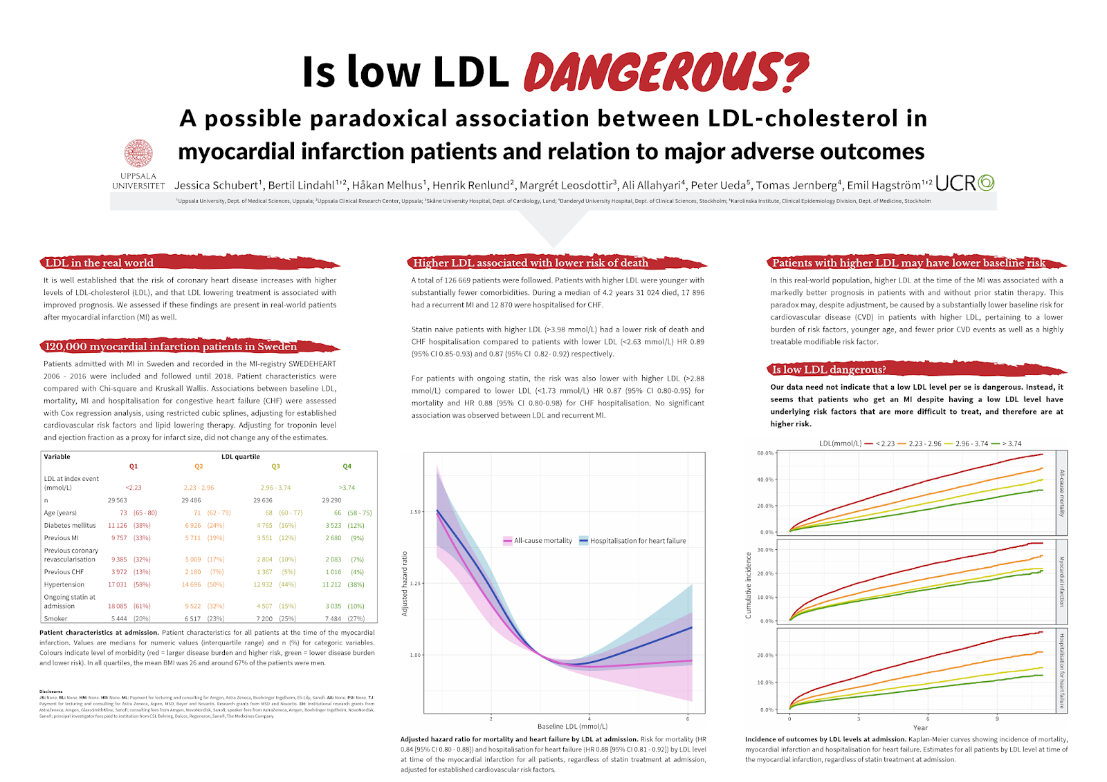

Slide 39
Poster Design Critique
Good
  Great title bar!
    Really pops out and grabs attention
      Could be stronger with the right font
  Section headers are nice
    Easy to identify sections
      Could be bigger to differentiate from other text
    “LDL in the real world” instead of “Introduction”

Slide 40
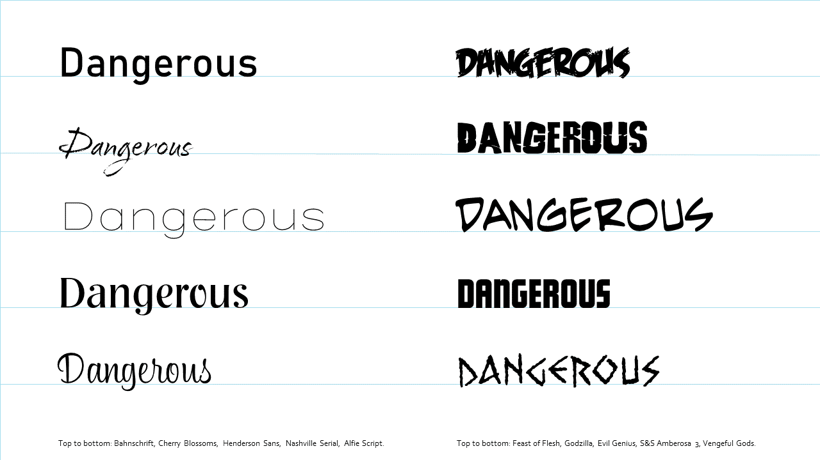
Poster Design Critique

Slide 41
Poster Design Critique
Bad
  Positioning of the logos seems too close to the author lines
    A lot of white space
  Alignment could be more consistent and tighter
  Margins are not even
  Colors too light in places
  No visuals that tell you what this is about

Slide 42
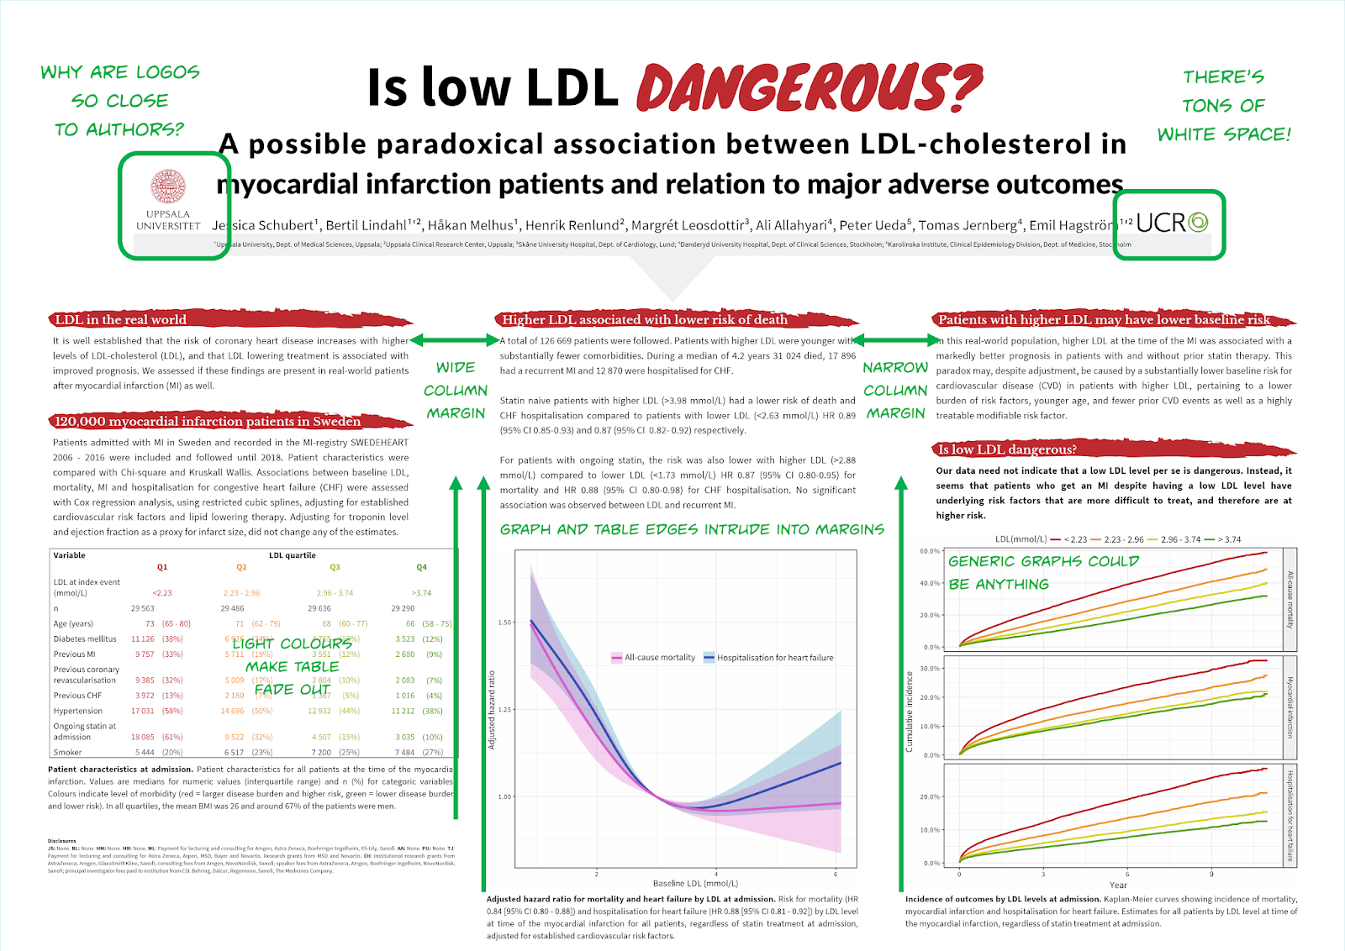

Slide 43


Slide 44
Poster Design Critique
Good
  Visual appeal
    Backdrop used to position text blocks on top on circles
      Slightly awkward, but not a big deal

Slide 45
Poster Design Critique
Bad
  Background causes some issues
    Because of the use of the circles, everything else has to revolve round them
  Things are not aligned or next to what they refer to
    Graphs
    Numbers

Slide 46
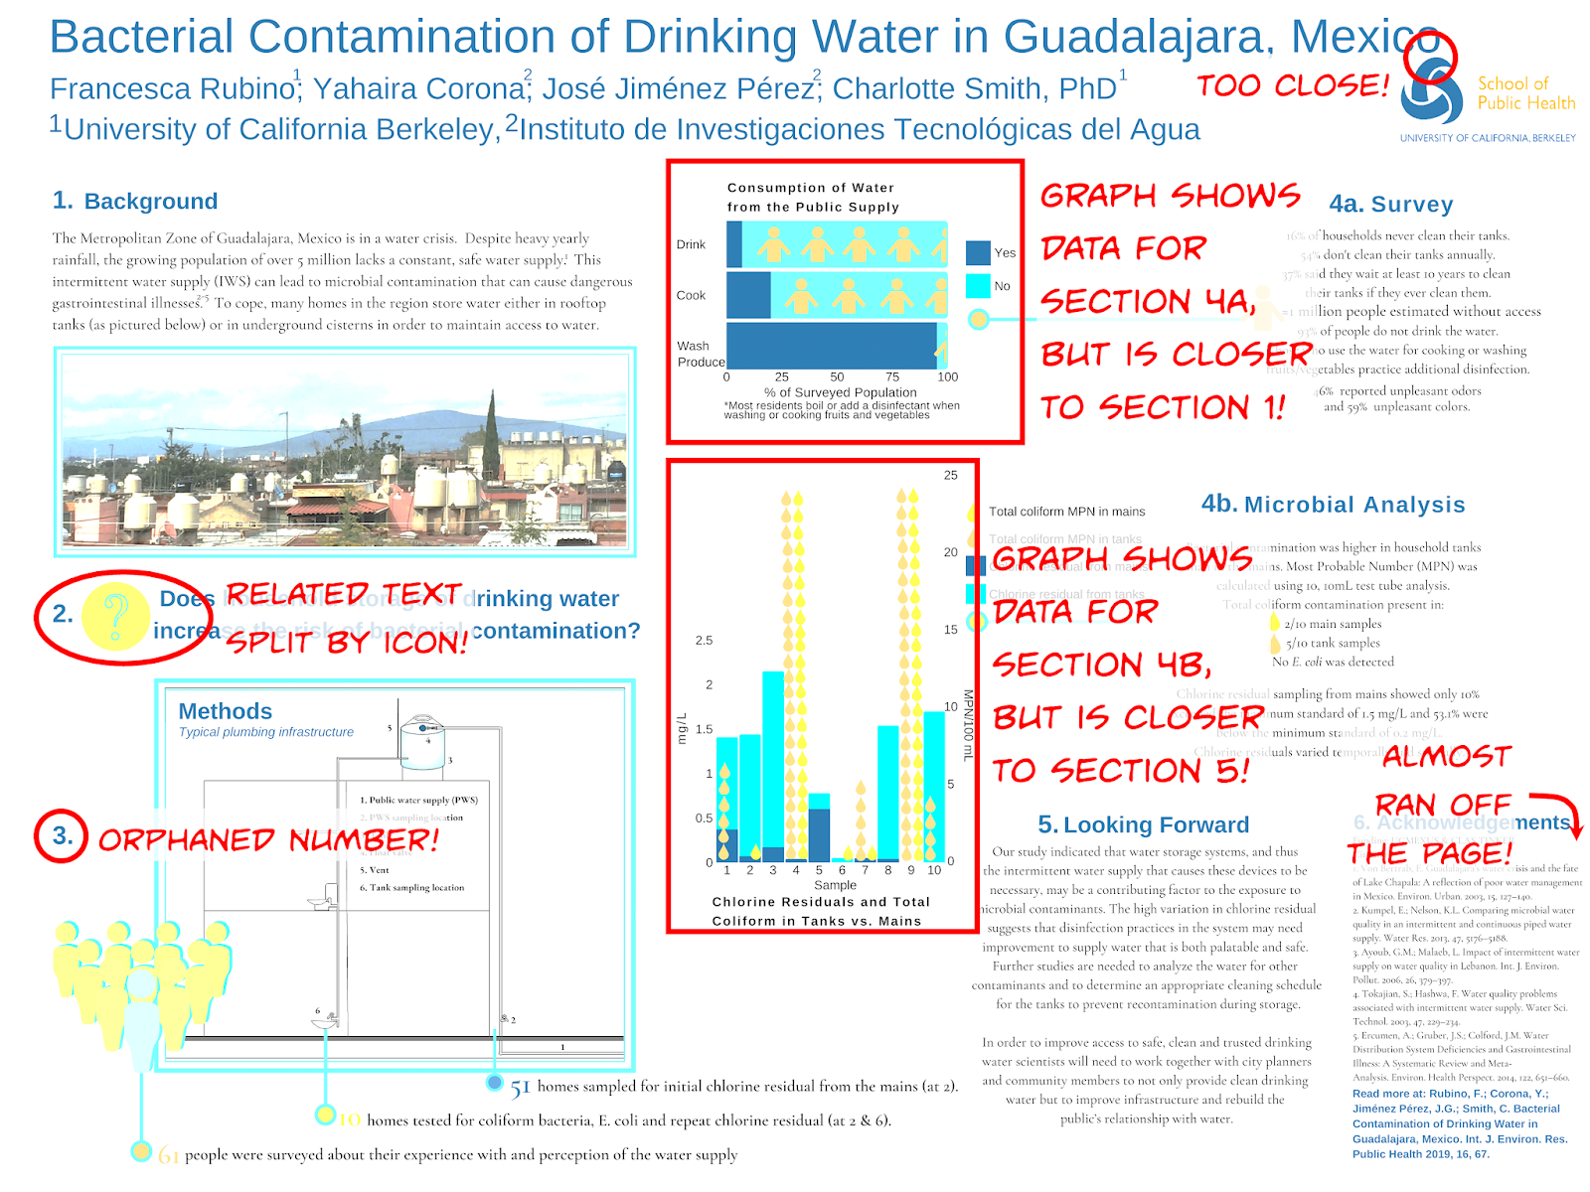

Slide 48


Slide 49
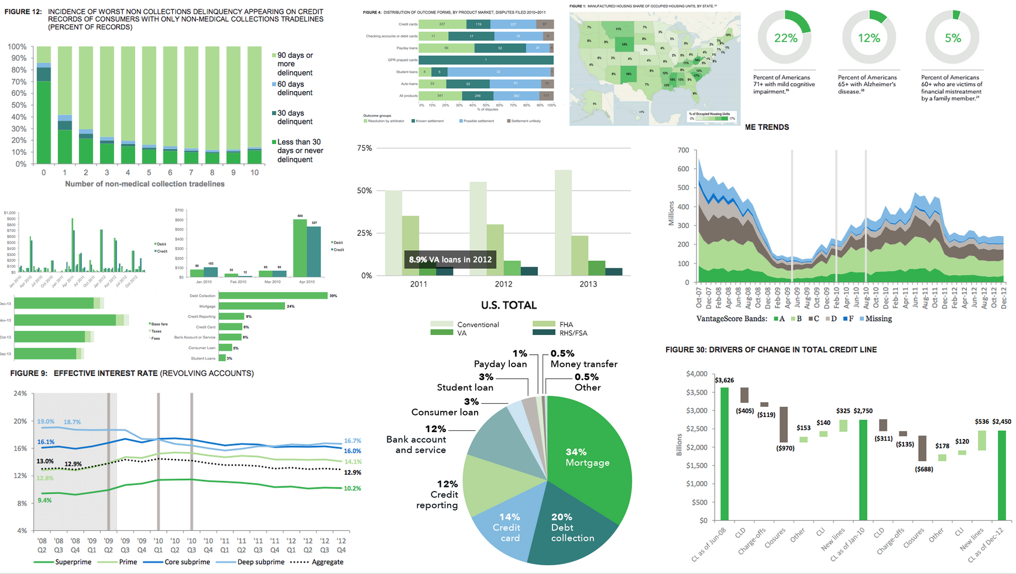

Slide 50
Poster Design
“Like any paper, the more drafts you do, the better it gets… usually.”
- Kevin Kau

Slide 51
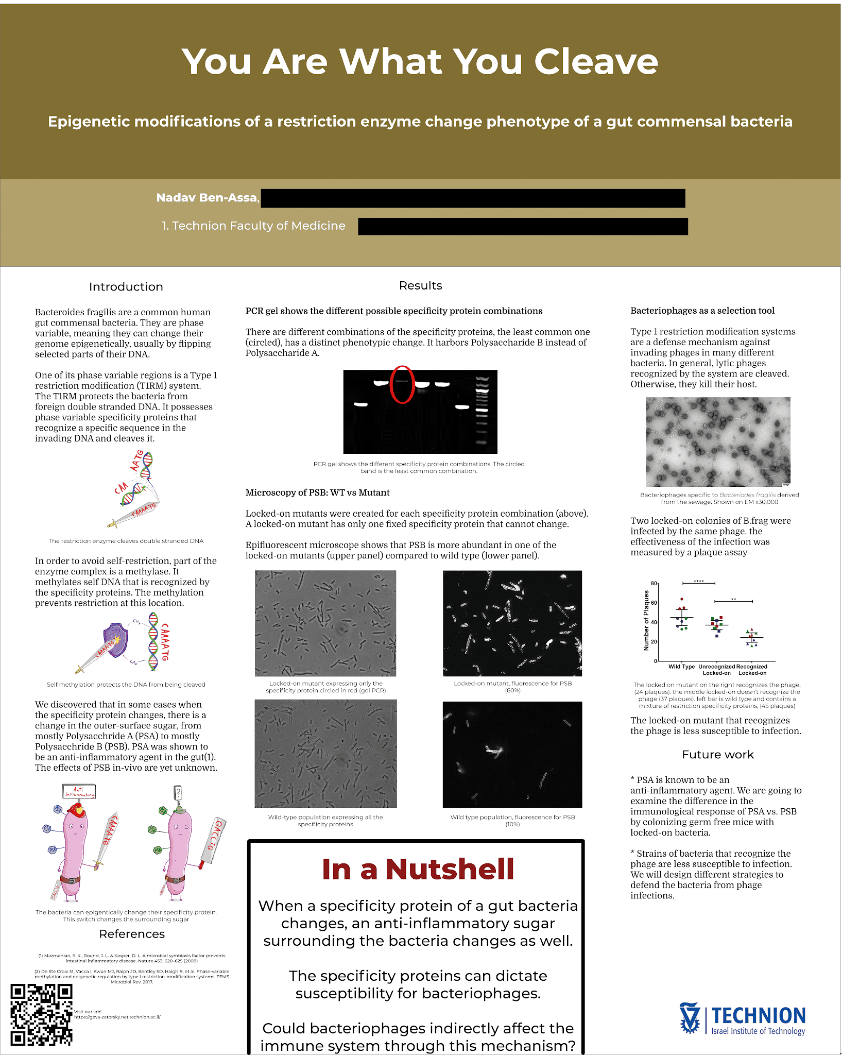
Clean and straightforward
Clean columnar layout
Text and images integrated
“In a nutshell” is a summary, but summaries usually are top left or bottom right..
Doesn’t have a lot of personality

Slide 52
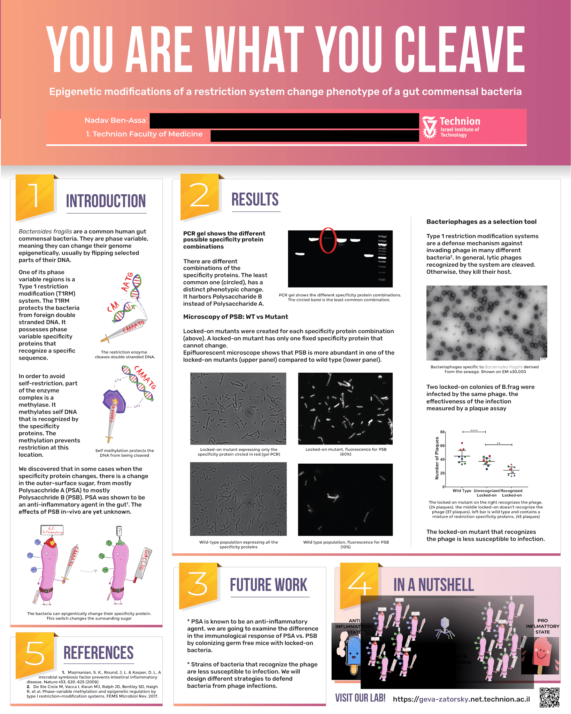
Much more personality and attractiveness
Title font change effective and easier to read
Use of numbers help guide readers
5 at the bottom left…

Slide 53
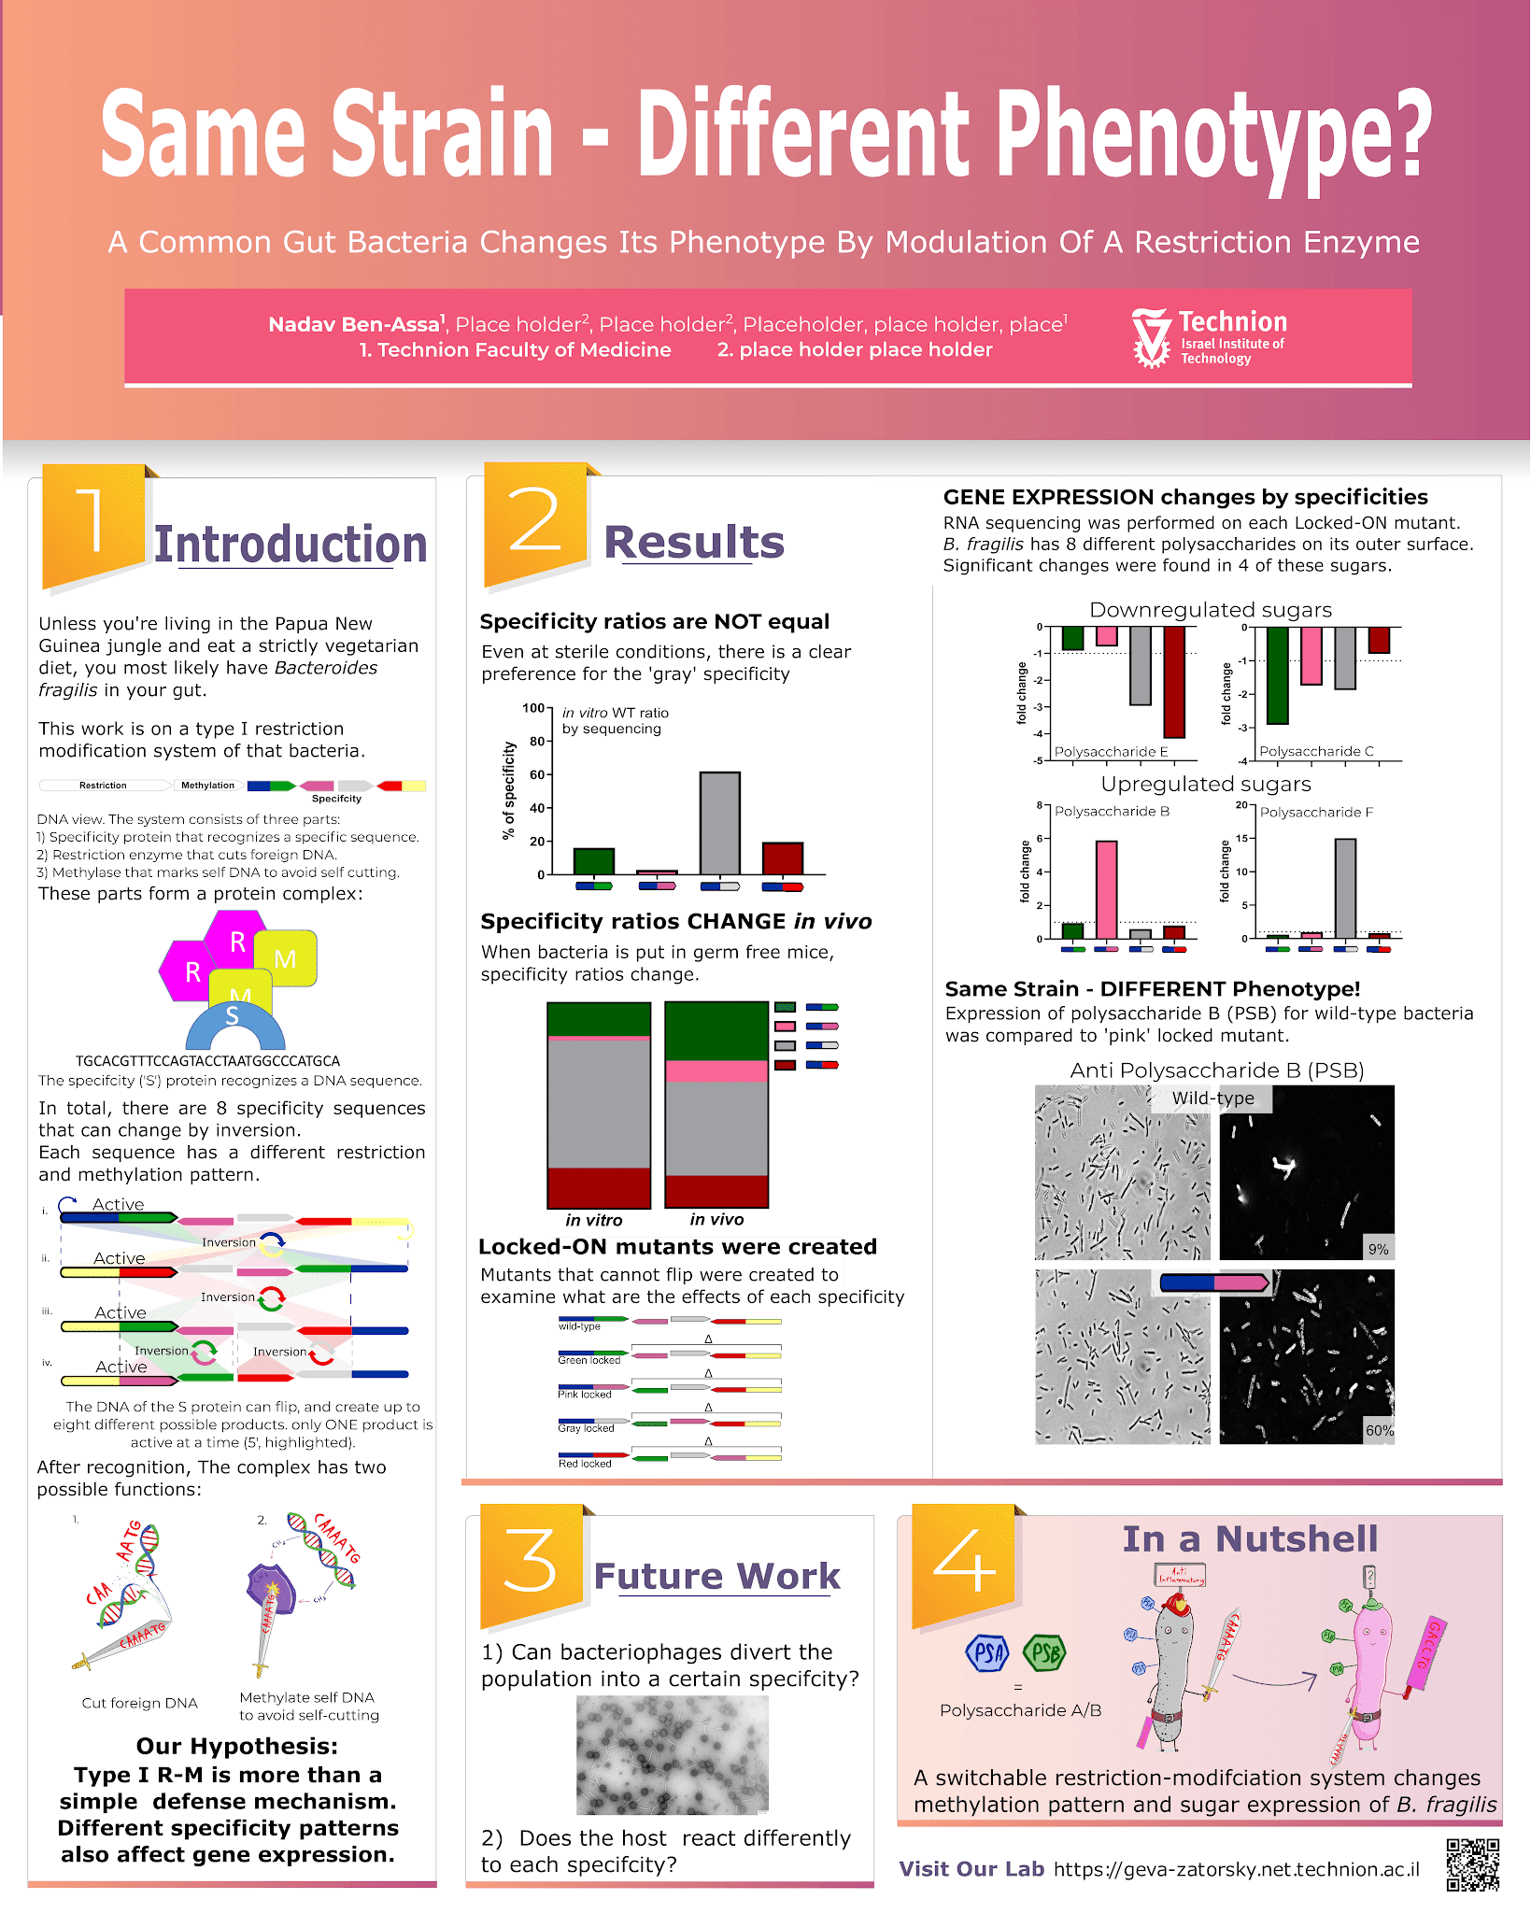
Numbers fall in expected order
Figures are more colored and themed
Less text
Title is more clear

Slide 55
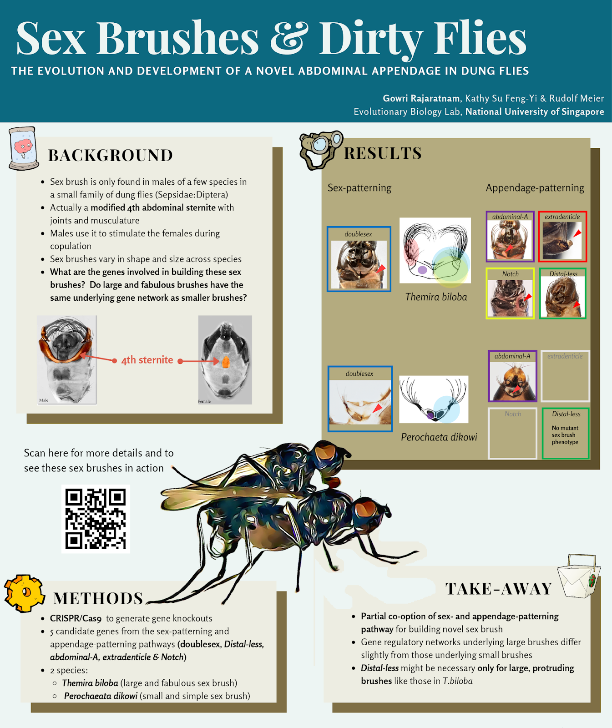

Slide 56
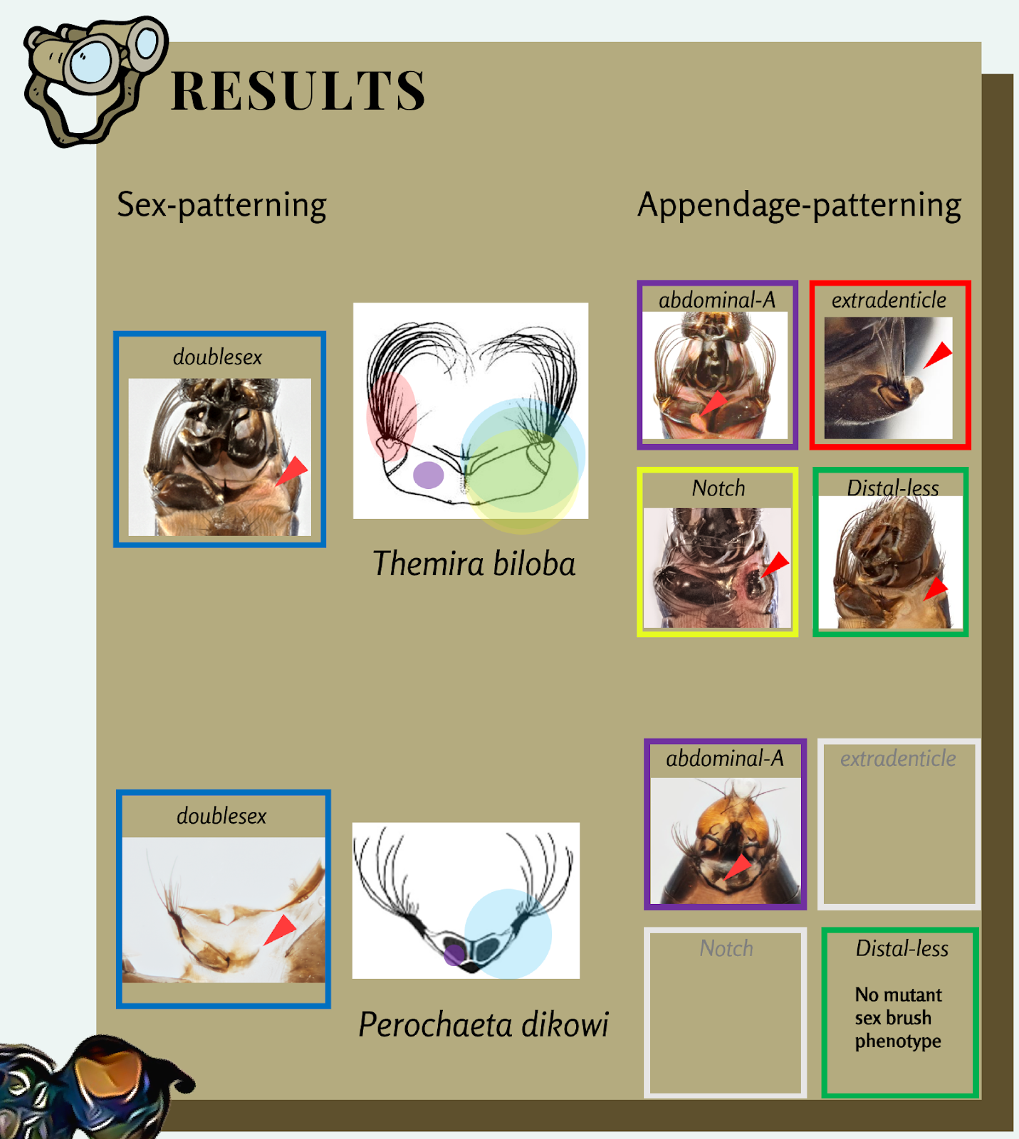
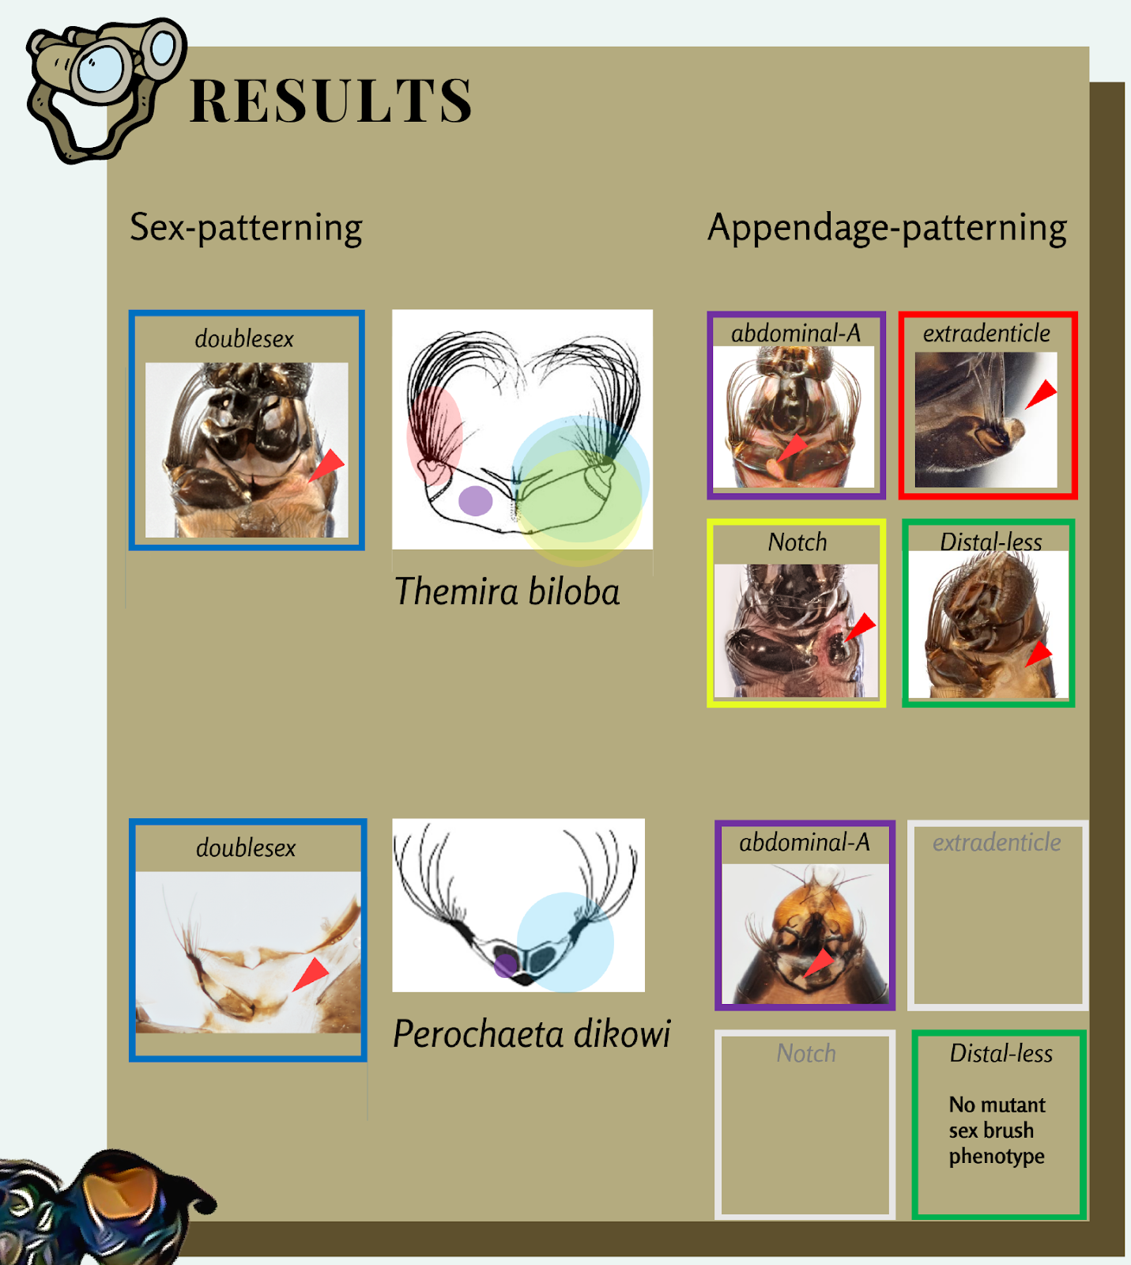

Slide 57
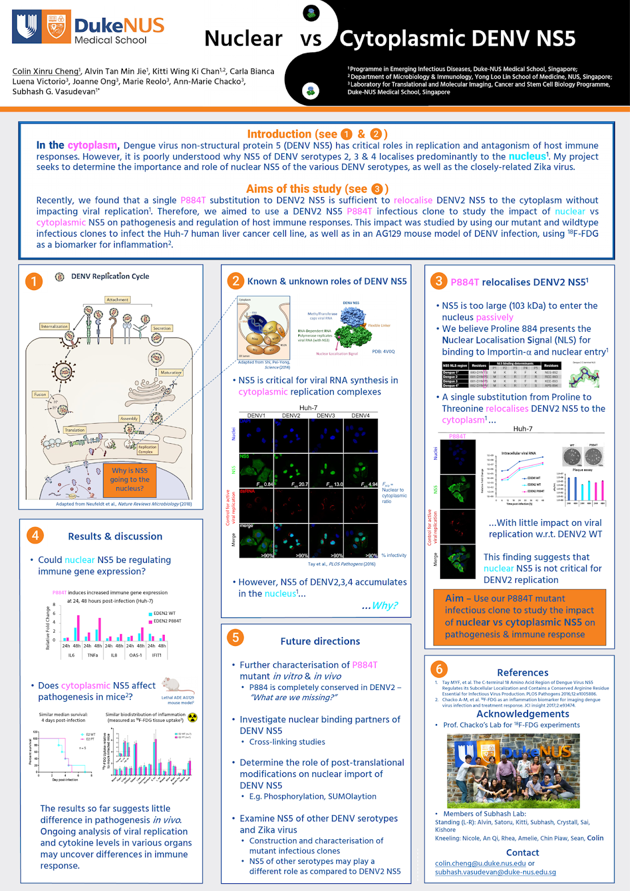
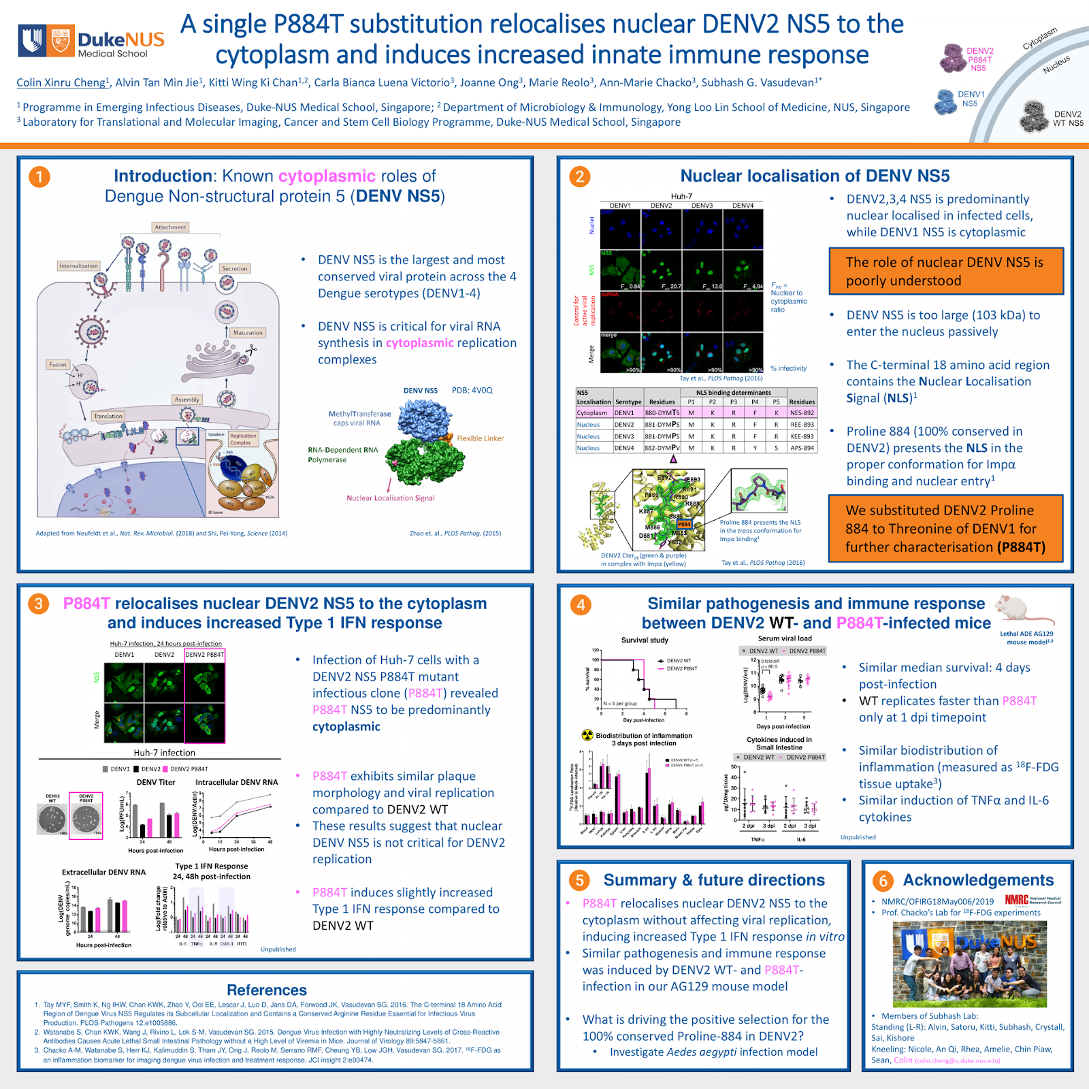

Slide 58


Slide 59


Use of Colors

Slide 60
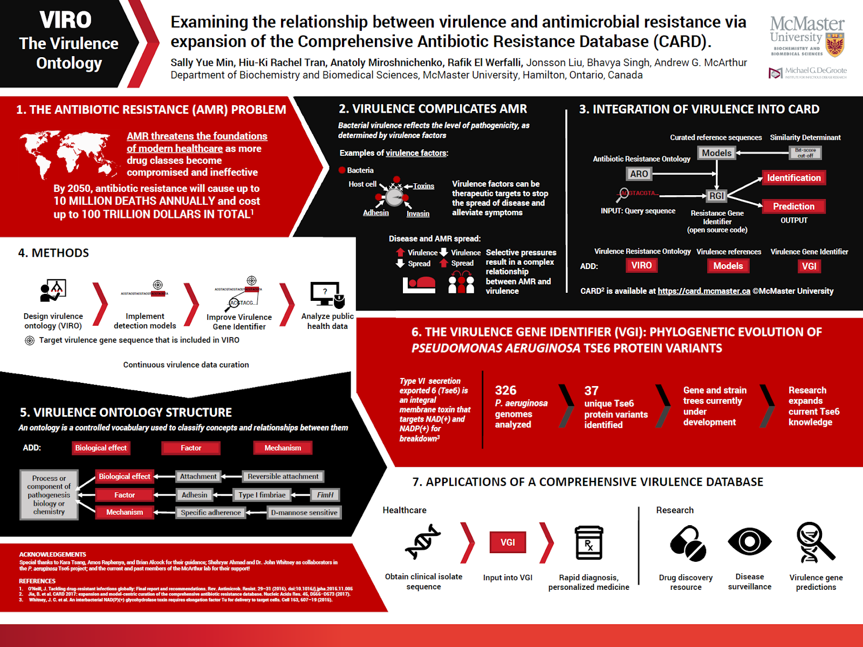
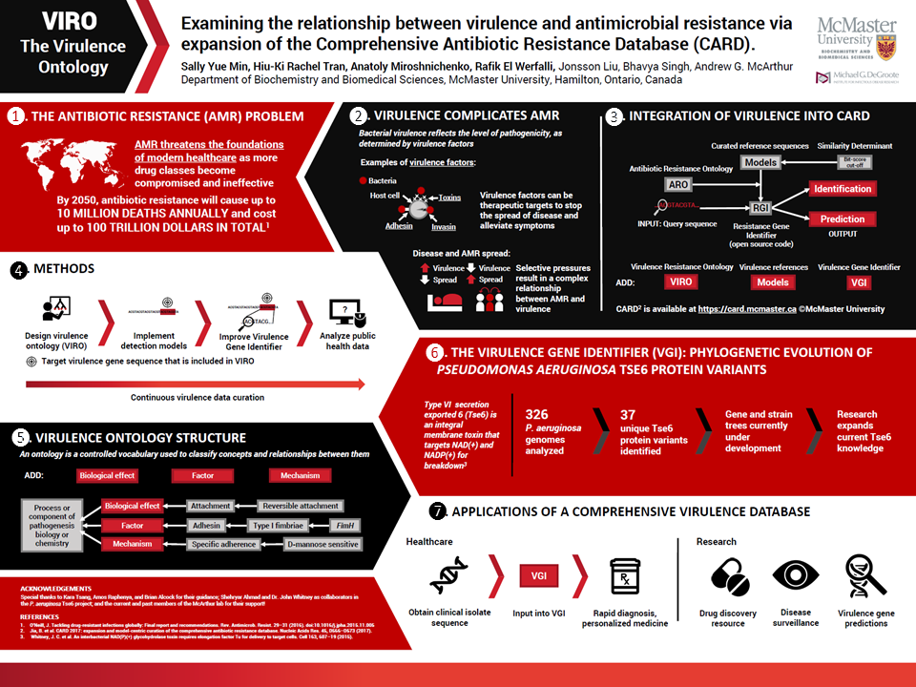
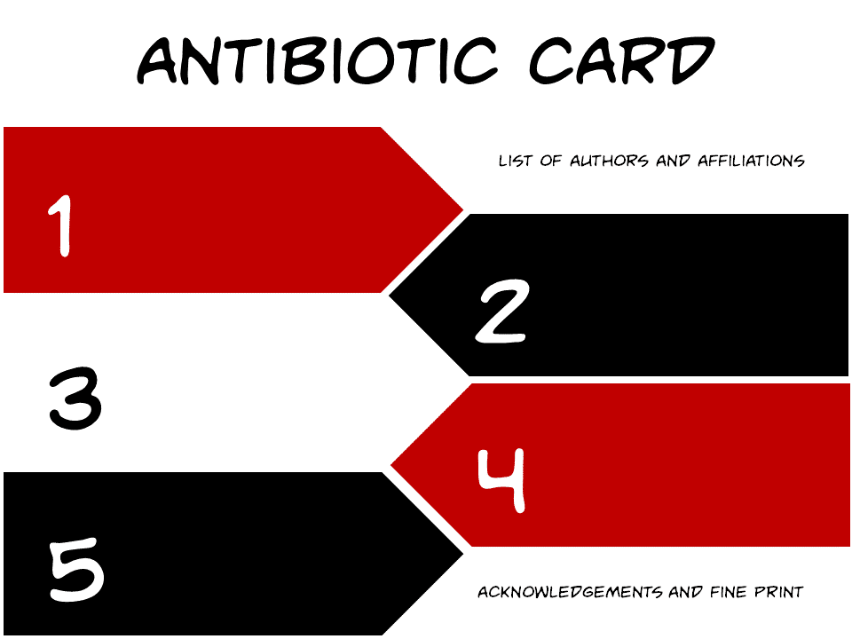

Slide 61
Poster Design
“When you get good, you get real good.”
- Kevin Kau

Slide 62
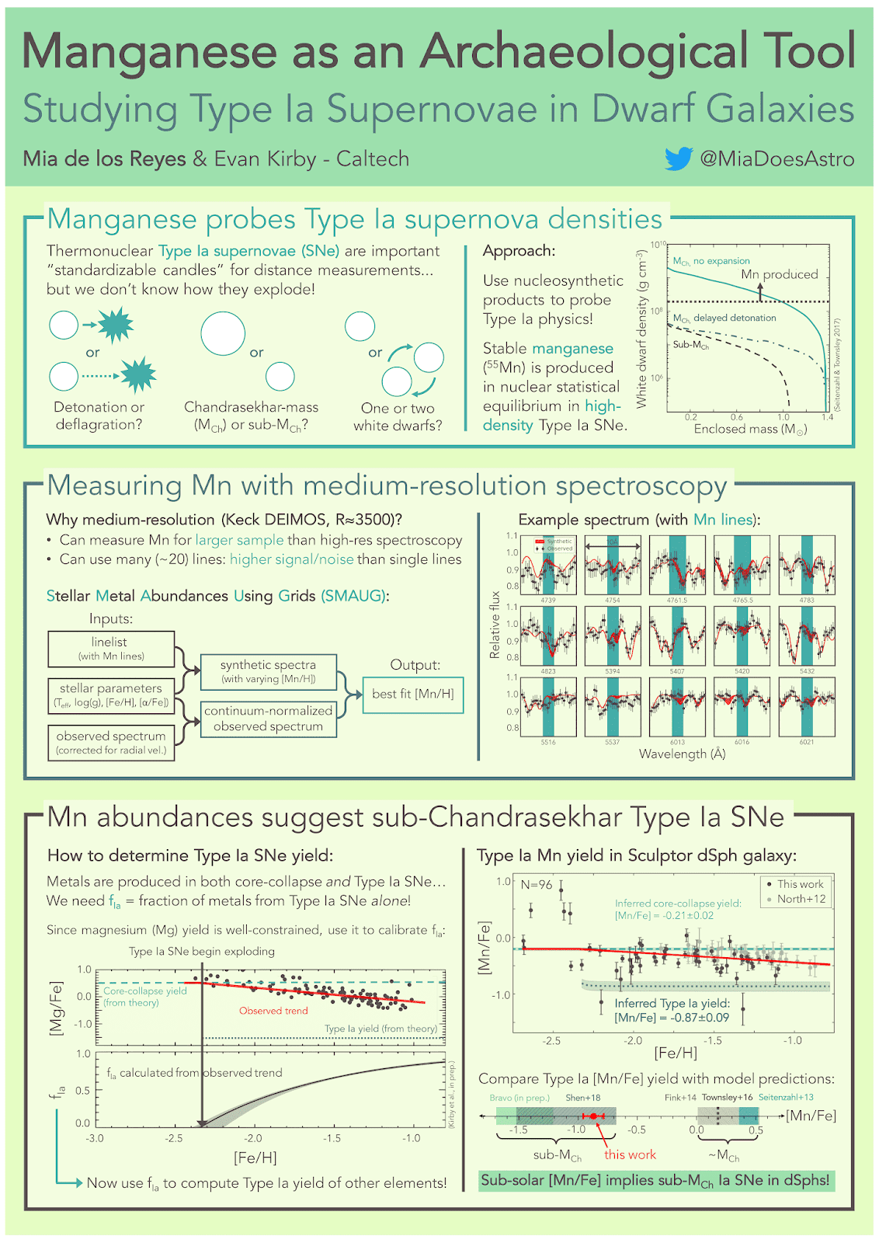

Slide 63
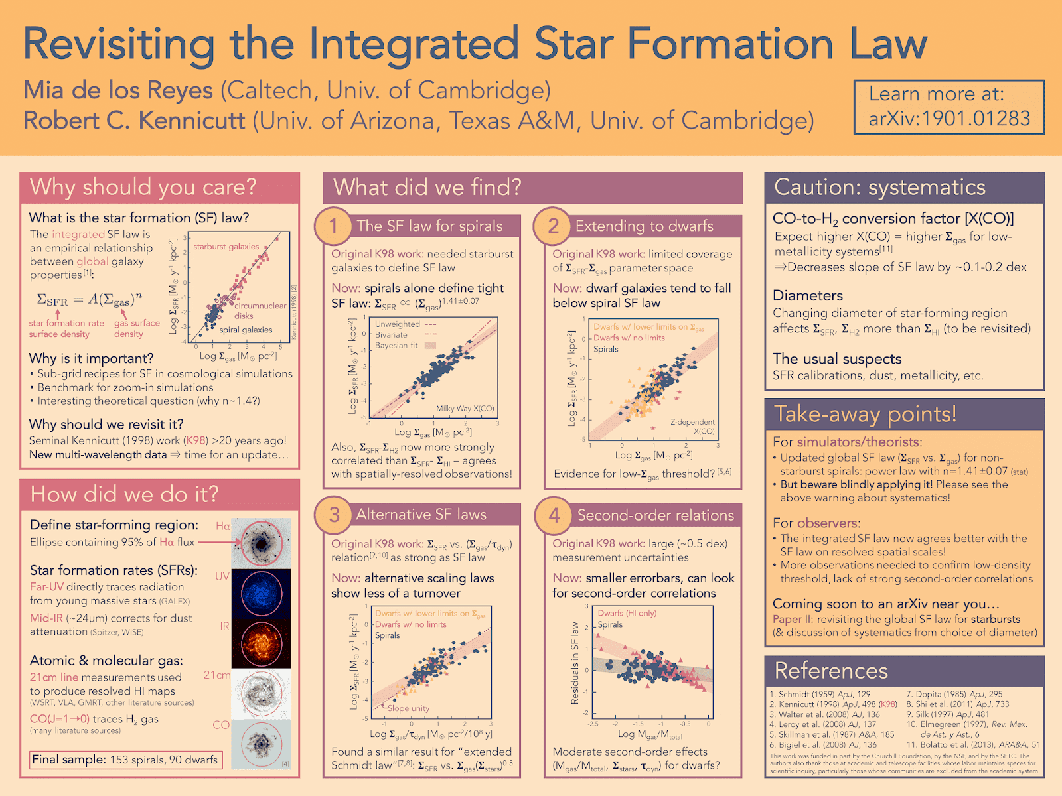

Slide 64
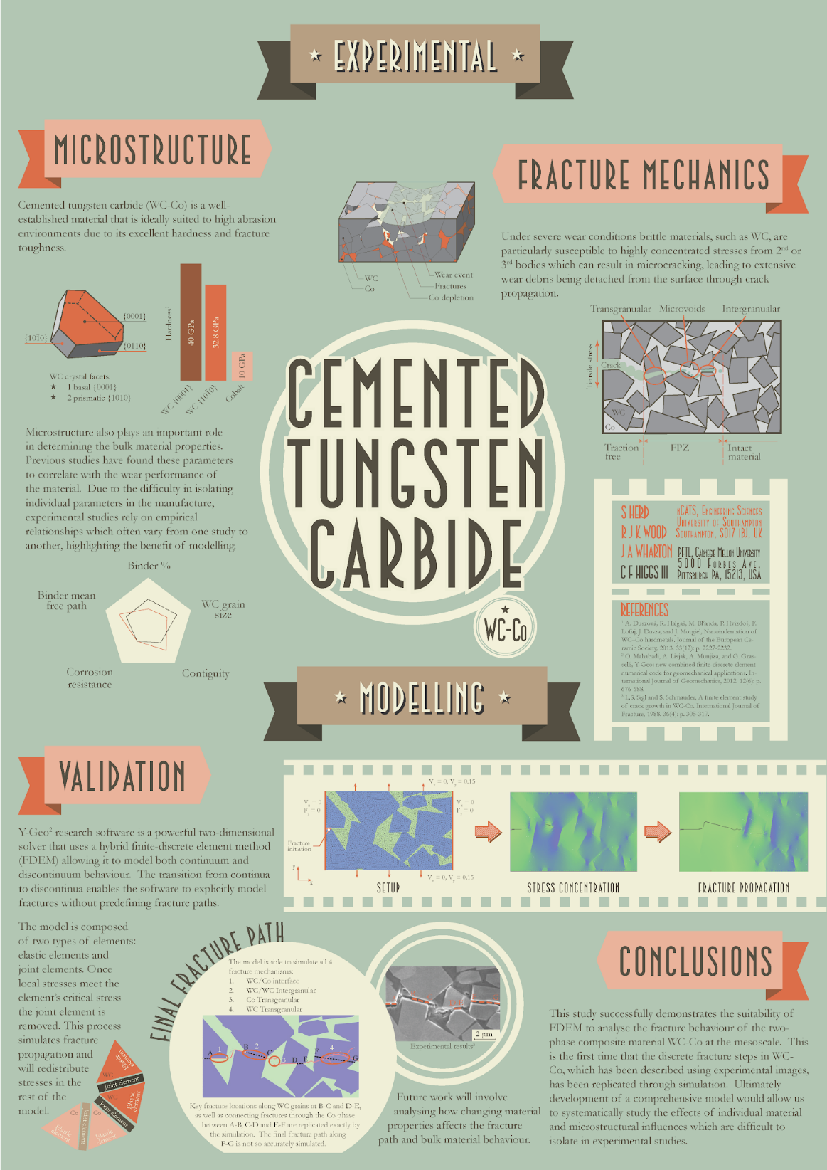

Slide 65
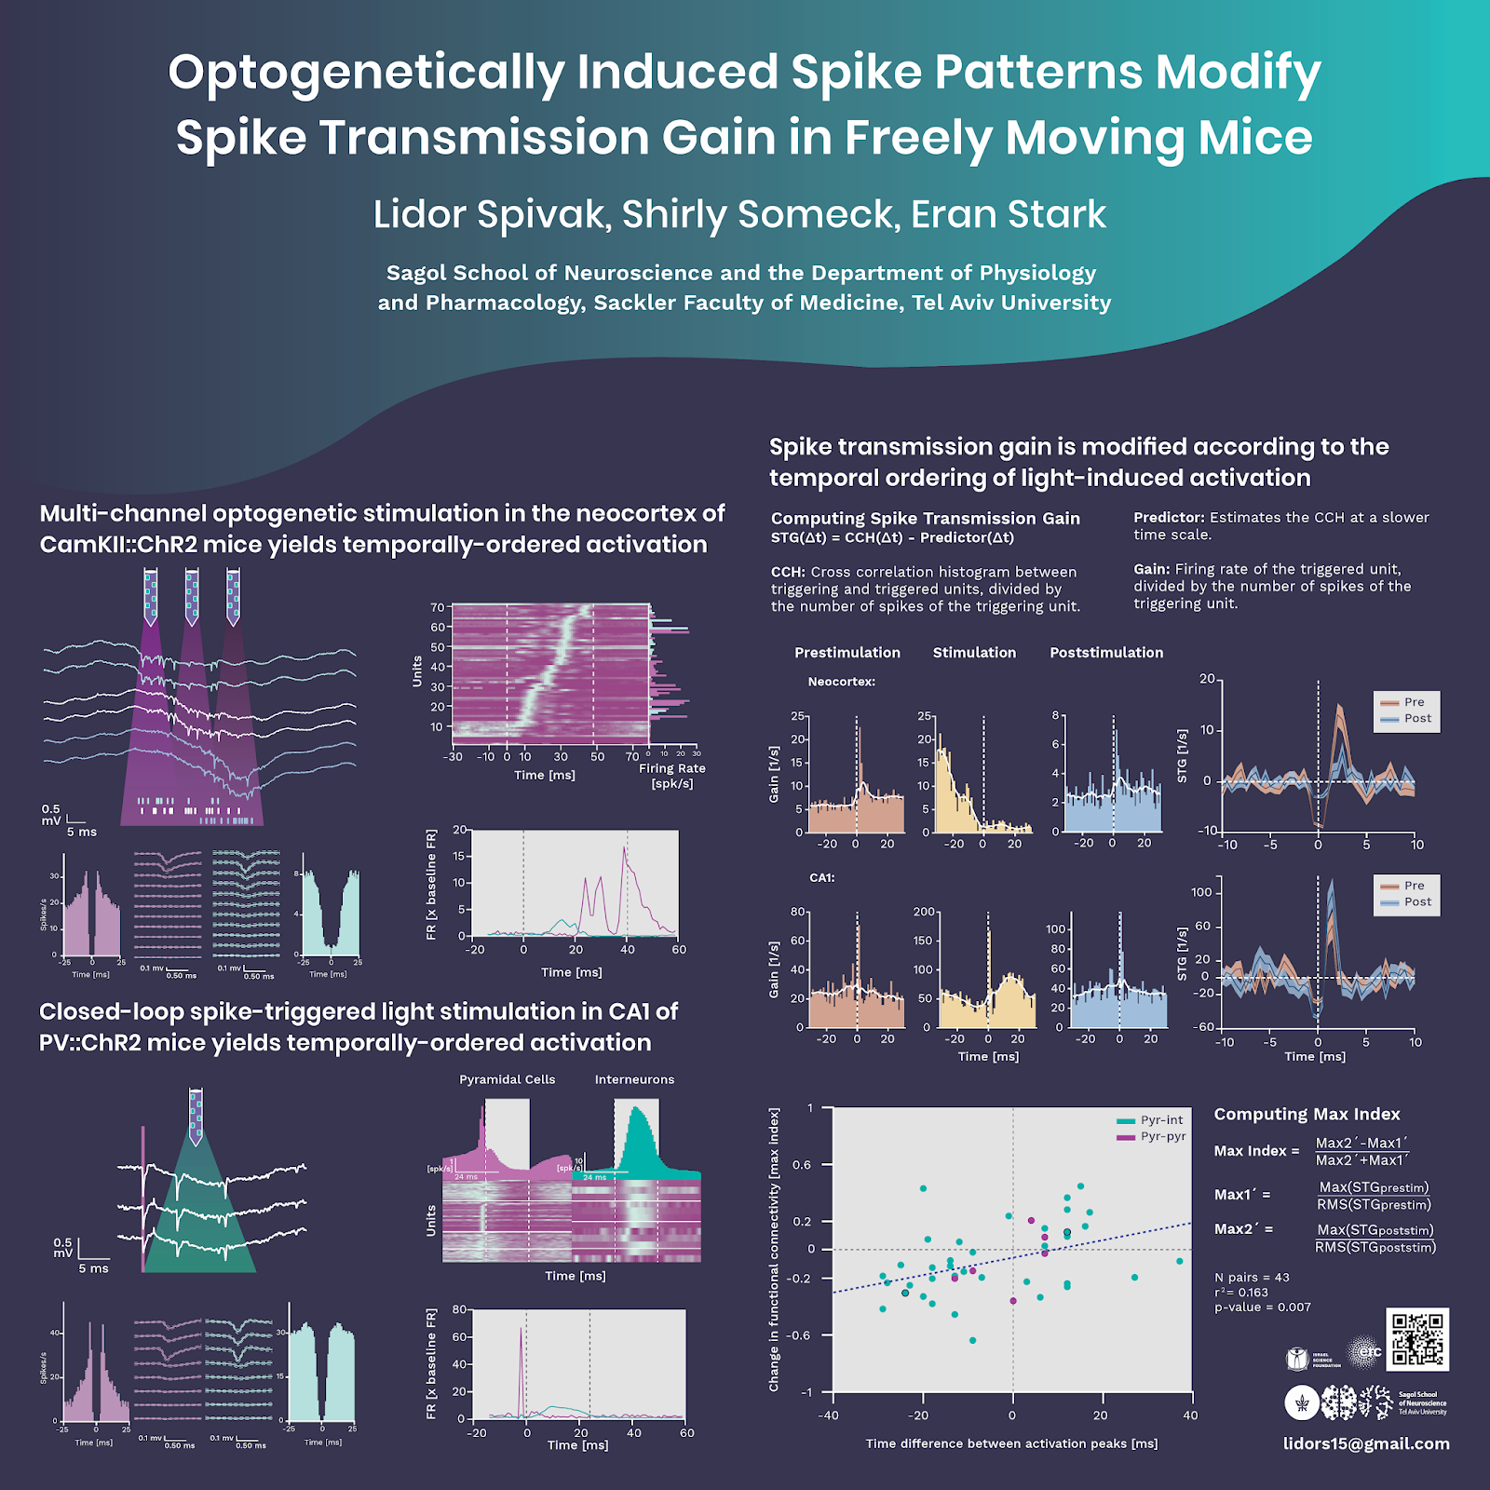

Slide 66


Slide 67
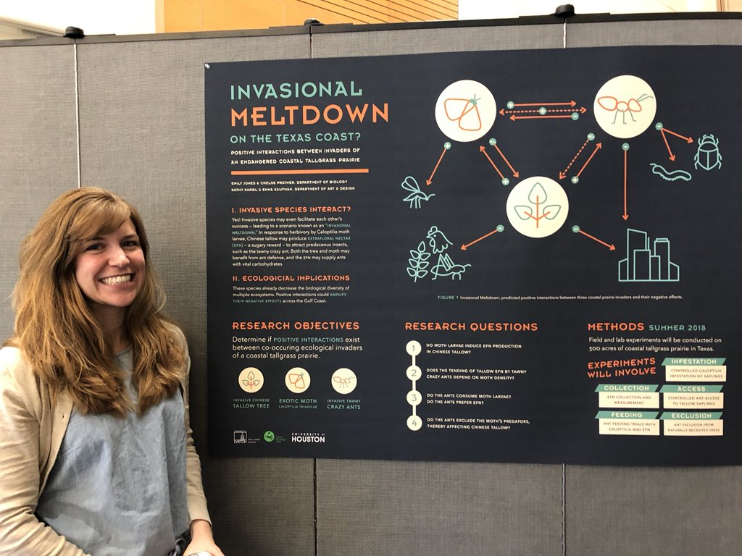

Slide 68
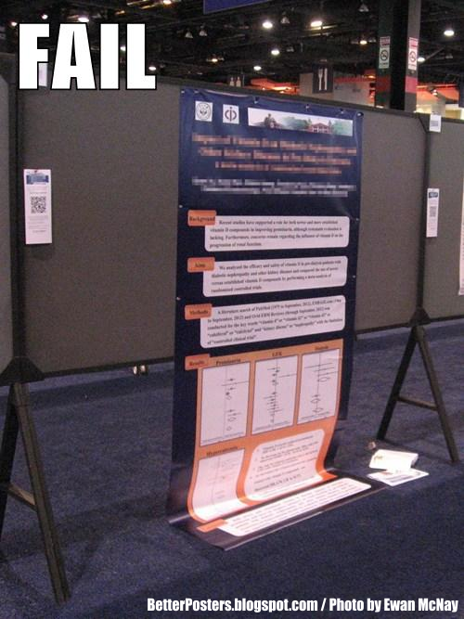

Slide 69
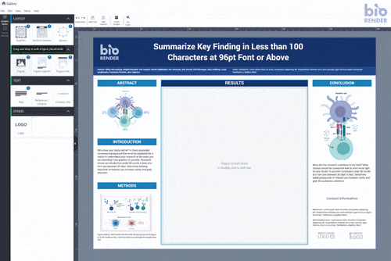
What software to use to make posters?
Powerpoint
Canva
Publisher

Slide 70
Poster Presentation
Be welcoming
  Stand by your poster for entire session
  Make everyone feel welcome to stand in the viewing zone
  Smile and say hello
  Point to the parts of the poster you are talking about

Slide 71
Poster Presentation
Creating a story
  Introduction should set the scene and introduce the main characters
    What is the necessary background information
    How did this lead to your research questions, what were you hoping to find?
    Who are the main characters?

Slide 72
Poster Presentation
The middle Section is the adventure
  How did you get from research questions to your conclusion?
  What did you find on your way?

Slide 73
Poster Presentation
The final section is the conclusion of the story
  What is the ultimate consequence of your journey?
  Is this really the end of the adventure or are there more to come?

Slide 74

02
3MT Workshop
Notes:
Image used in the preview file : https://unsplash.com/photos/ZqLeQDjY6fY

Slide 75
3MT Workshop
Share your 3MT with your group
Use our Grading Rubric to evaluate and give feedback to each other
  What did you like?
  What could be improved?

Slide 76
Rubric
How well you understood the research topic
 | 0 | 1 | 2 | 3 | 4 | 5 | 6 | 7 | 8 | 9
The presentation clearly explained the research project and helped me understand the research topic.
The presenter stated the method and objectives of the research, and addressed the data, texts, and/or primary and secondary materials being used as evidence.
The presenter was able to clearly articulate the significance of the research in accessible terms for a general audience.
Organization was manifest throughout the presentation: the research purpose was clear from the outset.
Ideas were logically built on each other; accessible examples were provided throughout; there was a storyline to the presentation as a whole.
Talked about the research: Methods and Objectives
Some type of results or findings
Did you understand/appreciate the significance of the research?
Clear organization: You had a sense of each step in the 3MT
The flow of ideas was clear, (Transition words/phrases/sentences) and examples/stories were provided
Subtotal: /45

Slide 77
Rubric
You were not difficult to understand because of technical language
 | 0 | 1 | 2 | 3 | 4 | 5 | 6 | 7 | 8 | 9
The presenter explained the research in jargon free language appropriate to a non-specialist audience.
Key terms were defined and background information was provided where useful.
The research was presented as significant and purposeful and not overly generalized
The presentation stimulated my interest in the research and made me want to learn more.
The presenter spoke at an even pace; various aspects of the presentation were allotted sufficient time.
The single PowerPoint slide was legible, concise and enhanced the presentation.
If you had difficult language, you defined/explained it. AND you provided useful background information
Significance was understandable and was not overgeneralized
You were not difficult to understand because of technical language
Good Voice Performance
How good the PPT was

Slide 78
3MT Workshop
Period 3 (10:20-11:10)
  3MT Workshop
    共同303
    共同402
    共同401

Slide 79
3MT Workshop
Return to class @ 11:20

Slide 80
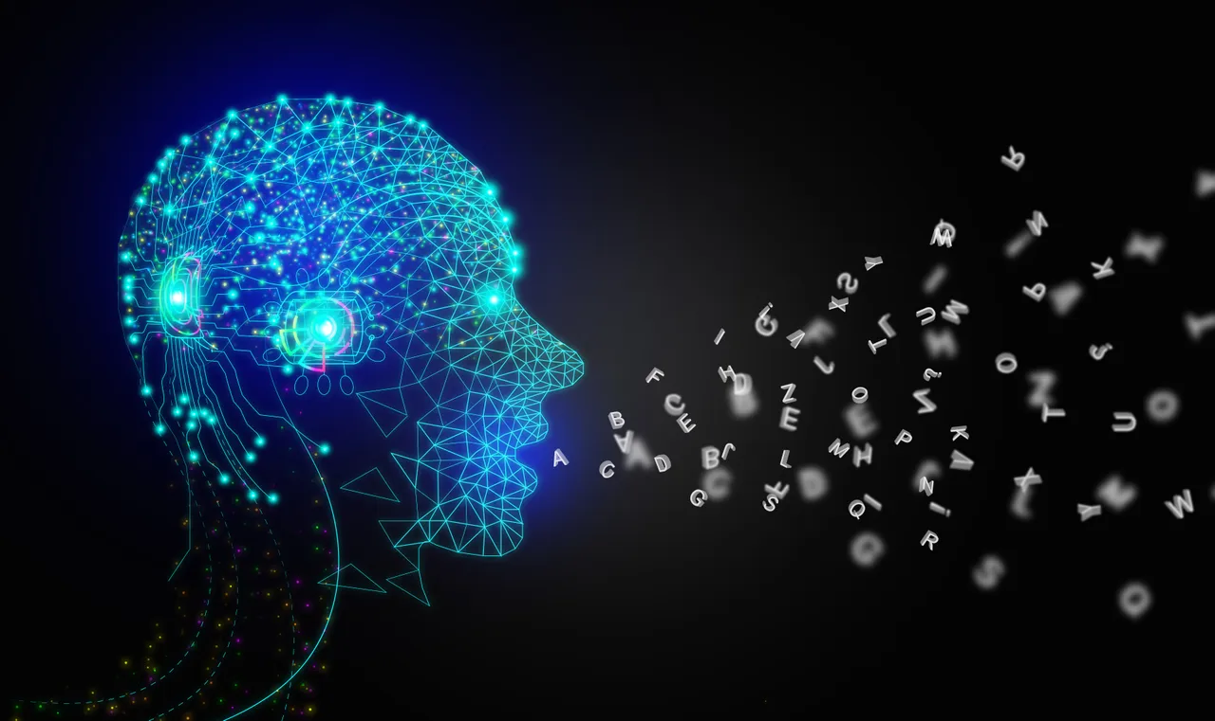
03
Scriptwriting with AI
Notes:
Image used in the preview file : https://unsplash.com/photos/CAbbMdcenUQ

Slide 81
Scriptwriting with AI / Chat GPT
Ethics
  Rules for scriptwriting are much different than paper writing
    Much more lax and more acceptable for scriptwriting
  You’ll never learn anything if you only use AI
  Best if you use AI and learn from what the AI gives you

Slide 82
Scriptwriting with AI / Chat GPT
What is Chat GPT?
  Language Model
    Super large collection of written text
How does Chat GPT work?
  Predicts the most likely word/phrase with some variation
What is Chat GPT not?
  Google

Slide 83
Scriptwriting with AI / Chat GPT
What can it do for our scriptwriting?
  Make it much more “natural”
  Apply different styles
  Give general advice
    That is based on its language model

Slide 84
Making Chat GPT Work for You
Make your language more:
  “Natural”
  Clear

Slide 85
Making Chat GPT Work for You
Make this easier to understand?
Many people like to start their day with a morning run, and these runners usually smile when they run. Why? These runners smile because they achieve a faster pace, or because they run with their romantic Mrs Right. So, if we want to analyze why people smile when running, we can observe a runner’s behavior by checking whether he continually looks at his sports watch or whether he talk with his charming partner. Now, we assume that the runner is a system, and this runner system has two inputs and one output. The first input is knowing that a shorter running time is achieved, and the second input will be running with another romantic lovebird. Also, smiling is the only one output. To estimate the system input, we must recognize the observable output pattern. If we can exactly know which the system input is, then we can focus on the transmission only from this system input to the observable output

Slide 86
Input
The following is part of my script for a presentation on my research. Can you make this easier to understand and maybe even more interesting? Here is my script: “ “

Slide 87
Output
Many people enjoy starting their day with a morning run, and you might notice that they often smile while doing it. Have you ever wondered why? It could be because they're running faster than usual, or perhaps they're sharing the experience with a special someone. To understand the reason behind their smiles, we can observe the runner's behavior by noticing if they keep checking their sports watch for their pace or if they're chatting with their charming companion.
Think of the runner as a system with two inputs and one output. The first input is the feeling of accomplishment from achieving a faster running time, and the second input is the joy of running with a loved one. Smiling is the only output we see.
To determine the cause of the smile, we need to identify the input responsible for it. If we can figure out which input is responsible, we can then focus on understanding how it leads to the observable output, the smile.

Slide 88
Input
Can you do this again, but when talking about "understanding how it leads to the observable output, the smile" could you include the idea that we don't know what's causing the smile; is it the running or is it the partner?

Slide 89
Output 2
Many people enjoy starting their day with a morning run, and you might notice that they often smile while doing it. Have you ever wondered why? It could be because they're running faster than usual, or perhaps they're sharing the experience with a special someone. To understand the reason behind their smiles, we can observe the runner's behavior by noticing if they keep checking their sports watch for their pace or if they're chatting with their charming companion.
Think of the runner as a system with two inputs and one output. The first input is the feeling of accomplishment from achieving a faster running time, and the second input is the joy of running with a loved one. Smiling is the only output we see.
The challenge lies in determining what's causing the smile: is it the running itself or the presence of the partner? To find the answer, we need to identify the input responsible for the smile. By pinpointing the input, we can better understand how it leads to the observable output – the smile – even though the exact cause might still be unclear.

Slide 90
Clarity
Now, let’s look at the drone system. When the wind is blowing, the drone will be affected: the drone may be hovering at a tilt. This is because the force of the wind can push the drone, so the inputs of the drone system are given: three force inputs in x, y, z direction, respectively. Besides, orientation of the drone can be expressed also in three directions, which are roll, pitch, and yaw, and these three parameters are the outputs of the drone. If roll, pitch, and yaw can be estimated, it is possible that force inputs can also be estimated

Slide 91
Input
Can you make the idea clearer and more understandable and interesting?

Slide 92
Output
Now, let's explore the concept of a drone system to make this idea more relatable to a diverse audience. Imagine a drone flying on a windy day. The wind affects the drone's movement and might cause it to hover at a tilt. This is because the wind exerts force on the drone in three different directions: x, y, and z.
Similarly, the drone's orientation can be described using three directions: roll, pitch, and yaw. These are the outputs of the drone system. So, just like we tried to understand the runner's smile by examining the observable outputs, we can analyze the drone's behavior by looking at its roll, pitch, and yaw.
If we can estimate these three orientation parameters, we might be able to estimate the force inputs that are affecting the drone. In this way, we can better understand the drone system and how external factors, such as wind, influence its behavior.

Slide 93
Making things easier to understand
So far, I’ve decoupled a drone system, a three-input three-output system. The next thing is do is to control your drone. Since that the three force inputs can be estimated, you can design three controllers targeted specifically at each force input. Because each controller corresponds to each system input, the complicated multi-input multi-output system can be controlled easily. And we call this control method “decoupling control”. Therefore, the decoupling control algorithm is developed to decouple and control the complicated system in a desired way, and engineers can solve the control problem much easier. We hope to see that decoupling control will make the drone robust and stable even in strong winds.

Slide 94
Getting ideas for hooks
I'm trying to write a hook for this presentation. Can you write a hook for me that will get people interested in this decoupling control algorithm that will be used in drones?

Slide 95
Getting ideas for hooks
"Imagine a world where drones effortlessly navigate through turbulent winds, maintaining stability and control in even the toughest conditions. Welcome to the cutting edge of drone technology – the decoupling control algorithm. In today's presentation, we'll unveil the secrets behind this game-changing approach, revolutionizing the way we understand and control these remarkable flying machines. Get ready to be amazed!"

Slide 96
Key Takeaways
Chat GPT is a tool
  Use it correctly, and it can help a lot
  Use it poorly, and it might hurt you
Chat GPT doesn’t know anything
  It’s only a language model
  Language models are good at looking like reality
    But it has no knowledge
      Oftentimes information is incorrect

Slide 97
Key Takeaways
How to use Chat GPT effectively for scriptwriting:
  Incremental improvements work the best
  Specific requests work best
    Improve cohesion
    Make language more understandable
  Always observe the output
    Catch errors

Slide 98
Last try
Can you make me an example for this decoupling control algorithm that I've been talking about in this script?

Slide 99
Output
Let's consider a drone that is responsible for delivering packages in an urban environment. In this scenario, the drone must navigate around obstacles such as buildings and trees while maintaining a stable flight, even when faced with unpredictable wind gusts.
Using the decoupling control algorithm, we break down the complex drone system into three separate controllers for each force input (x, y, and z). Each controller is designed to manage one specific aspect of the drone's movement:
The x-controller manages the drone's side-to-side movement (left and right), ensuring precise navigation around obstacles.
The y-controller controls the drone's forward and backward movement, allowing it to maintain an optimal flight path.
The z-controller takes care of the drone's altitude, ensuring that it stays at a constant height above ground level.
By implementing the decoupling control algorithm, the drone can now independently manage each aspect of its flight, resulting in a more stable and controlled performance, even when faced with strong winds or other challenging conditions. This ultimately leads to safer and more reliable package deliveries, improving the efficiency and effectiveness of drone-based delivery services.

Slide 100
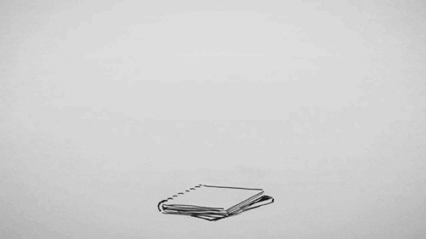
Homework

Slide 101
Homework
Be ready to present your 3MT!
Notes:
Can minimize most of these fears by realizing that we speak in public all the time

Slide 102
學號 | 姓名 | Order
R11944073 | 呂品君 | 1
R09323046 | 許卿柔 | 2
R10429005 | 周承毅 | 3
R11451008 | 楊裕萌 | 4
R09A21005 | 梁廷瑋 | 5
R10625021 | 王彥喬 | 6
D09527002 | 謝欣妤 | 7
ntnu_61130042A | 韓芸珊 | 8
R10943074 | 黃俊瑋 | 9
R10444004 | 朱雯嘉 | 10
R10455003 | 郭力中 | 11
R10527064 | 曾于容 | 12
R10643005 | 文政傑 | 13
R09643005 | 劉軒睿 | 14
R11322023 | 賴彥丞 | 15
R10227120 | 鄭嘉妤 | 16
R11K41025 | 許嘉芯 | 17
R11522631 | 林季妍 | 18
R10241214 | 鄧志毅 | 19

