Slide 1
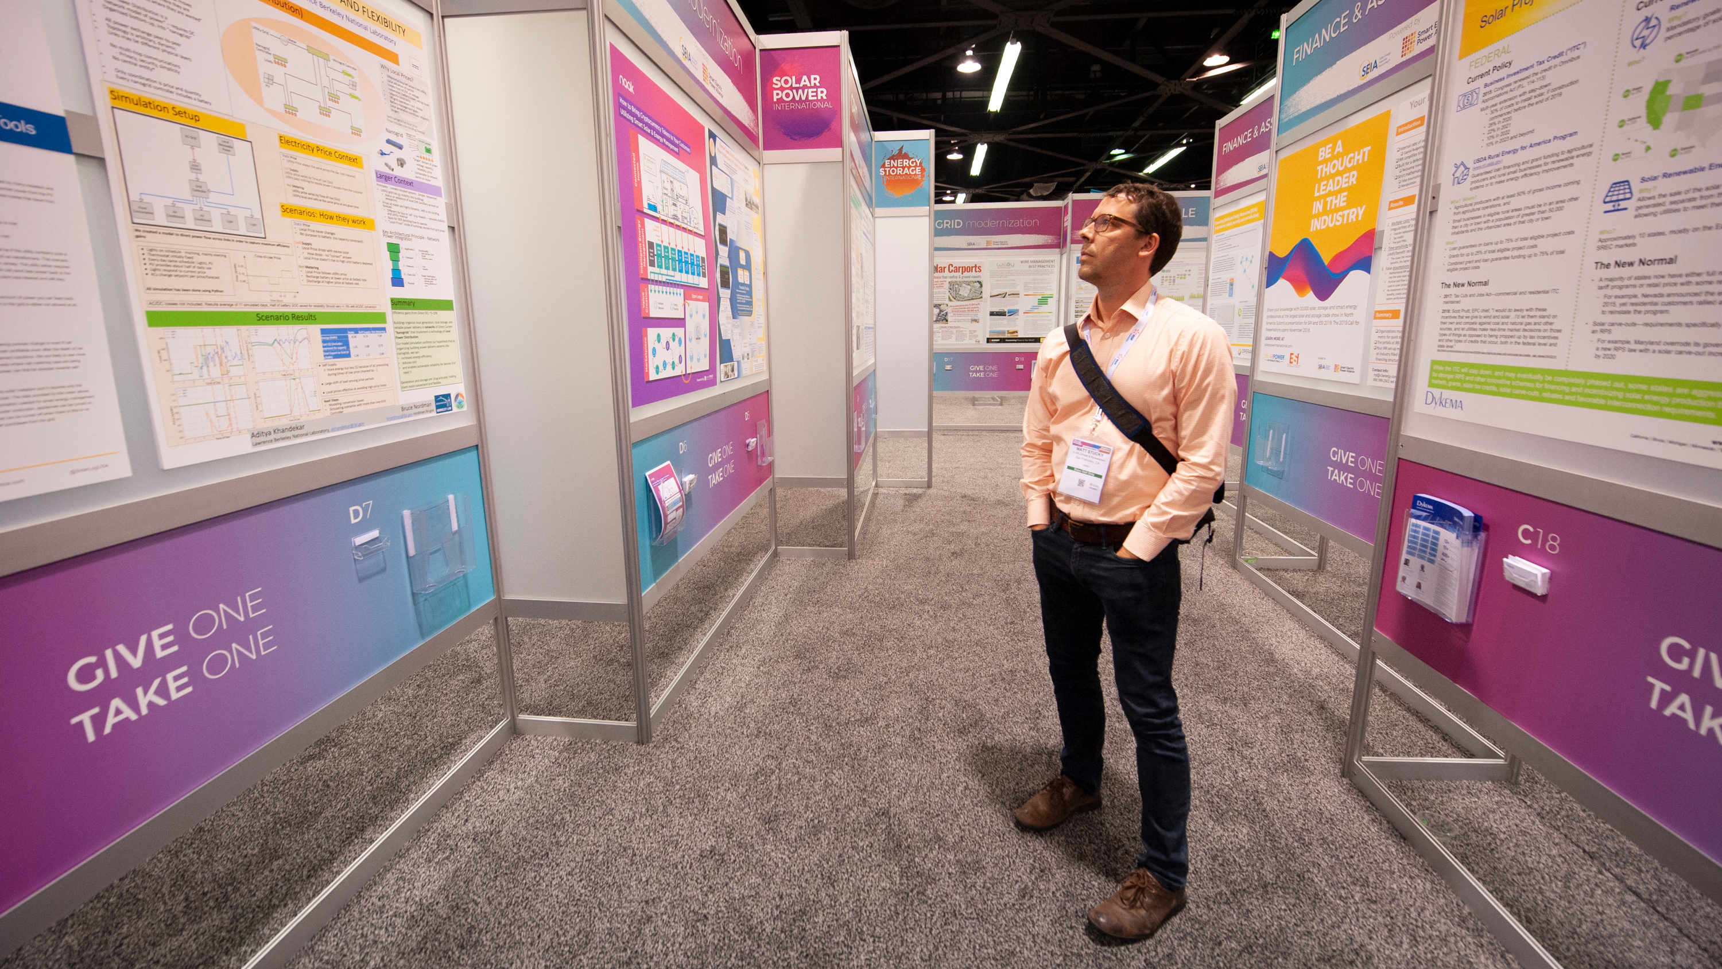
Write 7015
English Writing for Academic Purposes
Presentation Skills Day 2
Notes:
Image used in the preview file : https://unsplash.com/photos/16eva2FRETo
To insert the picture, just drag the image from your file explorer to the this template placeholders

Slide 2
English for Academic Writing (with Kevin) - Schedule
Date | Topic
3/3 | What is the Three Minute Thesis Presentation Basics
3/10 | Scriptwriting Voice Technique Slide Design
3/17 | Scriptwriting with AI Poster Presentation Design 3MT Workshop
3/24 | 3MT Workshop
3/31 | Three Minute Thesis Presentations

Slide 3
Evaluation
3/31
  3 Minute Thesis Presentation
    3 minutes
    Targeted at a general audience
    Present your graduate research
      Or any other research…
    Engage the audience

Slide 4

Agenda
Review
01
3MT Analysis and 3MT Slide Design
02
Talking about your research - Workshop
03
Voice Technique
04
Notes:
Image used in the preview file : https://unsplash.com/photos/vNGL14-V5TY

Slide 5

01
Review
Notes:
Image used in the preview file : https://unsplash.com/photos/NDuPLKYRXQU

Slide 6
Giving presentations give you visibility and advances your career
School
  Show peers and professors the progress of your research
  Get feedback on your research and projects
  Display your academic prowess by impressing others

Slide 7
Giving presentations give you visibility and advances your career
Conferences
  Gain visibility and inform others of the results you have achieved
    Increase your chances of getting feedback on your work
    Establish new contacts
    Collaborate with other research groups
    Get more funds so that you can carry out better research

Slide 8
Giving presentations give you visibility and advances your career
Outside
  Convey your research to the public
    Affect how the public perceives your field
    Get the public to change their lifestyles
    Counter unsubstantiated beliefs

Slide 9
Giving presentations give you visibility and advances your career
Presentations
  Opportunity to talk about factors that you probably wouldn’t mention in your paper
    Ideas and conjectures
    Negative results
    Unfinished work
    Etc…

Slide 10
Good Presentations
Presenter = professional and confident
Material made specifically for that day
Slides are clear and easy to follow
Interesting
Easy to follow
Friendly and not too formal
Fun!

Slide 11

Bad Presentations
Clearly not practiced the presentation
No clear introduction, confused structure, no conclusion
Appears to be talking to themselves rather than engaging with the audience
Reads the slides
Series of similar slides full of text and diagrams
Relies on animations
Fails to address the audiences' interests
Too technical, too detailed
Speaks too fast, monotone, speaks too long
Shows little interest in his/her topic

Slide 12
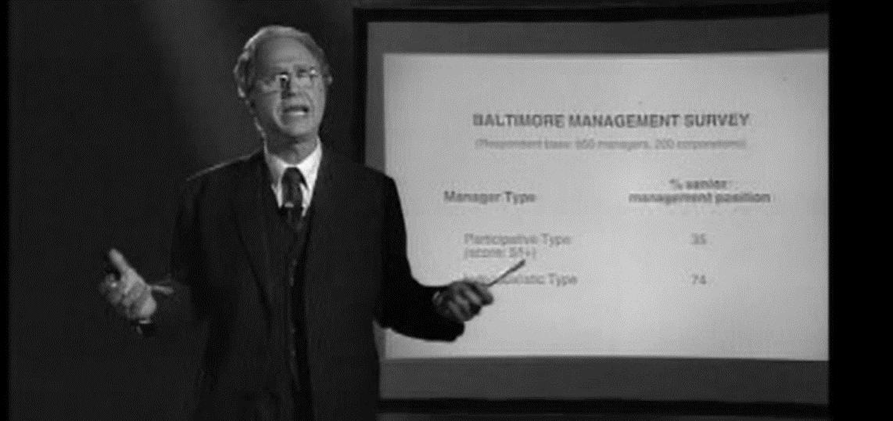
Meet Dr. Lindin

Slide 13
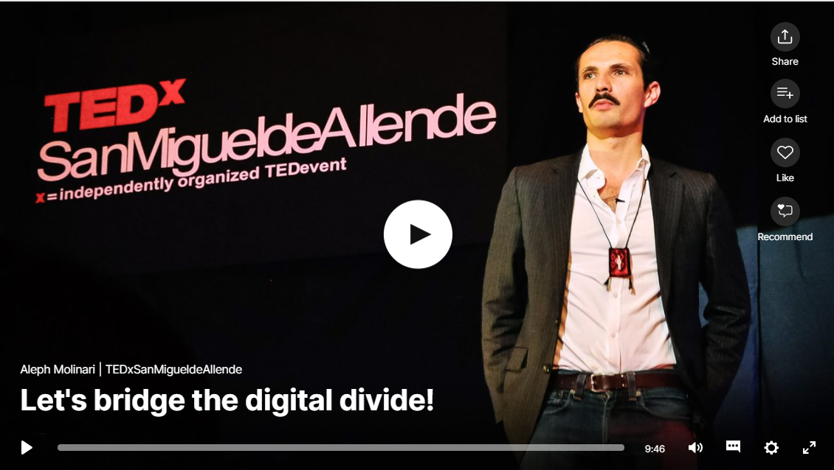

Slide 14
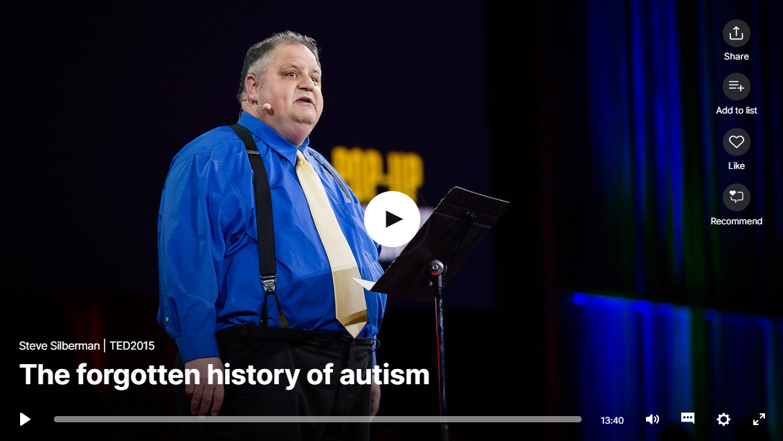

Slide 15
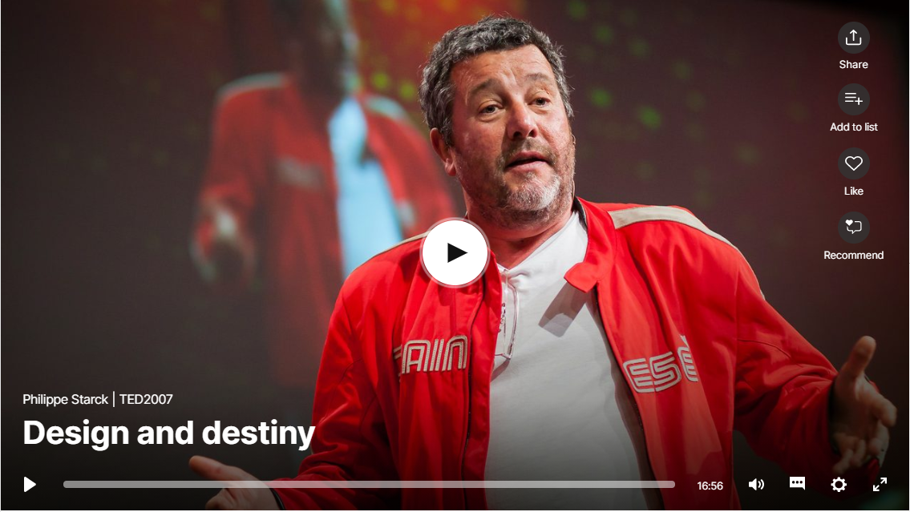

Slide 16
Structure
Steps
Move 1: Orientation
Move 2: Rationale
Move 3: Framework
Move 4: Purpose
Move 5: Methods
Move 6: Results
Move 7: Implication
Move 8: Termination
Introduction
Body
Conclusion

Slide 17
01
Orientation
Listener & Content Orientation
Greeting the Audience
Introduces the topic and provides background information to prepare the audience for the next move
“Ladies and gentlemen! Today I want to talk to all of you about thousands of robots right across the world that want to make your lives better.”

Slide 18
02
Rationale
State the motivation of the research
Convince the audience of the relevance or usefulness
  Gaps
  Problems
  Needs
“Unfortunately, we know very little. But one thing we do not expect.. On the other hand, people with other disease also produce the protein, but somehow they don’t stick together and form plug. We do not fully know why.”

Slide 19
03
Framework*
* Not Obligatory !
Set out a theoretical position, model or framework that was adopted as a basis for their research prior to the collection and analysis of their data
“To classify species as a lek breeder, there’s four criteria that have to be met. And I use some analogies in human behavior to help explain them. First…”
“My research is founded upon a theory called Activity Theory and activity theory simply tells me that human beings create or adopt tools to…”

Slide 20
04
Purpose
State research objectives, purposes or focus of the study, and/or specific research questions
“The big question that we want to know is how effective are these reading programs for these struggling readers, considering their limited resources.”
“The purpose of my research is to investigate individual feeding strategies in seabirds…”

Slide 21
05
Methods
Inform audience of how the research is/was undertaken, often by describing the materials used, such as a model species, and the technology adopted
Justify why a certain material, method, or approach was chosen
“How am I doing this? By a new combustion technology called MILD or flameless combustion.”
“Now historians have tended to use adults’ reflective sources such as autobiographies and memoirs to tell us about childhood, but I argue that we really need to use and hear the children’s voices. So I use hundreds of evacuee letters in my work…”

Slide 22
06
Results*
*Not Obligatory !
Informs the audience of what has been found so far or what is expected to come out of the research
“As a result, I’ve discovered that guerrilla warfare is not chaotic…”
“My findings show that drama can facilitate the reading in at least three ways.”
“And what I found is that where catalase’s present, less hydrogen peroxide is produced, causing less damage to the host.”

Slide 23
07
Implication
Draw conclusions, discuss the implications, significance and contributions of the reported research, or offer recommendations
Answer the question “So What? Why is the research important?”
“ My research shows that it is very important to encourage parents to read to the children… And my research also shows that it’s very important that teachers use diverse strategies to teach vocabulary to young children”
“And ultimately with this dummy, vehicle manufactures can design safer cars and take a deep bite out of this 7,500 people that dies each year in US from rollover crashes.”

Slide 24
08
Termination
End the presentation by thanking the audience with a simple expression or in a more elaborate way
Pose questions to the audience to stimulate their thought or create some kind of suspension before ending the presentation
“I thank you kindly for your patience and kindness!”
“So, do you want to know what the penny in your pocket will be worth tomorrow? Thank you.”

Slide 25

02
3MT Analysis
Notes:
Image used in the preview file : https://unsplash.com/photos/ZqLeQDjY6fY

Slide 26
Workshop
Groups!

Slide 27
Workshop
3MT Winning Presentations Analysis
  How closely does the presenter follow the model?
  How did they make graduate research understandable?
    How technical were they?

Slide 28
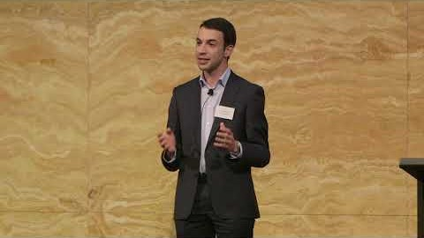

Slide 29
Workshop
1: Orientation
  Great and powerful city metaphor
  Picture/slide
  Dangers of pancreatic cancer
2: Rationale
  Pancreatic cancer is a death sentence
  Why pancreatic cancer is so dangerous

Slide 30
Workshop
3: Framework
  NA
4: Purpose
  Conquer the pancreatic capital
5: Methods
  Designed a gene therapy nano drug
    Penetrates the fortress and reprograms helper cells
  Used another drug too

Slide 31
Workshop
6: Results
  Nano drug destroyed tumor
  Tracked down mechanism
7: Implications
  Could signal the death knell to the scourge of pancreatic cancer
8: Termination
  Perhaps pancreatic cancer will become a treatable/curable disease

Slide 32
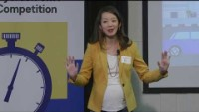

Slide 33
Workshop
1: Orientation
  Games shape who we are
  Can shape perceptions
  Monopoly
  How we learn lessons from games
  What is it about games that make them special
  Simulate scenarios

Slide 34
Workshop
2: Rationale
  Board games are powerful tools for social engagement and collective problem solving
3: Framework
  NA
4: Purpose
  Design a board game to influence how people relate to climate change

Slide 35
Workshop
5: Methods
  Designed a board game
  Researched and adapted game mechanics to mimic the attributes of climate change
  Description of the game
6: Results
  Research questions
  Preliminary findings
  Pushes players to confront their biases
  Galvanized frustrations toward inefficient use of common resources

Slide 36
Workshop
7: Implications
  What if the drive for winning and frustration towards loosing could be linked to a degree of self-reflection about how we behave in real life?
  This self-reflection could inspire a shift in mindset and behavior
8: Termination
  Thank you

Slide 37


Slide 38
Workshop
1: Orientation
  Flooding scenario with pharmacists
2: Rationale
  During disasters health systems become overburdened and unbalanced
  Large number of patients, reduced number of health professionals
  Pharmacists can help

Slide 39
Workshop
3: Framework
  NA
4: Purpose
  To develop recommendations to enhance the preparedness of pharmacists to respond to disasters in local communities

Slide 40
Workshop
5: Methods
  Began to interview pharmacists
  Next phase of the research
6: Results
  Brief description of the results of the interviews

Slide 41
Workshop
7: Implication
  These recommendations could lead to legislative change or support the development of a training program
8: Termination
  Imagine initial scenario, but now you have the solution

Slide 42
3MT Criteria
No more than 3 minutes
Do not have to introduce yourself
1 slide
  No sound
  No animation
No costumes or props

Slide 43

Slide Design
Content Design

Slide 44
Slide Design
  Philosophy
  Examples
  Analysis

Slide 45


Slide 46
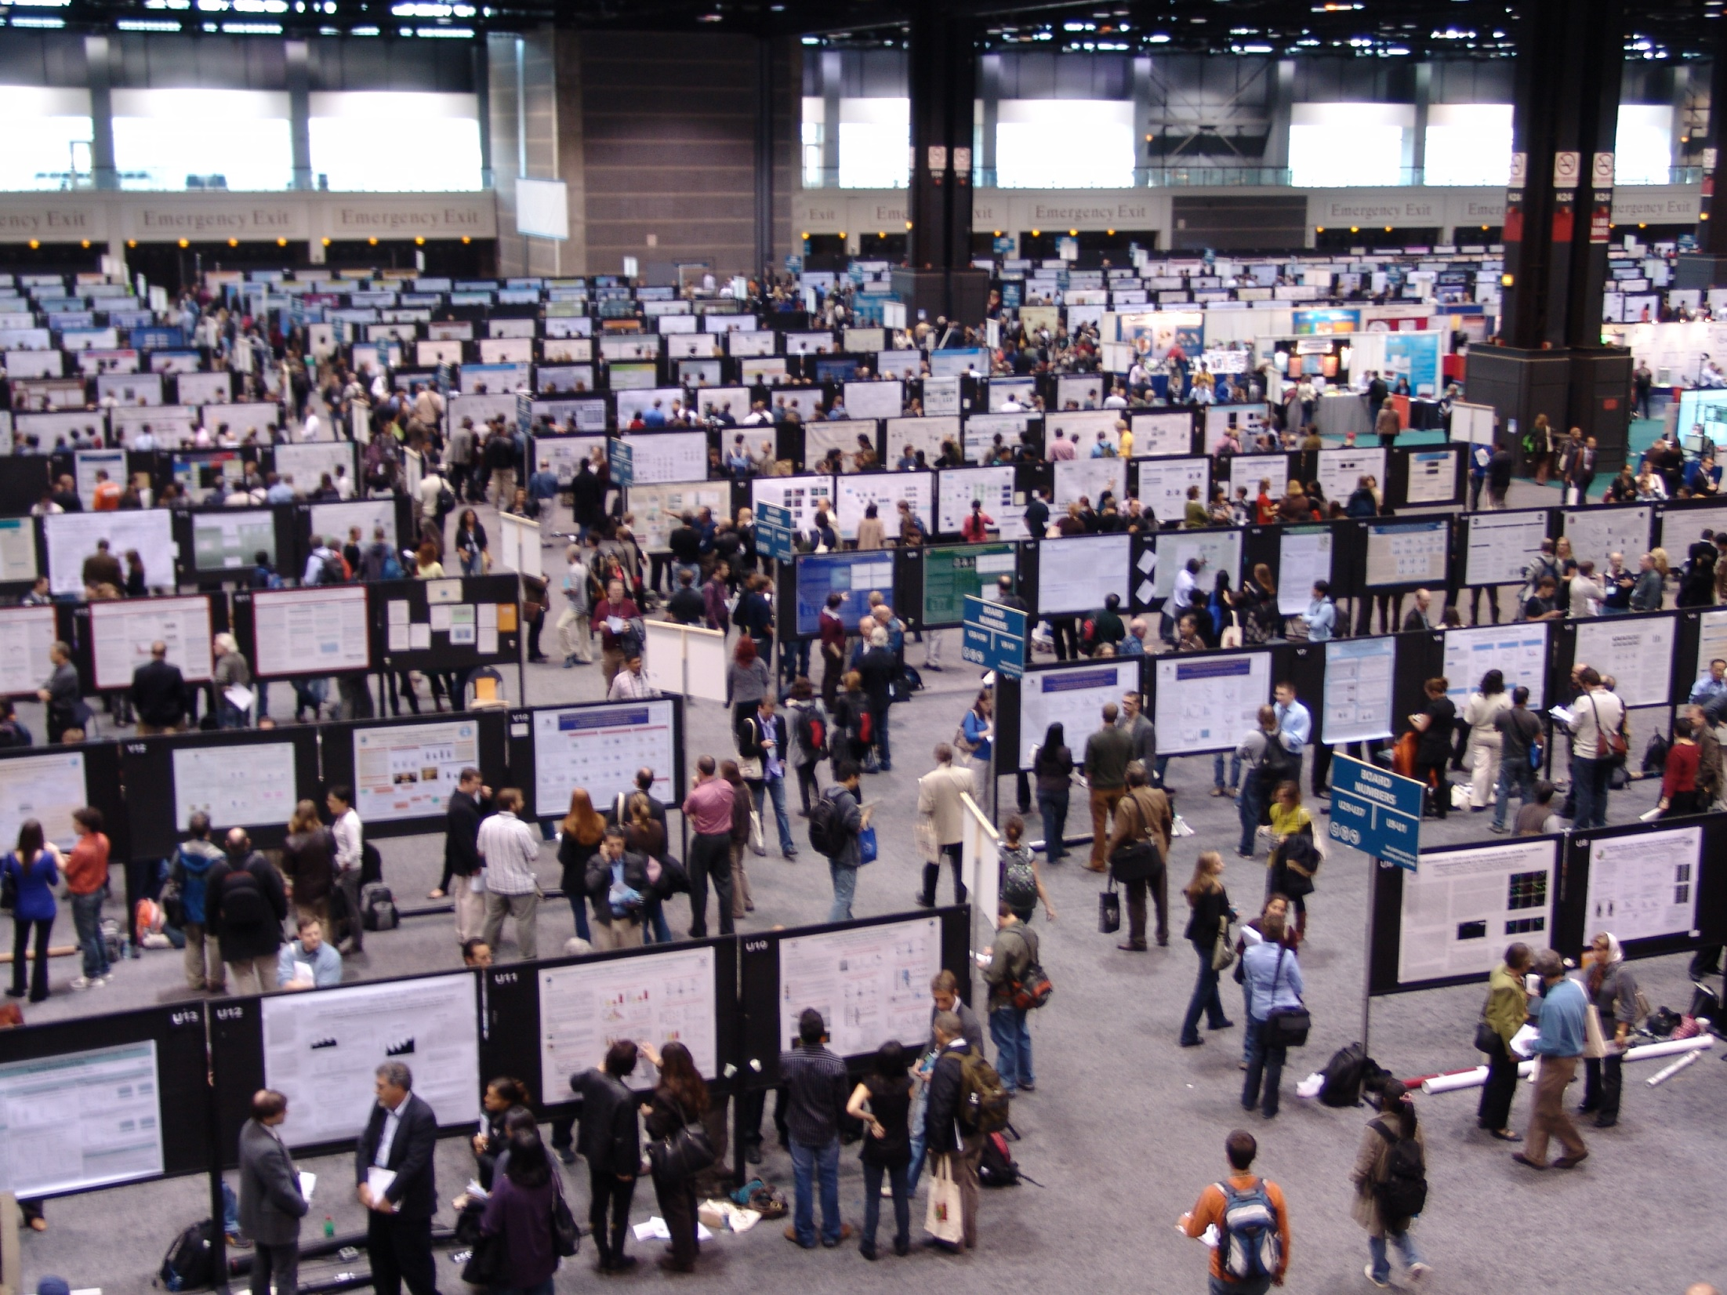

Slide 47
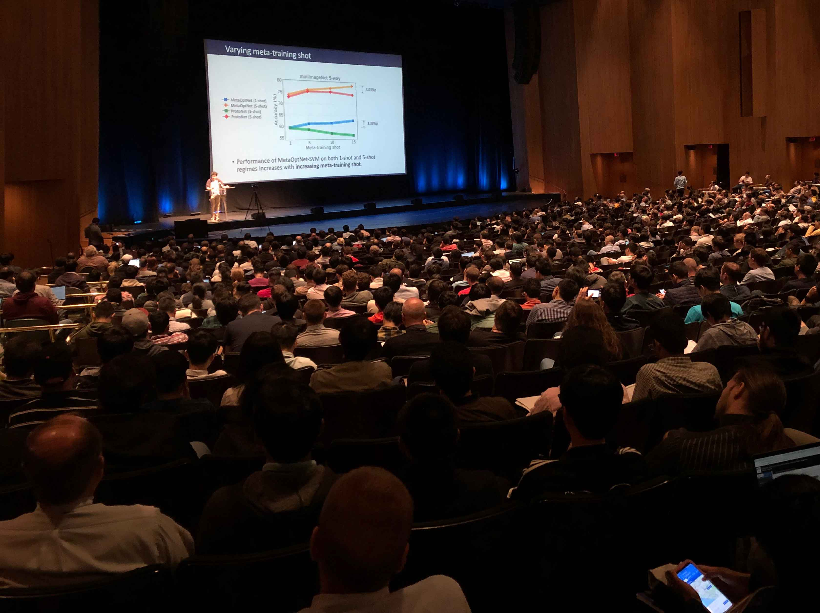


Slide 48
Slide Design
  Philosophy
  Examples
  Analysis

Slide 49
3MT Slide Philosophy
Simple Clean Design
Less is More
1
2
A Picture Is Worth a Thousand Words
Memorable
3
4
Does Not Distract from Your Presentation
Make It Easy for Your Audience
5

Slide 50
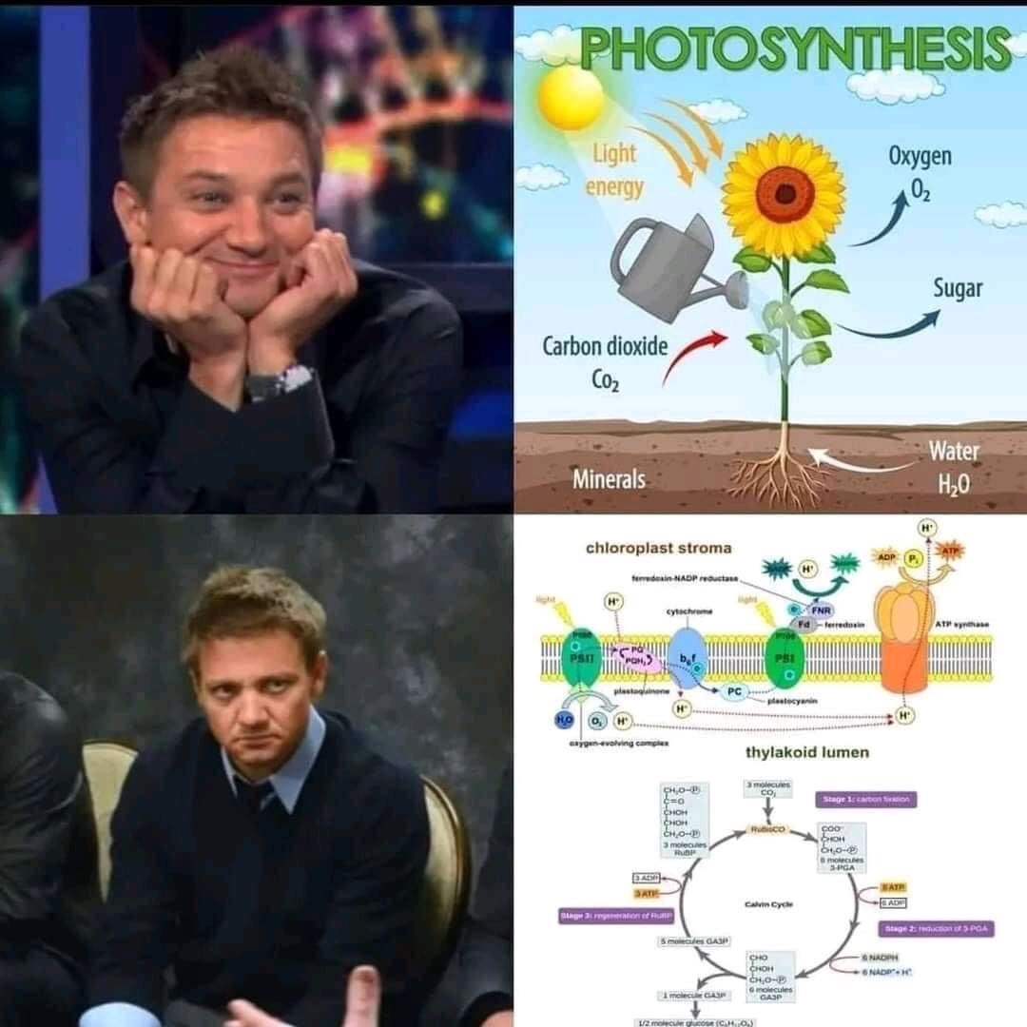

Slide 51
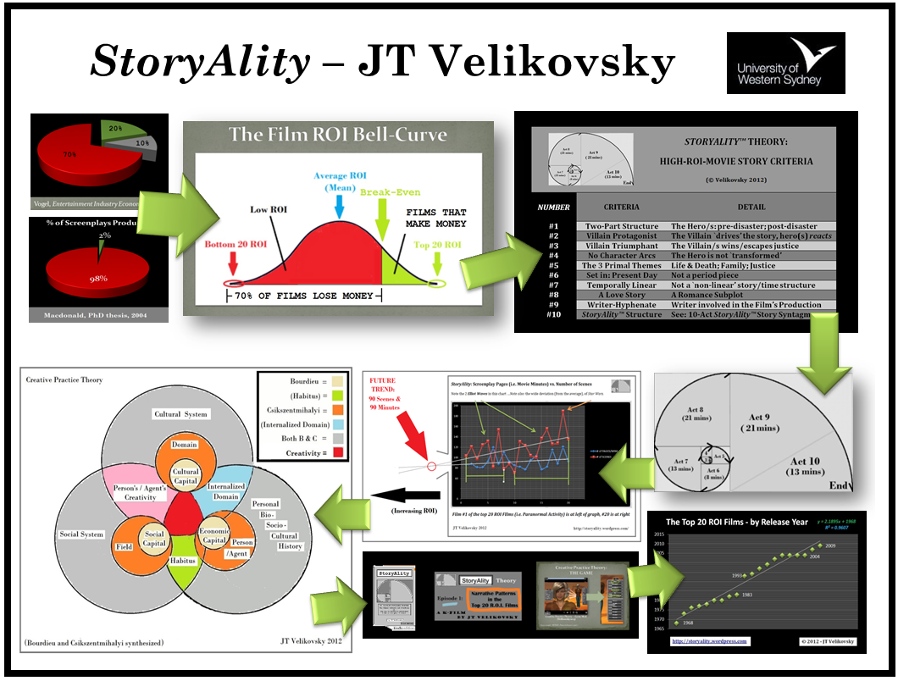
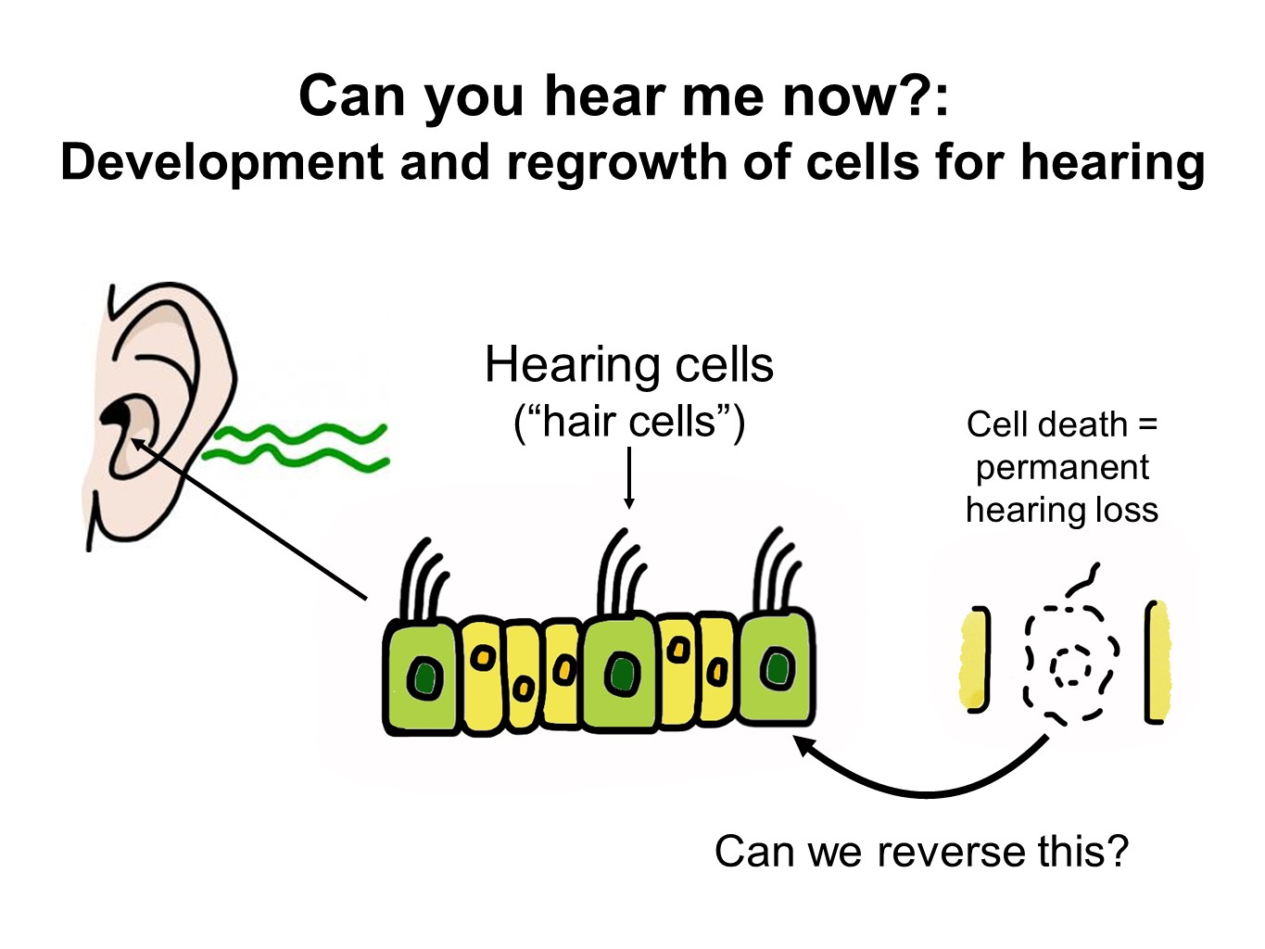
01
Simple Clean Design
Too much going on
Hard to follow
Distracting
Easier to follow
More productive
Notes:
Slide 1
IMRD Approach
Too much
Not a regular presentation
Slide 2
Much more clear
Focus on conveying main idea
IMRD Discussion
Not advisable to put all sections
Focus on what is most important / interesting

Slide 52
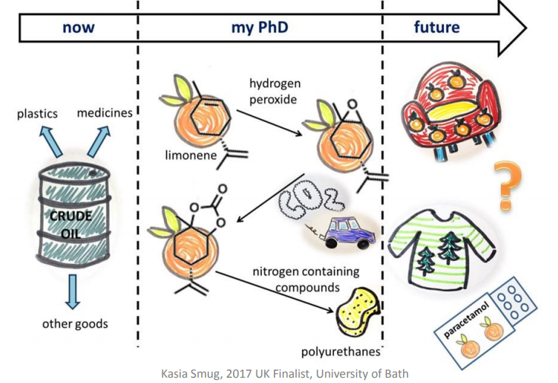
01
Simple Clean Design
Notes:
Slide 1
IMRD Approach
Too much
Not a regular presentation
Slide 2
Much more clear
Focus on conveying main idea
IMRD Discussion
Not advisable to put all sections
Focus on what is most important / interesting

Slide 53
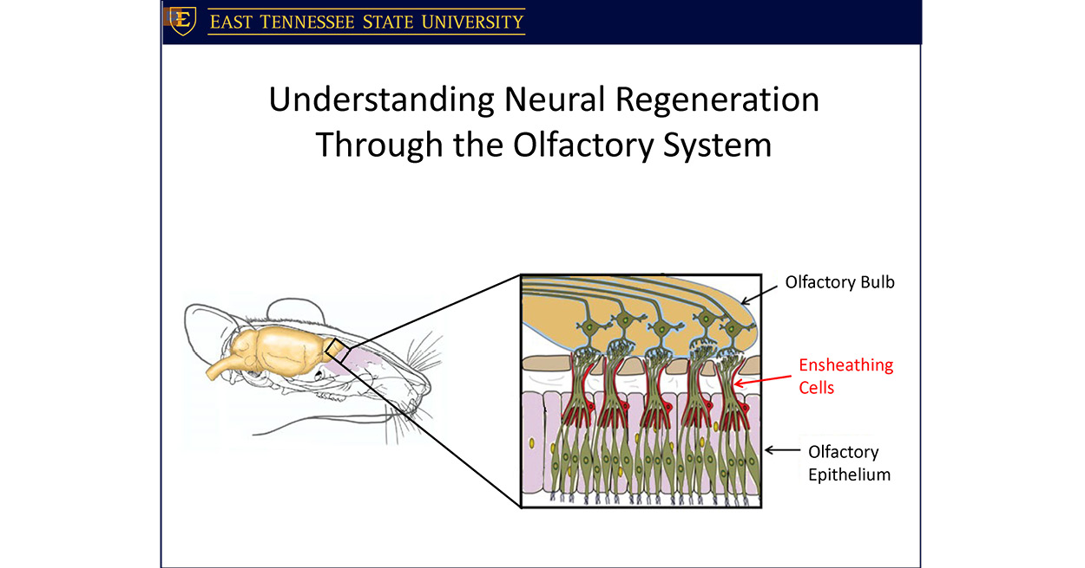
01
Simple Clean Design
Notes:
Slide 1
IMRD Approach
Too much
Not a regular presentation
Slide 2
Much more clear
Focus on conveying main idea
IMRD Discussion
Not advisable to put all sections
Focus on what is most important / interesting

Slide 54
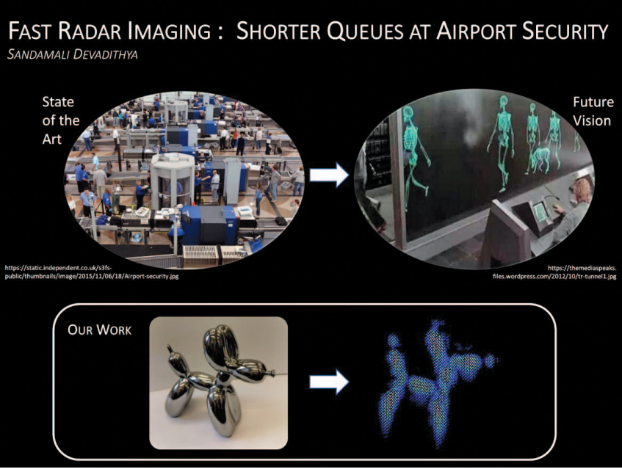
01
Simple Clean Design
Notes:
Slide 1
IMRD Approach
Too much
Not a regular presentation
Slide 2
Much more clear
Focus on conveying main idea
IMRD Discussion
Not advisable to put all sections
Focus on what is most important / interesting

Slide 55
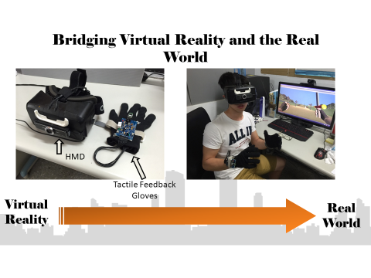
01
Simple Clean Design
Notes:
Slide 1
IMRD Approach
Too much
Not a regular presentation
Slide 2
Much more clear
Focus on conveying main idea
IMRD Discussion
Not advisable to put all sections
Focus on what is most important / interesting

Slide 56
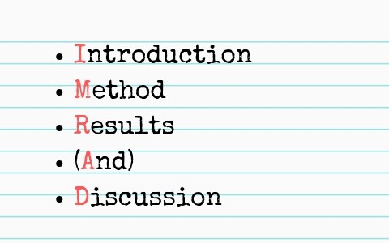
01
Simple Clean Design
Notes:
Don’t cover all IMRD
Choose the parts you will talk about the most
No results → focus on possible outcomes, goals, or applications

Slide 57


02
A Picture Is Worth a Thousand Words
The Taiwan subtropical evergreen forests is an ecoregion that covers most of the island of Taiwan, with the exception of the southern tip of the island, which constitutes the South Taiwan monsoon rain forests ecoregion
Notes:
Never seen a finalist slide with no imagery
Use images in place of text when possible
You can still talk about them, but don’t let them distract from you
Map Example
2017 Finalist
Pictures follow the presentation

Slide 58
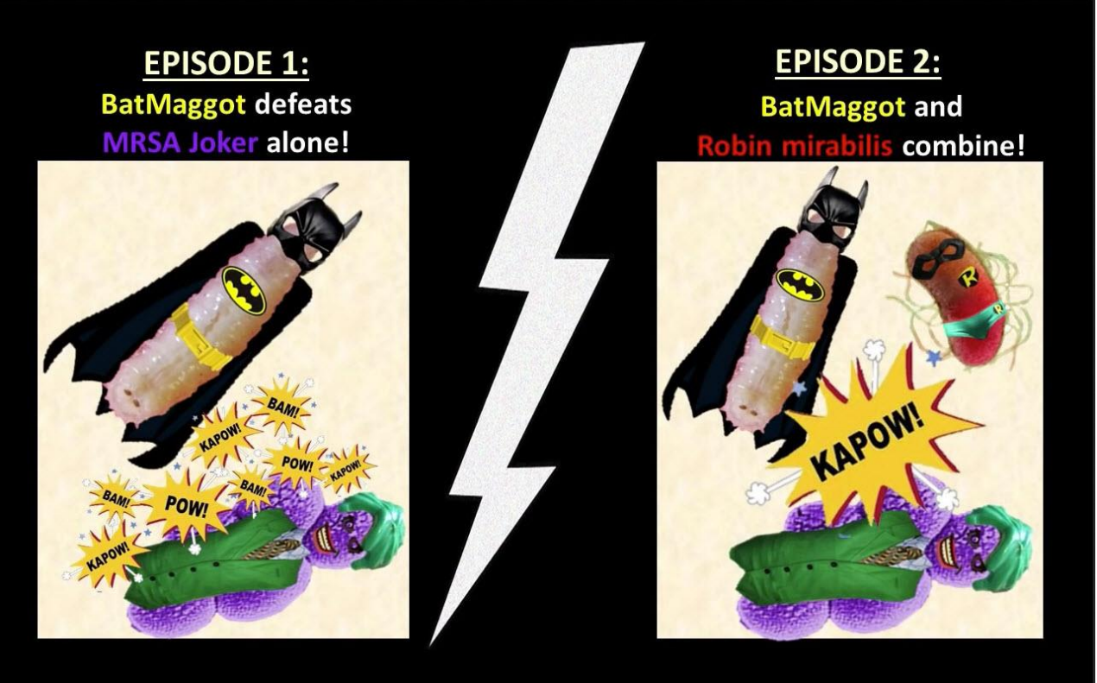

03
Memorable
Has a personal / emotional impact right away
Something you will remember

Slide 59
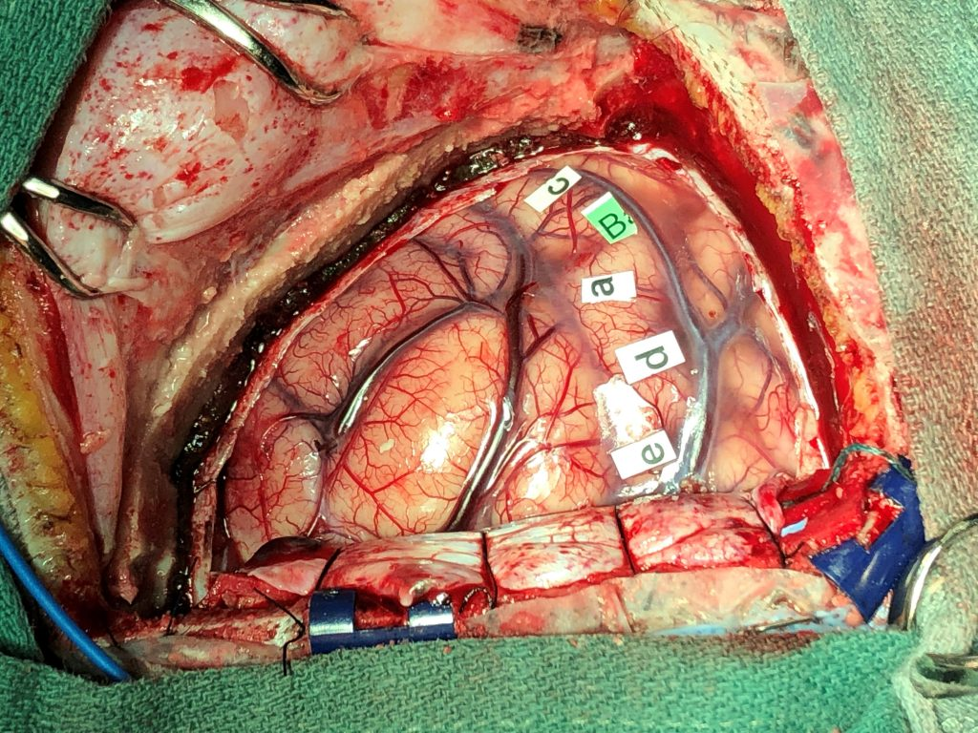
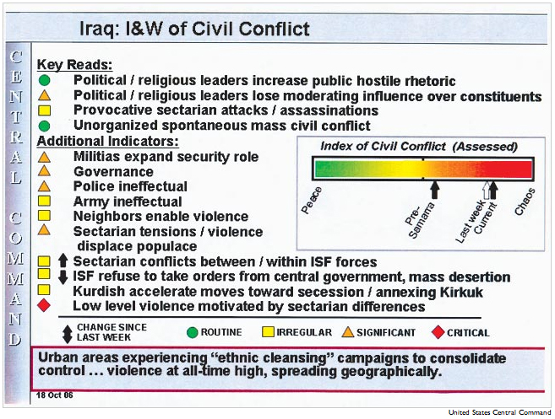
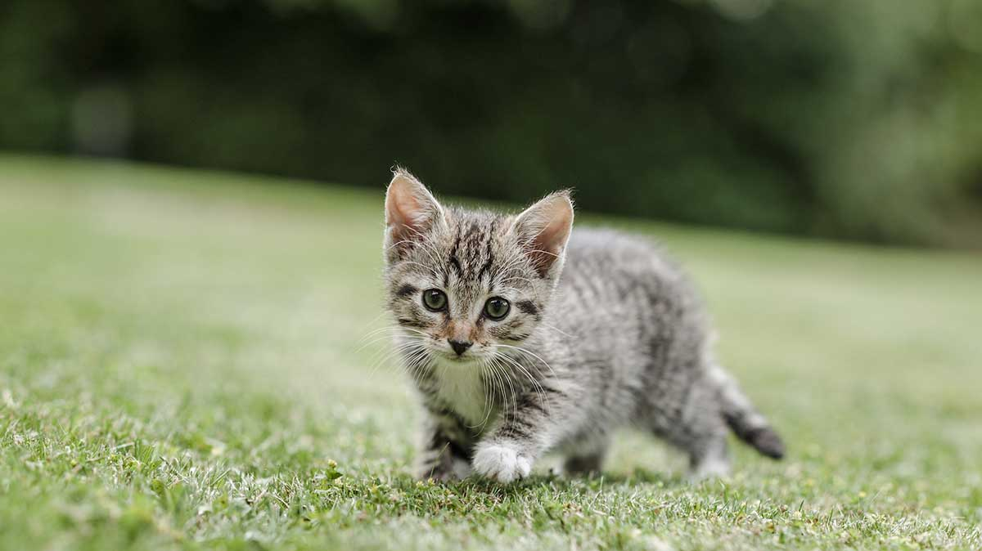
04
Does Not Distract
Notes:
Avoid:
Can’t tell what it is
Poor quality or fuzzy
Things that make people uncomfortable
Too many things going on
Cutesy or contrived

Slide 60
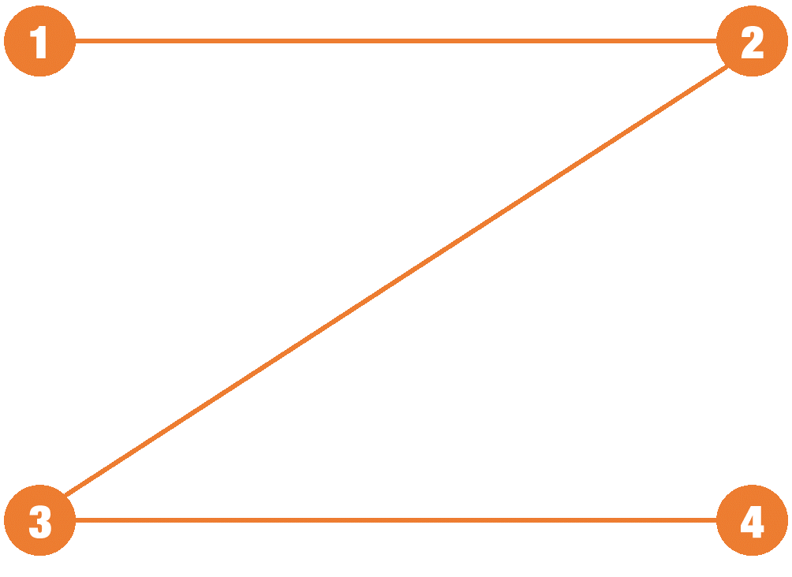
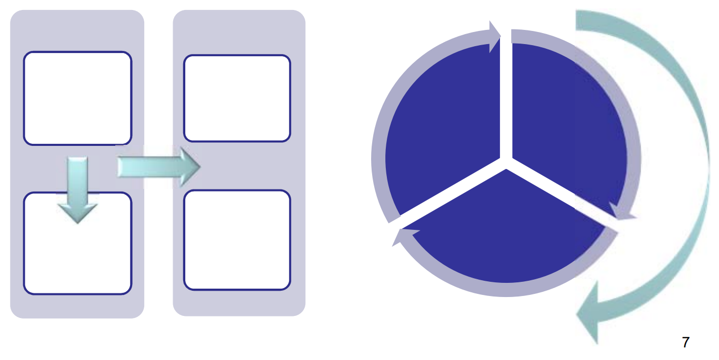
05
Make It Easy for Your Audience
Notes:
Eye Path
Top to bottom
Left to right
Left → Right → Top → Bottom
Hierarchy
Colors

Slide 61
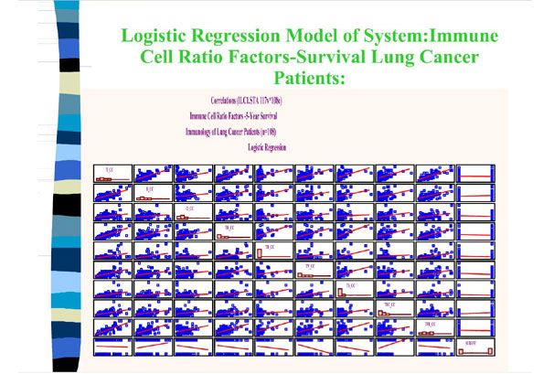
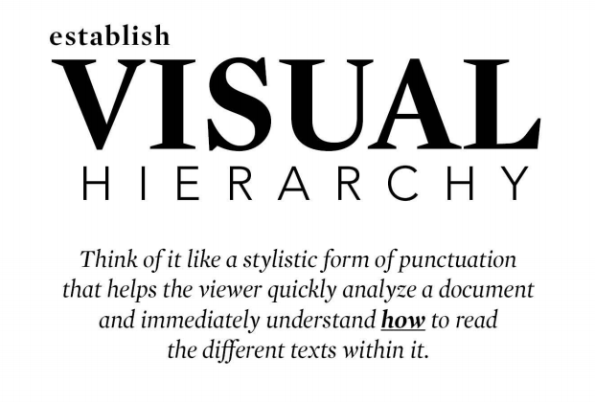
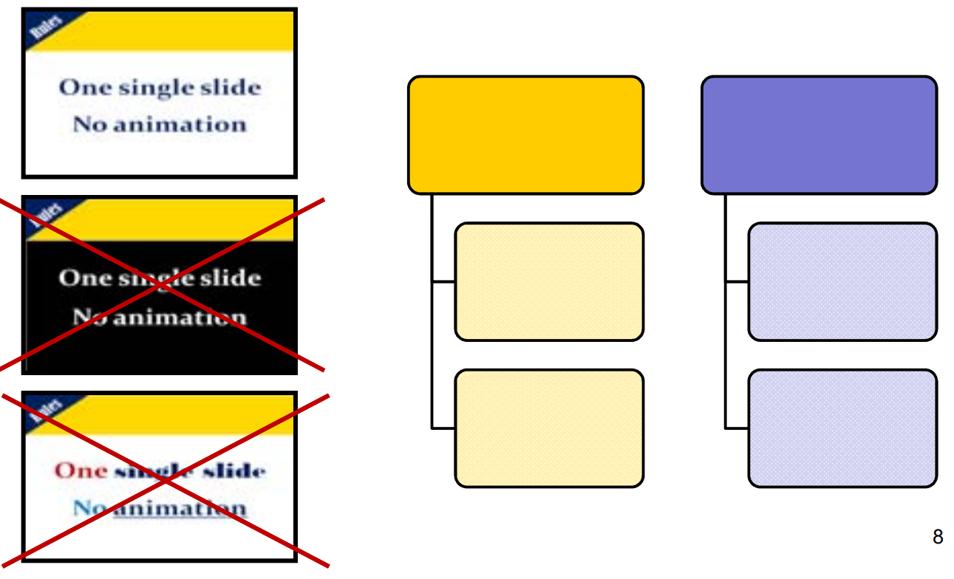
05
Make It Easy for Your Audience
Notes:
Eye Path
Top to bottom
Left to right
Left → Right → Top → Bottom
Hierarchy
Colors

Slide 62
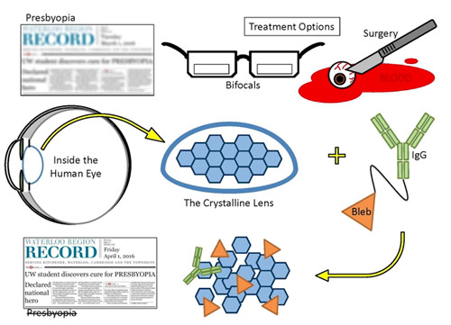

Slide 63
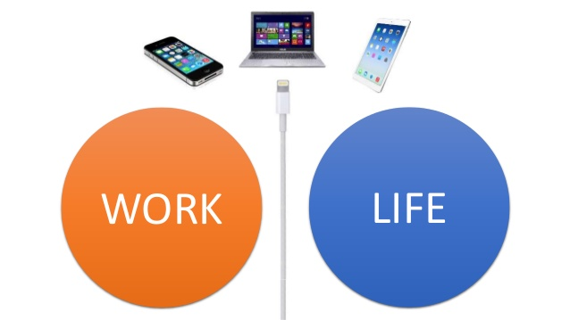

Slide 64
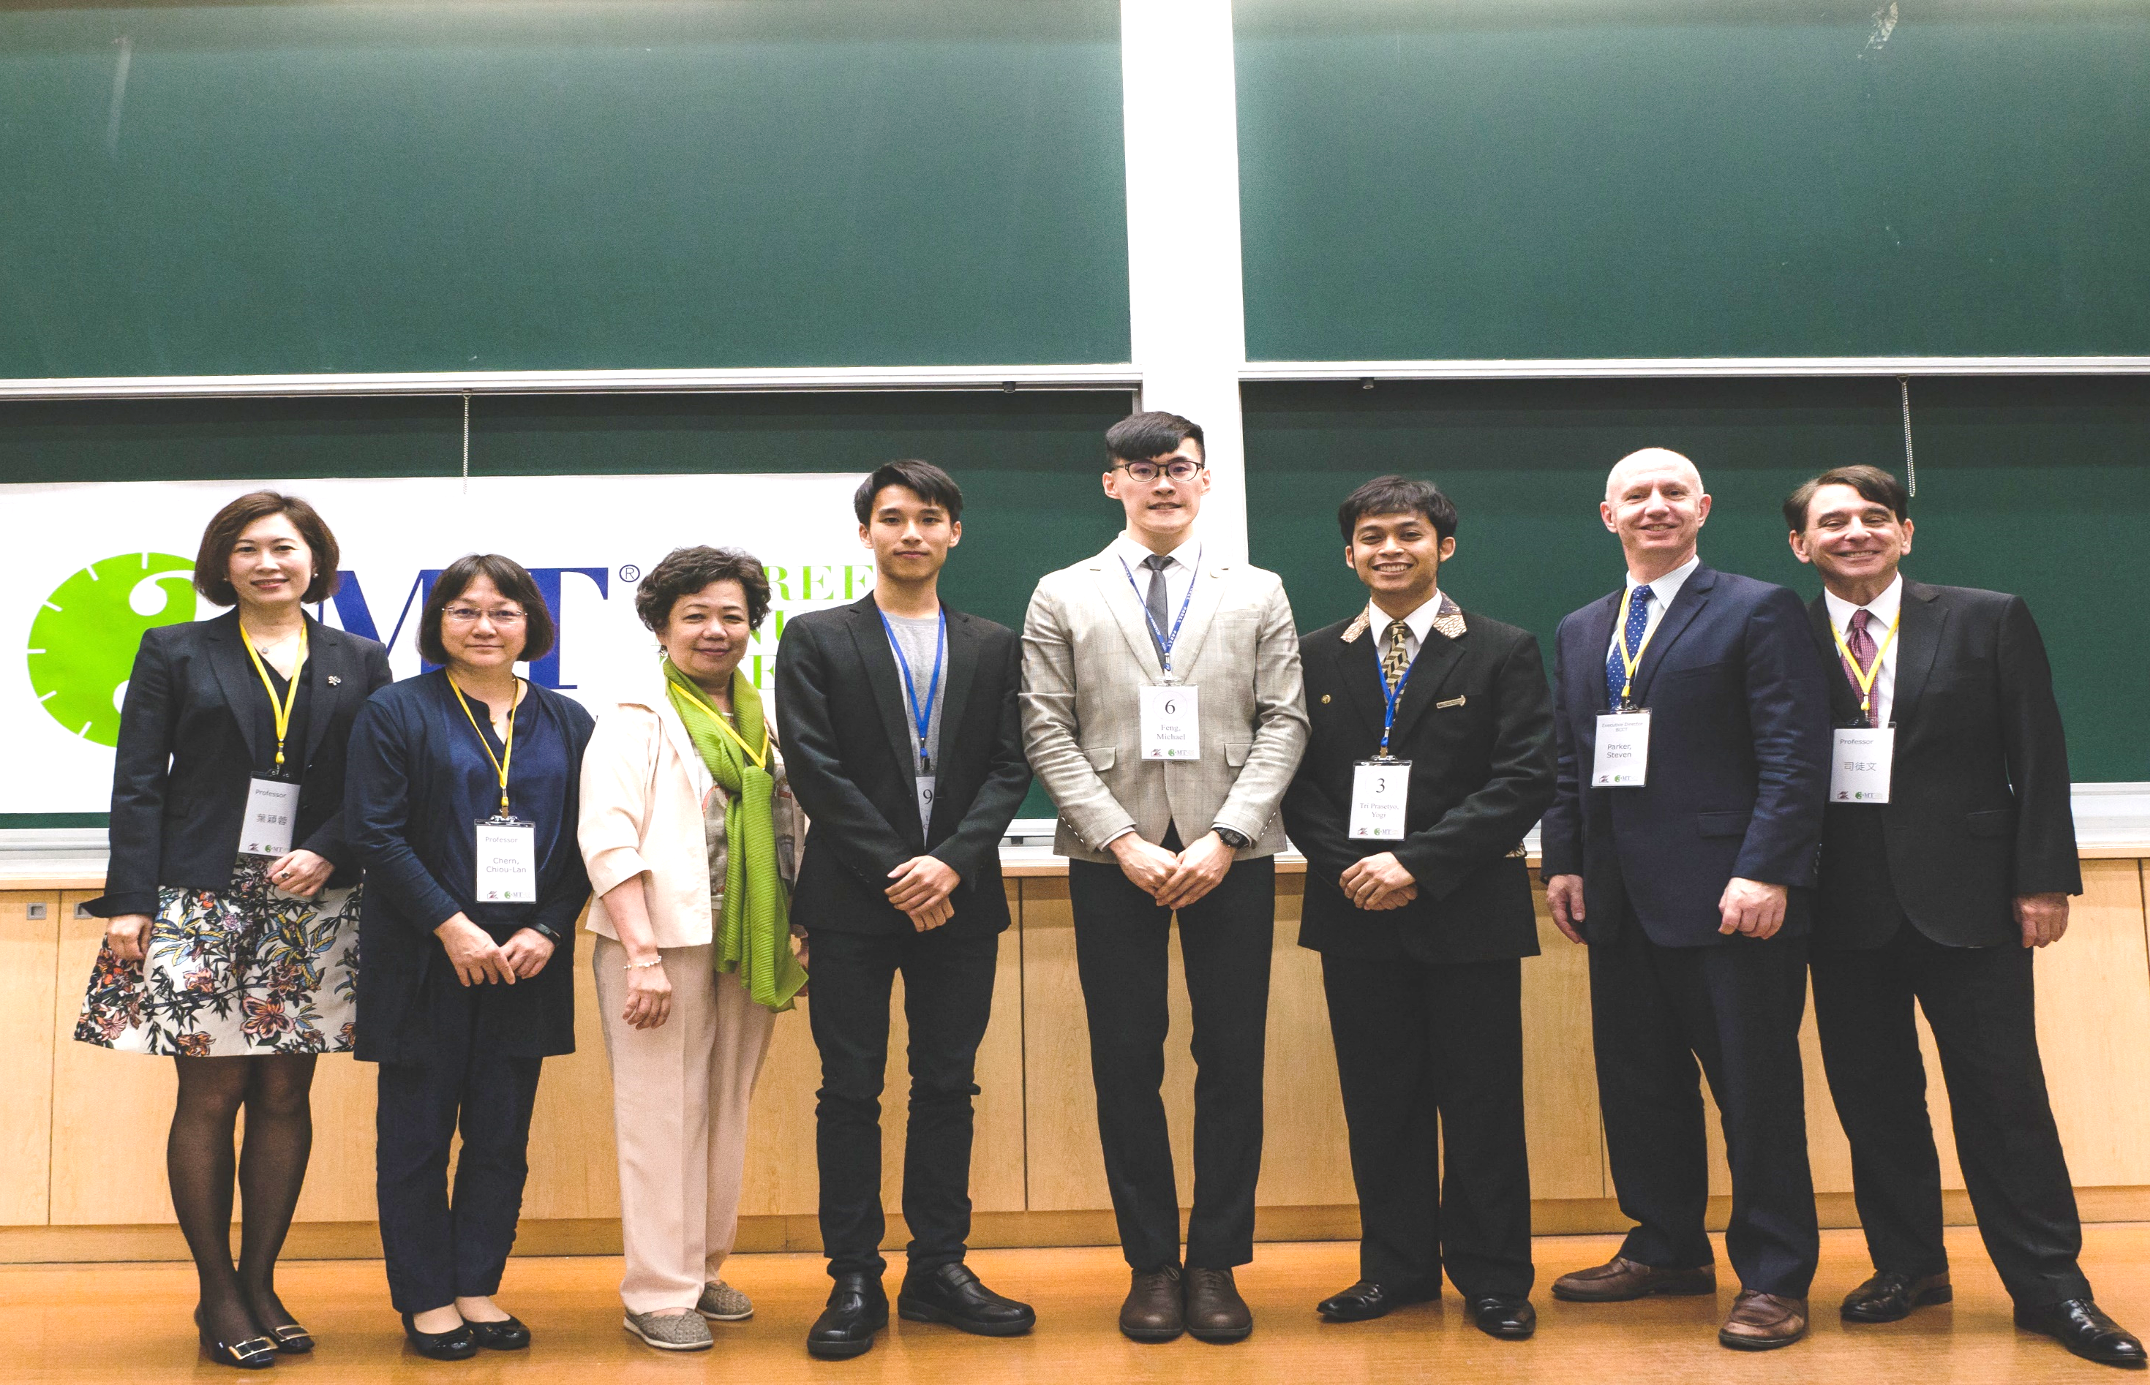

Slide 65
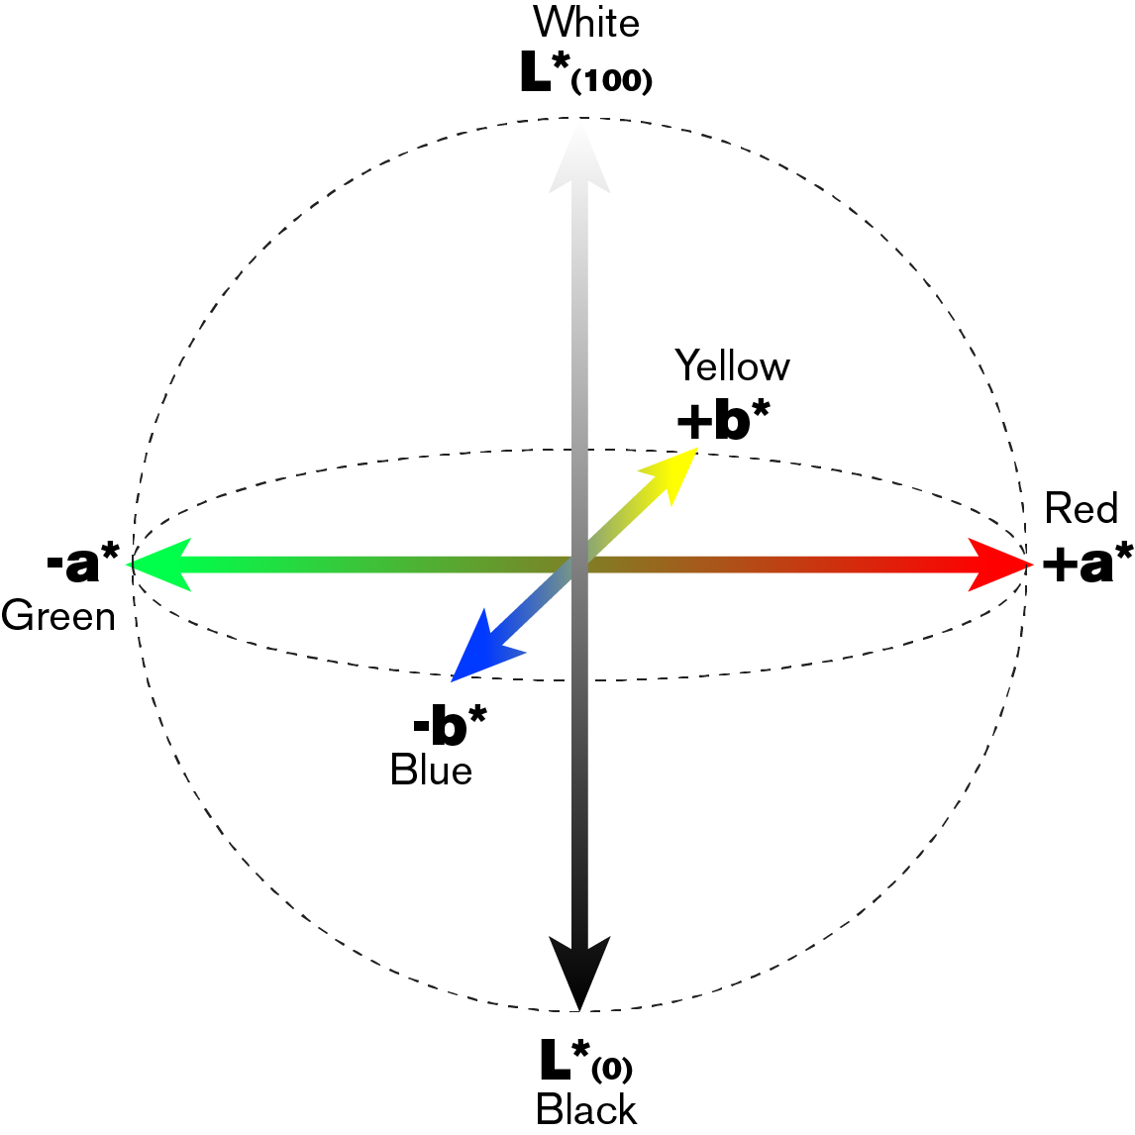

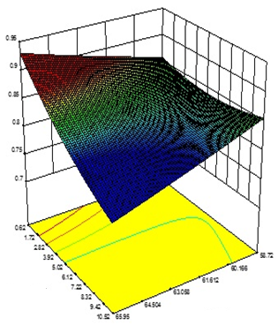

1. CIELAB Color Space
2. Optimization

Slide 66
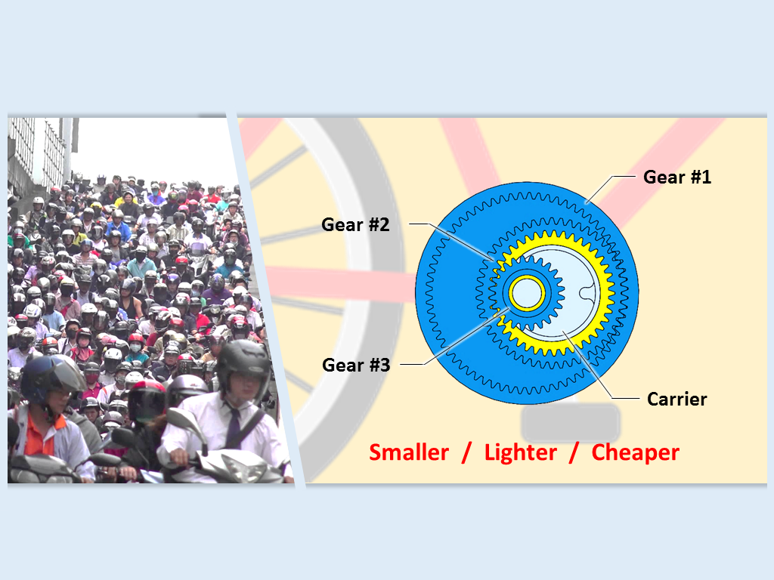

Slide 67
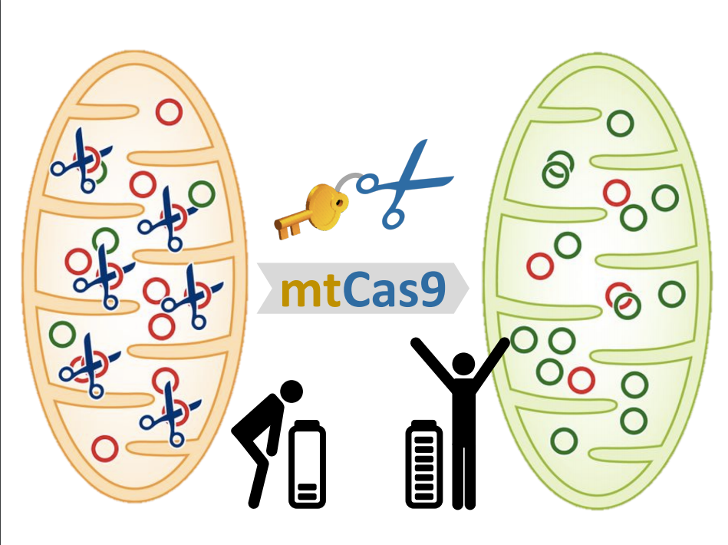

Slide 68
*
3MT Titles
“Ventilation distribution and lung recruitment with speaking valve use in tracheostomized patient weaning from mechanical ventilation in intensive care”
“Examining tourist non-purchase intention of peer-to-peer accommodation: impeding factors and perceived risks”
“Hayashi Yasuo and Yagi Kazuo in postwar Japanese ceramics: the effects of intramural politics and rivalry for rank on a ceramic artist’s career” from the slow fashion movement”
Notes:
Eye Path
Top to bottom
Left to right
Left → Right → Top → Bottom
Hierarchy
Colors

Slide 69
*
3MT Titles
“Answering Ancient Questions with Modern Methods”
“Re-growing Appalachia: Understanding the Hydrologic Impacts of Deforestation and Restoration”
“How to Learn a Language from the Dead”
Notes:
Eye Path
Top to bottom
Left to right
Left → Right → Top → Bottom
Hierarchy
Colors

Slide 70
*
3MT Titles
“Ventilation distribution and lung recruitment with speaking valve use in tracheostomised patient weaning from mechanical ventilation in intensive care.”
“Dying to talk”
Notes:
Eye Path
Top to bottom
Left to right
Left → Right → Top → Bottom
Hierarchy
Colors

Slide 71
*
3MT Titles
“Sex-specific dmrt1 and cyp19a1 methylation and alternative splicing in gonads of the protandrous hermaphrodite barramundi.”
“Let’s talk about sex change”
Notes:
Eye Path
Top to bottom
Left to right
Left → Right → Top → Bottom
Hierarchy
Colors

Slide 72
Considerations
Your slide is the background for your performance
Try to communicate only your primary message
One of the first things your audience will see

Slide 73
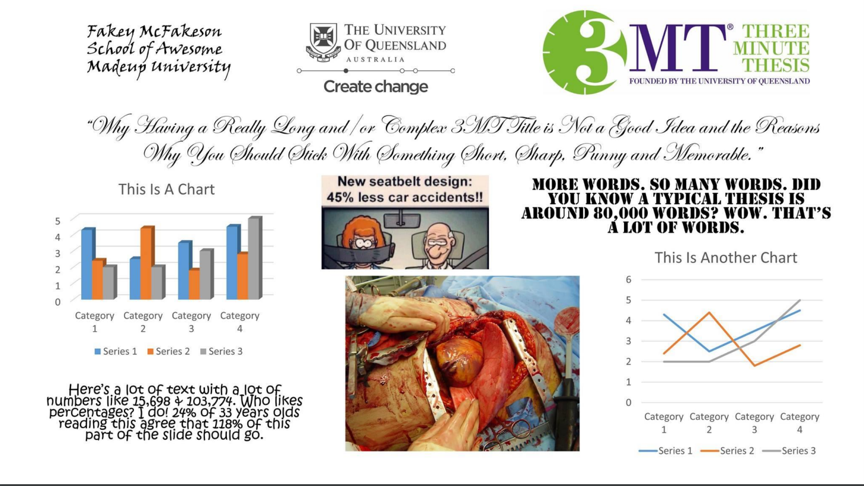

Slide 74
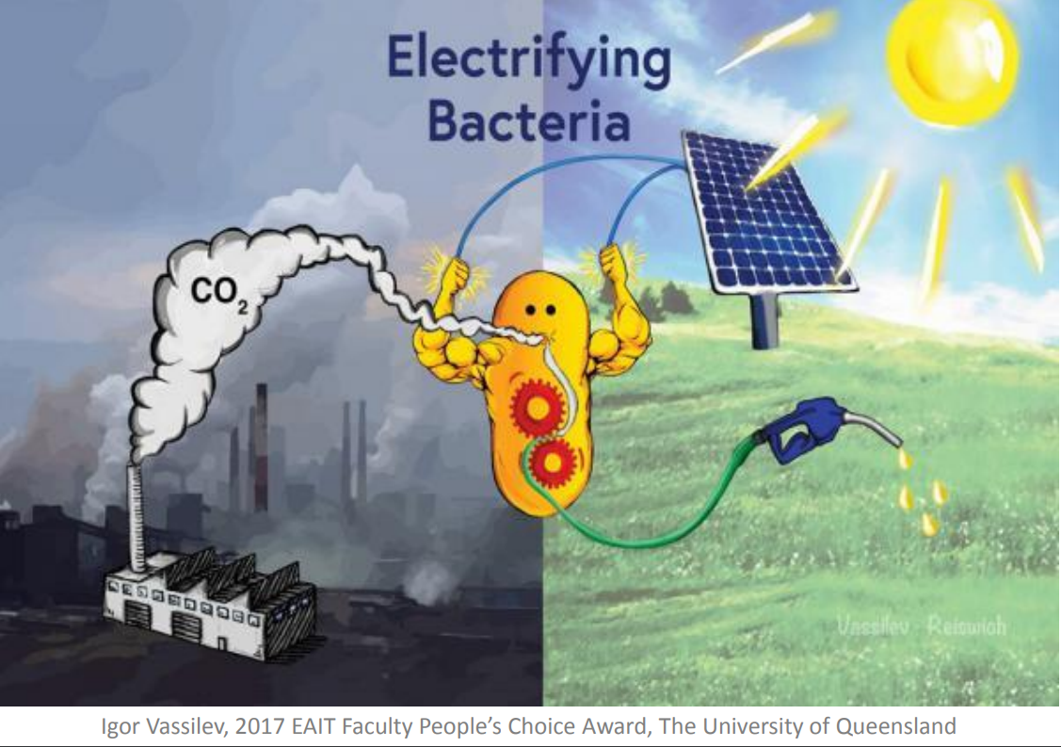

Slide 75
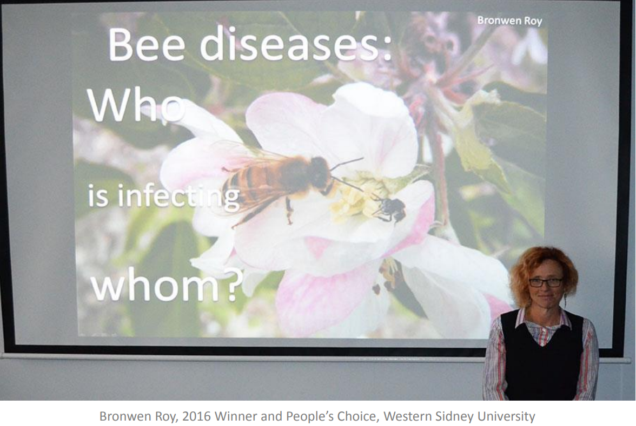

Slide 76
Summary
Simple and Clean
  Focused
Effective Images
Impact
Not Distracting
Easy On the Audience

Slide 77

03
Talking About your Research
Notes:
Image used in the preview file : https://unsplash.com/photos/ZqLeQDjY6fY

Slide 78
Workshop
Share your research introduction to your group
  Read it out, don’t just “show” it to them
Feedback
  Does the research sound:
    Important/necessary?
    Interesting?
  Is it easy to understand?
  Does the language sound like a conversation or a lecture?
  If no to any of these, what could they do to fix it?

Slide 79
Talking about your research
What next?
  Begin to put your 3MT together
    Take the feedback that you received today
    Ensure that your 3MT is understandable and interesting for your audience
Things to accept
  You will have to simplify
  It’s not important for audience to understand details
    They just need the general picture
      Avoid difficult language and terms

Slide 80

04
From Script to Outline
Notes:
Image used in the preview file : https://unsplash.com/photos/ZqLeQDjY6fY

Slide 81
Discussion
How do you prepare for a presentation?
  Script?
  Outline?
  Other?
What do you think is the ‘best’ way?
What do you think is the ‘best’ way if you are short on time or energy?

Slide 82
Advantages of a Script
If grammar bothers you
  Can fix it
Get feedback from colleagues without having to perform each time
Insert into ppt notes if you are using presenter view
Work on voice performance

Slide 83
Write down your speech
Script isn’t necessarily for memorization
More about organization, content, and design
  Help you decide
    What the best structure is
    What information could be cut
    If audience really needs to know what you are planning to say

Slide 84

If you are presenting your paper, should you use the text directly from your paper?

Slide 85
Don’t lift text directly from your paper
Papers and presentations are different
  Papers tend to be
    More formal
    Longer sentences
    Considerably more detail

Slide 86
Task 1
Compare these two versions of text
Which would be a paper?
Which would be a presentation script?
How can you tell!?

Slide 87
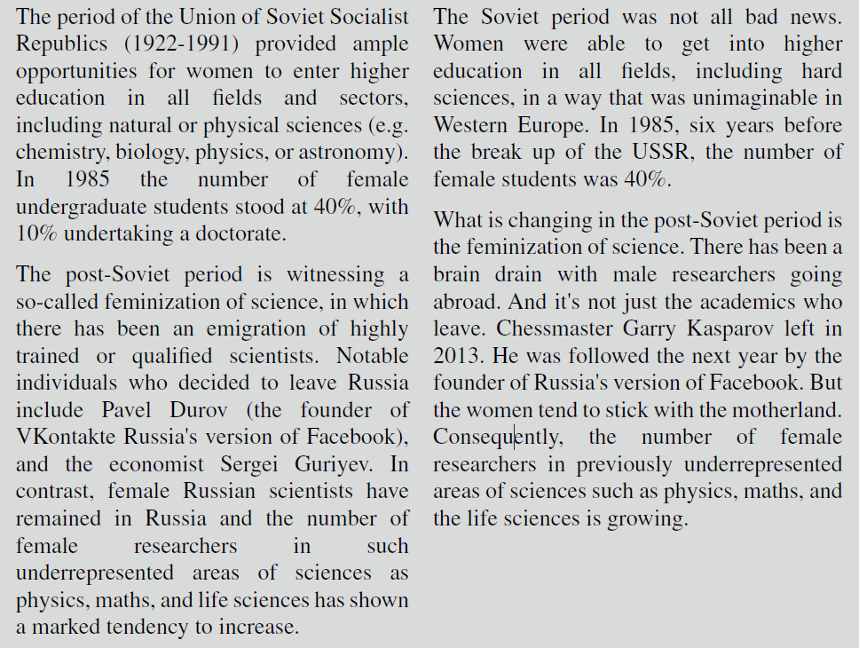

Slide 88
Task 1
B is:
  Much more listener friendly (look at the first sentence of each version!)
  Generally uses shorter sentences and thus easier to say
  Uses less formal language
    Brain drain vs emigration of highly trained or qualified scientists
  Fewer hard facts
    Exact dates of the Soviet Republic…
  More interesting facts, or presented in a more audience related way
  Uses a narrative style

Slide 89
Only have one idea per sentence
Each sentence should only contain one idea
  Makes it easier for you to say and for audience to understand
Use short phrases containing words that you find easy to say

Slide 90
Listen to Kevin
Kevin will read two versions of a text
Goal
  Take notes based on Kevin’s reading
Task
  2 groups for each passage
  Try to write down the main pieces of information

Slide 91
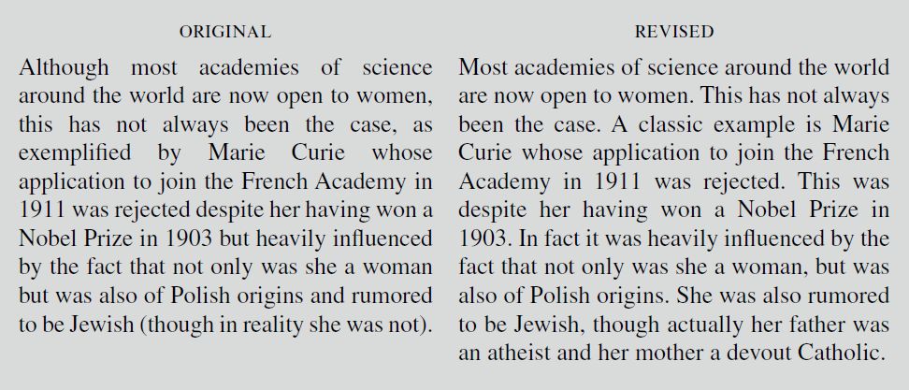

Slide 92
Only have one idea per sentence
Passage A
  1 sentence, 75 words
  In text form, not difficult to understand
  In a presentation:
    Hard for the presenter to say
    Audience will have much more difficulty following

Slide 93
Only have one idea per sentence
Passage B
  Four short sentences instead of one long one
    Give you natural pauses when speaking
  Emphasis and drama can be created by very short phrases interrupted by pauses

Slide 94
“ The most valuable of all talents is that of never using two words when one will do.”
Thomas Jefferson

Slide 95
Be concise – Only say things that add value
The more words you use:
  The more mistakes in English you might make
  The less time you have to give the audience important technical info

Slide 96
Examples of sentences that could be deleted
The work I am going to present to you today is…
My presentation always begins with a question…
I have prepared some slides…
This presentation is taken from the first draft of my thesis…
The title of my research is…

Slide 97
Phrases that could be reduced considerably
Testing [can be considered an activity that] is time consuming
The main aim of our research [as already shown in the previous slides] is to find new methodologies for calculating stress levels. [In order to do this calculation,] We first designed…

Slide 98
Phrases that can be reworded to make them more concise
Another thing we wanted to do was
We also wanted to
In this picture I will show you a sample
Here is a sample
Regarding the analysis of the samples, we analyzed them using…
We analyzed the samples using…

Slide 99
Simplify sentences that are difficult to say
Try reading this sentence aloud:
In 2016, Kay proved that most people speak at a speed of one hundred and twenty to two hundred words per minute, but that the mind can absorb information at six hundred words per minute

Slide 100
Simplify sentences that are difficult to say
Difficult to say
  Lots of numbers
  Repetition of sounds

Slide 101
Simplify sentences that are difficult to say
Aim should be to create sentences that you find easy to say
Scripts help you identify sentences that do not come out of your mouth easily or naturally
Read script aloud, underline phrases that are difficult to say, rewrite until you find a form that is easy for you

Slide 102
Simplify sentences that are difficult to say
Task 2
  Work with a partner
  Modify the original sentence so that it is easier for you to say
  Consider the various things we have discussed so far today
  Be emotionally ready to perform

Slide 103
Simplify sentences that are difficult to say
Possible versions
  In 2016, Kay proved that most people speak at a speed of nearly two hundred words per minute. However, the mind can absorb information at six hundred words per minute
  In 2016, Kay proved that most people speak at a speed of around two hundred words per minute. However, the mind can absorb information at six hundred words per minute – that is four hundred words more than the speed of speech

Slide 104
Do not use synonyms for technical/key words
Never use more than one term to refer to the same key concept
  Audience may think that each has its own specific meaning
Example
  Gender studies → gender politics → Feminist studies → Women’s studies

Slide 105
Only use synonyms for nontechnical words
Having a written script will help you from unnecessarily repeating the same word

Slide 106
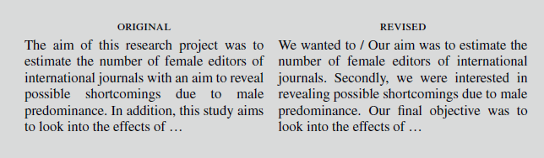
Only use synonyms for nontechnical words
“Aim” appears three times in the original!

Slide 107
Use verbs rather than nouns
Makes your sentences shorter, more dynamic, and easier to understand
X is meaningful for an understanding of Y
X will help you to understand Y
When you take into consideration…
When you consider…
This gives you the possibility to do X
This means you can do X

Slide 108
Avoid abstract nouns
Abstract nouns are more difficult to visualize than concrete nouns, and more difficult to remember
  Situation
  Activities
  Operations
  Parameters
Our research [activity] focused on…
Delete or find more concrete alternatives or examples
  - ability, -acy, -age, -ance, -ation, -ence, -ment, -ness, -ship

Slide 109
Avoid generic quantities and unspecific adjectives
Replace generic quantities such as some, a certain quantity, a good number of, with a precise number
I am going to give you a few examples
…three examples
We have found some interesting solutions to this problem
…four interesting solutions

Slide 110
Avoid generic quantities and unspecific adjectives
Audiences like numbers
  Make them more attentive because they can start counting
  Have a sense that they will be guided
  Give the information a more absorbable structure
  Help audience to remember better

Slide 111
Avoid generic quantities and unspecific adjectives
Today I’m going to talk to you about 15 things you should do when preparing a script

Slide 112
Advantages of having a written script
Once you have a script, you can write the slides
Slides will help you to remember what to say
  Practice talking about the slides without using your script

Slide 113
Advantages of having a written script
A written script will also help you to:
  Identify words that you may not be able to pronounce
  Check that the sentences are not too long or complex
  Understand when an example would be useful for the audience
  Clarify where you need to make connections between slides
  Delete redundancy and unnecessary repetition
  Identify the moments in the presentation where interest might fall
  Check if there are terms the audience might not understand
  Think of how you could deliver your message in a more powerful or dynamic way
  Verify if you are spending too much time on one point
  Time how long the presentation will take

Slide 114
Review
Don’t lift text directly from your paper
Only have one idea per sentence
Be concise – only say things that add value
Simplify sentences that are difficult to say
Do not use synonyms for technical/key words
Only use synonyms for nontechnical words
Use verbs rather than nouns
Avoid abstract nouns
Avoid generic quantities and unspecific adjectives

Slide 115
Mark up your script and then practice reading it aloud
Once you have a final (or close to final) version, you can mark it up for performance notes

Slide 116
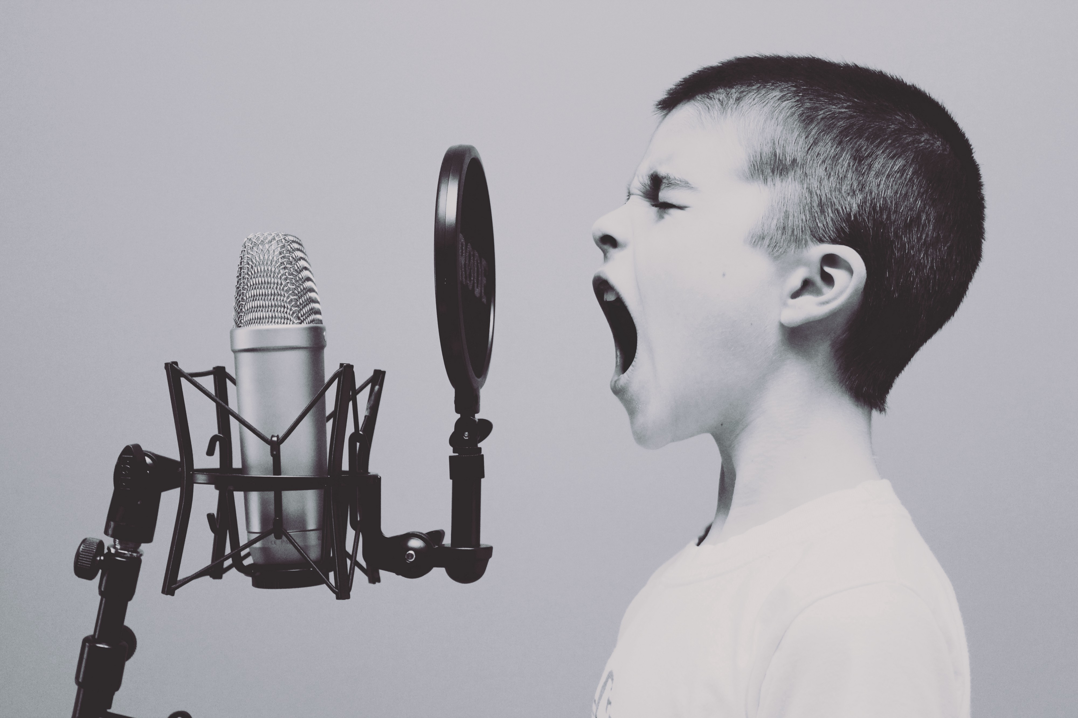
02
Voice Technique
Notes:
Image used in the preview file : https://unsplash.com/photos/CAbbMdcenUQ

Slide 117
Using your voice
When we speak, our voice is very expressive
When it is not.. It gets weird

Slide 118


Slide 119
How to make your voice more dynamic and expressive
Regulating / Chunking
Emphasis
Intonation

Slide 120
Regulating / Chunking
The artificial control over speaking in which the speaker breaks up the spoken line into smaller parts and puts silent beats between them

Slide 121
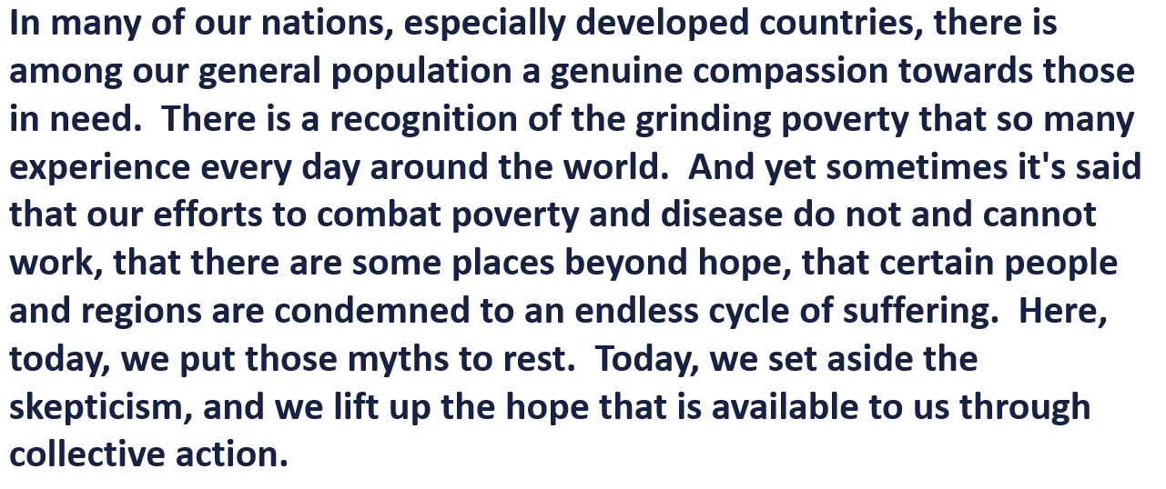

Slide 122
Emphasis / Stress
In every sentence, there will be something that is more important than others
  Actions
  Actors
  Adjectives

Slide 123
Emphasis / Stress
Emphasis / Stress
Identifying something as more important
  Louder
  Softer
  Longer
  Slower

Slide 124
Emphasis / Stress
Emphasis / Stress
Creating contrast so that the words or ideas you want to emphasize stand out in the sentence

Slide 125
Emphasis / Stress
Tens of millions of more boys and girls are today in school
Prevention and treatment of measles and malaria and tuberculosis have saved nearly 60 million lives

Slide 126

Levels of Emphasis
Stressing certain words to highlight importance

Slide 127

Levels of Emphasis
Conveying importance or seriousness in other ways besides just stress

Slide 128
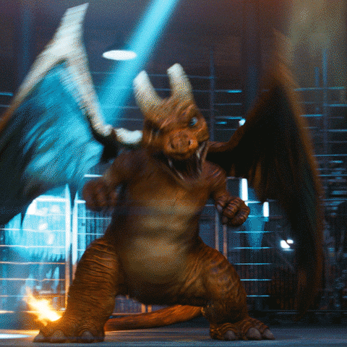
Levels of emphasis
Expressing your own opinions or feelings, or expressing your audiences feelings or reactions

Slide 129
Intonation
The rise and fall of the voice in speaking

Slide 130
Intonation
Two types
  Natural
  Intentional

Slide 131
Intentional Intonation
Yeah, that’s right. = Statement
Yeah, that’s right. = Sarcasm
Yeah, that’s right? = Question

Slide 132
Task 3
Work with a partner
  Identify what words/phrases are more deserving of emphasis than the others
  Decide on how you might emphasize these words to convey more meaning
  Be emotionally ready to perform

Slide 133
Task 3
The entire world can take enormous pride in these historic achievements

Slide 134
Task 3
We can break the cycle of poverty

Slide 135
Task 3
Despite the cruelties of our world and the ravages of disease, millions of lives can be saved if we are focused, and if we work together

Slide 136
Task 3
And yet, we are also here today because we understand that our work is nowhere near done

Slide 137
Task 3
The wealthiest and most powerful in our societies oftentimes like to keep things as they are, and they often have disproportionate political influences

Slide 138
Mark up your script and then practice reading it aloud
If you have a script, you can write in your performance

Slide 139
Mark up your script and then practice reading it aloud
First of all thank you very much for coming here today. My name’s Kevin Kau and I am currently doing research into psycholinguistics at National Taiwan University. I’d like to show you what I think are some incredible results that I got while…

Slide 140
Mark up your script and then practice reading it aloud
First of all / thank you very much for coming here today. My name’s Kevin Kau , / and I am currently doing research into psycholinguistics at [sy/my] National Taiwan University. / / I’d like to show you / what I think / are some INCREDIBLE results that I got while…

Slide 141
Mark up your script and then practice reading it aloud
World I want to stress
Regulating
First of all / thank you very much for coming here today. My name’s Kevin Kau , / and I am currently doing research into psycholinguistics[sy/my] at National Taiwan University. / / I’d like to show you / what I think / are some INCREDIBLE results that I got while…
Stress within the word
Pronunciation notes
Really emphasizing

Slide 142
Make slides based on your script
Create the slides →Practice your presentation
  Slides dictate what you say
Decide what you want to say → Create slides in support of what you say
  Much more logical and organic

Slide 143
Ideal work flow for high stakes presentation
Create a script
Edit and revise the script
Add in your performance notes
Practice script and performance
Create notecards or outline while continuing to practice with script
Adapt and revise notecards to suit your needs
Transition to practicing with just the notecards

Slide 144

From Script To Outline

Slide 145
Ideal work flow for high stakes presentation
Create a script
Edit and revise the script
Add in your performance notes
Practice script and performance
Create notecards or outline while continuing to practice with script
Adapt and revise notecards to suit your needs
Transition to practicing with just the notecards

Slide 146

Homework

Slide 147
Homework
3/17
  Create your 3MT slide
    Submit on COOL and bring a copy to class for feedback
  Write out your script for your “Orientation” of your 3MT
    Hook and background information
    Bring to class and submit online

